Slide 1
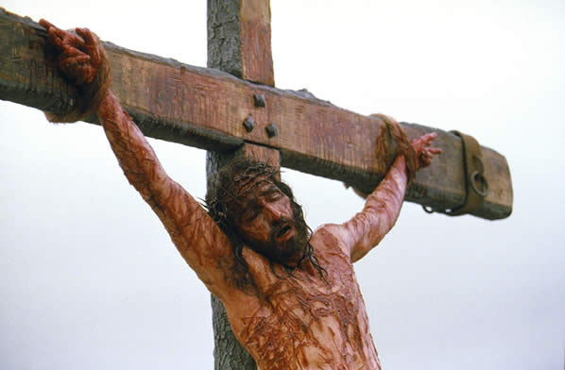
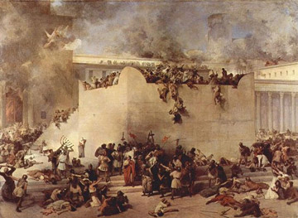
The AD 70 Doctrine Concerning the Law of Moses
Did Obligation to the Law of Moses End at the Cross of Jesus? Or, did it end at the AD 70 Destruction of Jerusalem?
or

Slide 2
What Did NOT Happen at the Cross OR at AD 70
The Law of Moses did NOT cease to testify of Christ
The Law of Moses did NOT cease to testify of sin and guilt
The Law of Moses did NOT cease to be scripture that gives “instruction in righteousness” (2 Tim.3:15-17)
The Law of Moses did NOT cease to make one wise unto salvation

Slide 3
The Law Was Abolished at the Cross
This means:
It ceased to be a BINDING Law
It does not cease to be a testifying Law

Slide 4
Don Preston’s Foundational Argument
Jesus said "Not one jot or one tittle shall pass from the law until it is all fulfilled" (Matthew 5:18). So, let me offer an argument: Major: Not one jot or one tittle of Torah would pass until it was all fulfilled. Minor: But, Torah predicted the second coming of Christ, the judgment and the resurrection. Conclusion: Therefore, not one jot or one tittle would pass from Torah until the second coming of Christ, the judgment and the resurrection were fulfilled. ___________________________ The major premise is undeniable.
The minor is irrefutable.
The conclusion is inescapable.

Slide 5
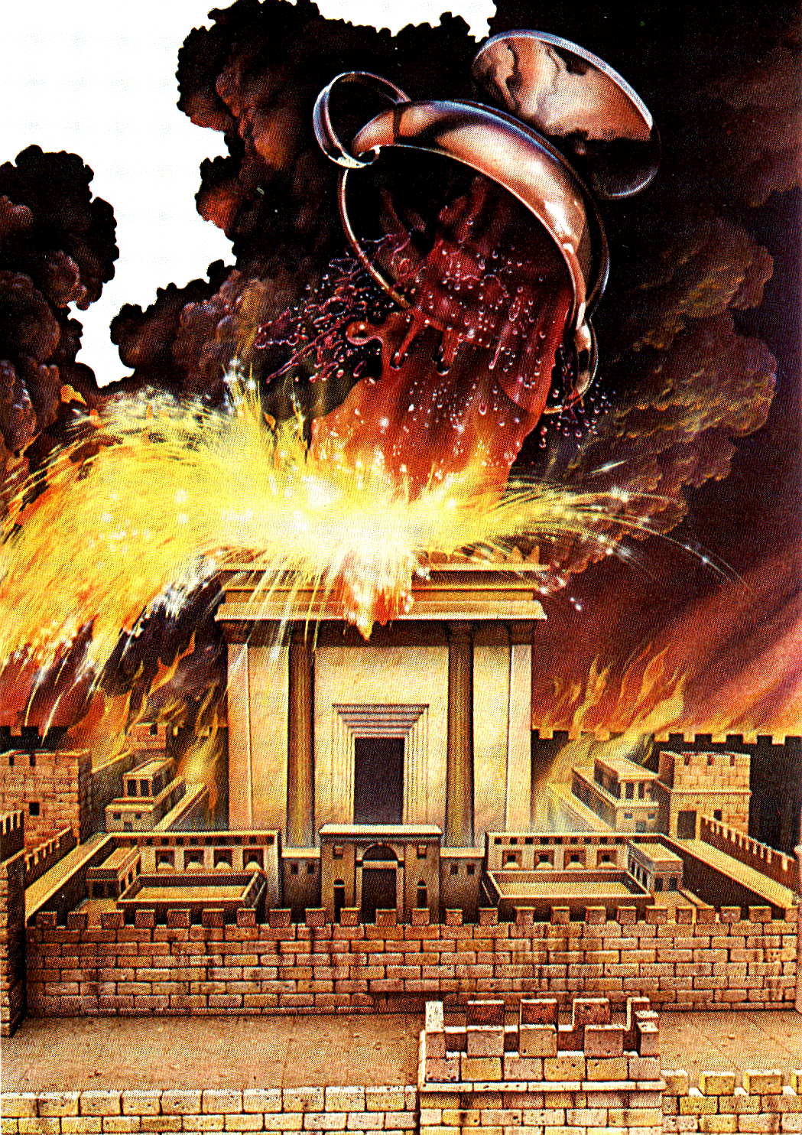
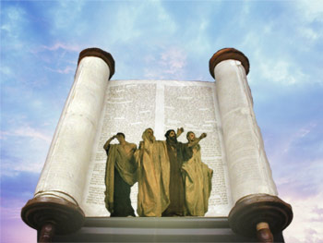

Law Prophesies Past the Cross
Dan.9:24-27 prophesies of events past the cross
The Law & the Prophets
Law can’t pass till ALL fulfilled (Matt.5:17);
Therefore, remained binding till the destruction of Jerusalem
AD 70

Slide 6
Daniel 2:40 Not Fulfilled by AD 70
If only one prophecy was fulfilled after AD 70, the entire belief system will crumble.
At least one was not fulfilled until almost four hundred years later.
In Daniel 2, four different kingdoms are described. The fourth kingdom (v. 40) would be in power at the time the everlasting kingdom/church would be set up (v. 44).
This fourth kingdom referred to the Roman Empire.
Daniel prophesied that the fourth kingdom would be destroyed (vv. 34-35; 44-45), which did not occur until AD 476.
This prophecy alone destroys the AD 70 system.

Slide 7
Law Prophesies Past the Cross
Dan.9:24-27 prophesies of events past the cross
Rome to be broken in pieces-
Dan.2: 44-45
Resurrection; Last Day; Final Judgment
The Law & the Prophets
AD 70
Law STILL
Binding
Law can’t pass till ALL fulfilled;
Therefore, remained binding till the destruction of Rome??? 476AD???? Or “Last Day”

Slide 8
Don Preston’s Foundational Argument - Reply #1
Jesus said "Not one jot or one tittle shall pass from the law until it is all fulfilled" (Matthew 5:18). So, let me offer an argument: Major: Not one jot or one tittle of Torah would pass until it was all fulfilled. Answer:
The context of Matt.5:18 is regarding keeping the “commandments”, even the least of “these commandments”; see 7:12
It is not about “promises” that only God could keep
Jesus fulfilled all the righteous commandments before His death (Jn. 17:4; 1 Pet.2:22)
Jesus “finished” that task and nailed the “LAW OF COMMANDMENTS” TO THE CROSS – Eph.2:11-14 He did not nail all promises to the cross
Thus, Don’s major premise involves a misuse and misapplication of his starting scripture
Therefore, his minor premise and conclusion will be wrong.

Slide 9
Don Preston’s Foundational Argument - Reply #2
Jesus said "Not one jot or one tittle shall pass from the law until it is all fulfilled" (Matthew 5:18). So, let me offer an argument: Major: Not one jot or one tittle of Torah would pass until it was all fulfilled. Answer:
The Old Testament predicted things beyond the AD 70 destruction of Jerusalem
It predicted the end of death – Isa.25:8
But, death is still here.
It predicted the end of sin by implication, but sin is still here.
Law is still testifying of sin – 1 Cor.15:54-56
This corruptible body has not put on incorruption (which fulfills the back to pre-sin and death Paradise with God) plan
Therefore, Don’s argument does not work for AD 70
IF every prophecy had to be fulfilled before the Law of Moses could be annulled, then the argument would mean the Law of Moses has not even yet been abolished.

Slide 10
Don Preston’s Foundational Argument –Reply #3
Jesus said "Not one jot or one tittle shall pass from the law until it is all fulfilled" (Matthew 5:18). So, let me offer an argument: TB: Major: Not one jot or one tittle of Torah COMMANDMENTS would pass until it was all fulfilled. Minor: But, Torah COMMANDED animal sacrifices and commanded not to accept a human as a sacrifice (Deuteronomy 18:10 says: "There shall not be found among you anyone who burns his son or his daughter as an offering.“)
Conclusion: Therefore, the Jews had no choice but to keep the animal sacrifices and reject Jesus’ sacrifice until all the commandments were fulfilled. ___________________________ The Commandments were fulfilled by Jesus before his death
Therefore, Jesus could abolish the Law of Moses in His flesh
Jesus could also become the ultimate antitype of all former sacrifices
But, this was accomplished long before AD 70

Slide 11
Don Preston’s Foundational Argument –Reply #3
Jesus said "Not one jot or one tittle shall pass from the law until it is all fulfilled" (Matthew 5:18). So, let me offer an argument: TB: Major: Not one jot or one tittle of Torah COMMANDMENTS would pass until it was all fulfilled. Minor: But, Torah COMMANDED animal sacrifices and commanded not to accept a human as a sacrifice (Deuteronomy 18:10 says: "There shall not be found among you anyone who burns his son or his daughter as an offering.“)
Conclusion: Therefore, the Jews had no choice but to keep the animal sacrifices and reject Jesus’ sacrifice until all the commandments were fulfilled.
Jews were responsible to accept and reject Jesus’ sacrifice for 40 years, pulled apart by obligation to two contrary laws at once

Slide 12
The Contextual Aspect of Matthew 5:17f
17 “Do not think that I came to destroy the Law or the Prophets. I did not come to destroy but to fulfill. 18 For assuredly, I say to you, till heaven and earth pass away, one jot or one tittle will by no means pass from the law till all is fulfilled. 19 Whoever therefore breaks one of the least of these commandments, and teaches men so, shall be called least in the kingdom of heaven; but whoever does and teaches them, he shall be called great in the kingdom of heaven. 20 For I say to you, that unless your righteousness exceeds the righteousness of the scribes and Pharisees, you will by no means enter the kingdom of heaven.
Ch.5-7 are ways the scribes and Pharisees were destroying the Law or the Prophets
7:12 -Therefore, whatever you want men to do to you, do also to them, for this is the Law and the Prophets.

Slide 13
The consequences of Don's misuse of Matthew 5:17-19 are as follows:
1) Since not one tittle of the Law could pass (and that is also taken to mean it cannot cease to be obligated and imposed) until AD 70, then there could not be a "change of the Law" regarding priesthood until AD 70 (Heb.7:12-13).
2) After the faith came we (Paul includes himself, a Jew) are STILL under the tutor until AD 70 (Gal.3:23-25 not withstanding).
3) Jews were obligated to two husbands at the same time (Rom.7 not withstanding).
4) No one could be "delivered from the Law" (Rom.7:6) until AD 70.
5) No one could be "dead to the Law" (Rom.7:4) until AD 70.
6) Thus, Jesus could not "abolish in His flesh the law of commandments contained in ordinances"(Eph.2:15) until AD 70.

Slide 14
Rebuttal of False Arguments
DON’S PLAY ON MATT.5:17 MEANS:
1) Some people’s obligation to the Law can pass (even before AD 70) and therefore to THEM:
The entire Law and prophets passed away without every jot and tittle being fulfilled,
Jesus abolished it and caused it to pass away without every jot and tittle being fulfilled. So, in this case:
Jesus had no right to do this for anybody at that point in time,
Jesus could not do it legitimately,
Jesus caused people to sin by telling them it was alright for them to die to the Law that had not yet been completely fulfilled in every prophecy
To “phase out”, some jots and tittles pass before it is all fulfilled. This does not work either.

Slide 15
Argument Made on Matt.5:17 & Lk.21:22
The Argument:
Jesus said that not one jot or one tittle of the Law would pass until it was all fulfilled. Matt.5:17f
But, Jesus said that in the destruction of Jerusalem in A.D. 70 "all things that are written must be fulfilled" (Luke 21:22).
Therefore, the Law– and thus obligation to keep the Law-- would not pass until the destruction of Jerusalem in A.D. 70.
The Answer:
Matt.5:17f is about all the “commands” being fulfilled. Jesus did not come to destroy but fulfill all “righteousness”
All promises are not under consideration.
The “law of commandments” was nailed to the cross. Eph.2:12f
The promises of the destruction of Jerusalem is a separate matter

Slide 16
Proof of the Proposition
ALL AUTHORITY IN JESUS
Matthew 28:18
After Jesus’ death on the cross, Jesus said that "all authority in heaven and on earth had been given to Him".
He instructed the disciples to make disciples and teach them to "observe all things whatsoever I have commanded you". The following are implications of Jesus’ statements:
Obligation to the Law of Moses had ceased. It could not have part authority at the same time that Jesus had ALL authority.
The Law of Moses did not command people to be baptized in the name of the Father, Son, and Holy Spirit. This command comes out of the authority of Jesus Christ.

Slide 17
Baptism = Commitment to Jesus
Based on Jesus having ALL Authority (Matt.28:18-20; Acts 2:38)
If Jesus did not yet have ALL AUTHORITY, none should be baptized in His name until He does.
Many were baptized from Pentecost forward. Acts 2:38-41
Therefore, Jesus had full authority.
Moses now has NO AUTHORITY, not even a little “phasing out” authority.
Realized Eschatology is WRONG

Slide 18
Baptism = For Remission of Sins
Remission of Sins is in Jesus’ name.
But, RE (Realized Eschatology) brethren contend that Jesus cannot offer real remission of sins until AD 70 when He supposedly “came back out of the MHP” fulfilling the priestly typology.
But, Jesus did the priestly work long before AD 70 that allowed “remission of sins to be taught and enjoyed by all nations” (Luke 24:46-48)
Therefore, baptism for remission of sins had full authority to begin long before AD 70.
RE brethren are wrong

Slide 19
Baptism = For Remission of Sins
Baptism for remission of sins had full authority to begin long before AD 70.
RE brethren are wrong
If they are right, baptism for remission of sins should have both began AND ended in AD 70
Began in AD 70 because Jesus’ priestly work could only be offered after He “came out of the MHP in AD 70”,….. And
Ended because the commission was “till the end of the age” (which they claim also is AD 70).

Slide 20
Proof of the Proposition
ALL AUTHORITY IN JESUS
Matthew 28:18
If the disciples are obligated to the Law of Moses at the same time that they are obligated to Christ, then Christ does not have ALL authority.
Combining this thought with Romans 7:4 ("you have become dead to the law through the body of Christ")…
1) we find that it would be spiritual adultery to remain bound to Moses’ law and to also be bound to Christ and His law at the same time.
2) We have to become dead to the law in order to be alive to the full authority of Jesus Christ.

Slide 21
Died TO The Law vs The Law Died
Don argued that Christians died TO the Law, while others remained obligated to it, and that Rom.7 does not argue that the Law died.
But, NO ONE was obligated to remain alive to the Law and dead to Jesus
How can Jesus authorize ANY to die TO it if it remained binding AND Jesus could not destroy a jot or tittle till it was ALL fulfilled in AD 70?
Jesus fulfilled the Law, disarmed it’s power to obligate mankind, nailed it to the cross, which is WHY we can lawfully and rightly “die To the Law” (Rom.7)

Slide 22
Proof of Proposition
THE PRIESTHOOD AND LAW CHANGED
Heb 7:12
12 For the priesthood being changed, there is made of necessity a change also of the law. KJV
First, the priesthood "changed" and when it did, there was, of necessity, a change of the law.
The law commanded a Levitical priesthood. If Jesus is priest, and disciples were obligated to His priesthood AND the Levitical priesthood at the same time, then the early disciples were obligated to accept Jesus’ offering and continue the animal sacrifices for 40 years at the same time.
The priesthood changed at the cross when Jesus offered Himself as a sacrifice. The law had to change then as well.

Slide 23
Proof of Proposition
THE PRIESTHOOD AND LAW CHANGED
Heb 7:12
12 For the priesthood being changed, there is made of necessity a change also of the law. KJV
Major premise: A new priesthood could not be recognized and submitted to while the old law with its priesthood still held people to its obligations.
Minor Premise: There has been a change of priesthood at the cross and long before AD 70
Conclusion: A new priesthood could be recognized and submitted to because the old law with its priesthood no longer held people to its obligations long before AD 70.

Slide 24
Proof of Proposition
Better Mediator and Covenant Established
Heb 8:6
6 But now He has obtained a more excellent ministry, inasmuch as He is also Mediator of a better covenant, which was established on better promises. NKJV
Obligation to the Law of Moses ended at the cross because a better covenant has been established by a better Mediator.
Obligation could not continue to the lesser Mediator and lesser, inferior covenant when the better covenant was established.
This better covenant was established by Jesus’ death.
This covenant did not wait till AD 70 to be established.

Slide 25
Proof of Proposition
New Testament In Force After Jesus’ Death
Heb 9:14-18
15 And for this reason He is the Mediator of the new covenant, by means of death, for the redemption of the transgressions under the first covenant, that those who are called may receive the promise of the eternal inheritance.
For where there is a testament, there must also of necessity be the death of the testator. 17 For a testament is in force after men are dead, since it has no power at all while the testator lives. NKJV
The better Mediator and better covenant could not be rightly turned down under pretense of being loyal to God.
God held all accountable to hear and obey His Son. None could remain under obligation to Moses instead.
The New Testament was “in force” and “in power” long before AD70

Slide 26
Proof of Proposition
THE OLD COVENANT ANNULLED
Heb 7:18
18 For there is verily a disannulling of the commandment going before for the weakness and unprofitableness thereof. KJV
When did this annulling of the old commandment take place?
It took place when Jesus became a priest after the order of Melchizedek and offered Himself as a sacrifice.
As soon as the new priesthood took over, the law of Moses was changed and annulled.
This did not wait till AD 70. It happened at the cross of Jesus Christ.

Slide 27
Proof of Proposition
THE UNCHANGEABLE PRIESTHOOD ESTABLISHED
Heb 7:24
24 But this man, because he continueth ever, hath an unchangeable priesthood. KJV
If the priesthood of Jesus began at any time before AD 70, and the above statement shows that He "HAS" an unchangeable priesthood, then the law and its obligations ceased at whatever time the new priesthood of Christ became effectively honored by God and man as a valid priesthood.
Remember, The AD 70-ist argues that the Levitical priesthood cannot pass from obligation until AD 70, ….
Therefore, no Jew (not even Jesus’ apostles) could be obligated to Jesus’ priesthood until then.

Slide 28
Proof of Proposition
THE GREATER MINISTER OF THE GREATER SANCTUARY ESTABLISHED
Heb 8:1-2
8:1 Now of the things which we have spoken this is the sum: We have such an high priest, who is set on the right hand of the throne of the Majesty in the heavens;
2 A minister of the sanctuary, and of the true tabernacle, which the Lord pitched, and not man. KJV
This verse shows that the new High Priest, Jesus, is now operating in the true tabernacle.
When He set Himself on the right hand of the throne, He was King and Priest.
Obligation to the law of Moses ceased, and obligation to the new King and Priest, Jesus Christ began.
This began long before AD 70.

Slide 29
Proof of Proposition
THE TIME OF REFORMATION ESTABLISHED
Heb 9:10
10 Which stood only in meats and drinks, and divers washings, and carnal ordinances, imposed on them until the time of reformation. KJV
The imposition of the law that obligated people to certain meats and drinks, and divers washings and carnal ordinances was changed at the time of reformation.
At the time of reformation people would no longer be imposed upon by those obligations.
But, the time of reformation was when we got a new King and Priest in Jesus Christ.
But, Jesus became a King and Priest in His death, resurrection and ascension to the throne. This was long before AD 70.
Therefore, the law and all its’ impositions ended when Jesus brought in the time of reformation, and that was when He became King and Priest, 40 years before the destruction of Jerusalem in AD 70.

Slide 30
Proof of Proposition
THE BETTER SACRIFICE ESTABLISHED
Heb 9:23-27
To say that the copies remained as "obligations" even while the TRUE and SUBSTANCE was in place is to say that which no verse says or implies, and AGAINST all evidence.
It calls upon us to believe that either:
1) obligation was to Moses instead of Jesus, or
2) obligation was to both Jesus and Moses at the same time, or
3) obligation was to Jesus the Greater and possessor of "all authority".
The copies of the heavenly things were annulled when Jesus changed the law and priesthood and went into HEAVEN ITSELF. The copies were replaced by the real thing by Christ.

Slide 31
Proof of Proposition
THE HANDWRITING OF REQUIREMENTS TAKEN OUT OF THE WAY
Col 2:13-18
14 having wiped out the handwriting of requirements that was against us, which was contrary to us. And He has taken it out of the way, having nailed it to the cross. 15 Having disarmed principalities and powers, He made a public spectacle of them, triumphing over them in it.
16 So let no one judge you in food or in drink, or regarding a festival or a new moon or sabbaths…
The handwriting of requirements is a reference to that Law of Moses that imposed food and drink laws, festivals, new moons and Sabbaths.
That law could not be used as a basis for judging others at the time Paul wrote Colossians. This was several years before AD 70.
Paul said that law was "nailed to the cross". Reason we can’t be judged by it.

Slide 32
Proof of Proposition
THE LAW OF COMMANDMENTS ABOLISHED
Eph 2:14-17
For He Himself is our peace, who has made both one, and has broken down the middle wall of separation, 15 having abolished in His flesh the enmity, that is, the law of commandments contained in ordinances, so as to create in Himself one new man from the two, thus making peace, 16 and that He might reconcile them both to God in one body through the cross, thereby putting to death the enmity. NKJV
When Jews and Gentiles were made ONE was long before AD 70
All one has to do to determine when the law of commandments was abolished is to determine when Jesus was "in His flesh" and on "the cross".
When did Jesus put to death the source of enmity between Jew and Gentile? He did this when He abolished it in His flesh.
When did He make possible the unification of Jew and Gentile in one body? He did this "through the cross".
The cross became the means of abolishing the law contained in ordinances.

Slide 33
Proof of Proposition
THE LAW OF COMMANDMENTS ABOLISHED
Eph 2:14-17
For He Himself is our peace, who has made both one, and has broken down the middle wall of separation, 15 having abolished in His flesh the enmity, that is, the law of commandments contained in ordinances, so as to create in Himself one new man from the two, thus making peace, 16 and that He might reconcile them both to God in one body through the cross, thereby putting to death the enmity. NKJV
Should we say anything further about the PAST TENSES that he also ignores in this passage?
"He HAS made both one" and "He HAS broken down the middle wall of division between us" and "having abolished in His flesh the law of commandments".
Don says that Jesus didn’t really do it in His flesh. He says that Jesus merely "initiated" it then, but would really abolish it in AD 70.

Slide 34
Proof of Proposition
THE LAW OF COMMANDMENTS ABOLISHED
Eph 2:14-17
For He Himself is our peace, who has made both one, and has broken down the middle wall of separation, 15 having abolished in His flesh the enmity, that is, the law of commandments contained in ordinances, so as to create in Himself one new man from the two, thus making peace, 16 and that He might reconcile them both to God in one body through the cross, thereby putting to death the enmity. NKJV
Don has argued that the law was abolished in Christ for believers even before it was all fulfilled (thus cancelling any validity to his Matthew 5:17 argument), and even before Jesus "consummated" the new covenant by "coming back out of the MHP" (thus cancelling an validity to his argument that consummating the covenant in this way was necessary).
He has Christians not being obligated to a still binding Law of Moses but bound to an initialized but not consummated new covenant for forty years.

Slide 35
Proof of Proposition
THE LAW OF COMMANDMENTS ABOLISHED
Eph 2:14-17
For He Himself is our peace, who has made both one, and has broken down the middle wall of separation, 15 having abolished in His flesh the enmity, that is, the law of commandments contained in ordinances, so as to create in Himself one new man from the two, thus making peace, 16 and that He might reconcile them both to God in one body through the cross, thereby putting to death the enmity. NKJV
He has unbelieving Jews still bound to the Levitical priesthood even though the greater, prophesied and fully established priesthood of their Messiah was already in place.
In this case, ALL were obligated to believe and enter Jesus’ death, while none were obligated to remain under the Law of Moses, but at the same time NONE could actually be out from under the Law of Moses until it was ALL fulfilled, and NONE could actually be under obligation to an "unconsummated" covenant until it is consummated.

Slide 36
AD 70 Doctrine and the Covenants
Alleges an overlapping of the Old and New Covenants.
Says the “Last Days” ended in AD 70.
Assigns a 40-year transition period (the Last Days) where the New Covenant is being established and the Old Covenant is passing away (Heb 8:13; 2 Cor 3:11).

Slide 37
No Overlapping of Covenants
Rom 7:4-6
Therefore, my brethren, you also have become dead to the law through the body of Christ, that you may be married to another -- to Him who was raised from the dead, that we should bear fruit to God. For when we were in the flesh, the sinful passions which were aroused by the law were at work in our members to bear fruit to death. But now we have been delivered from the law, having died to what we were held by, so that we should serve in the newness of the Spirit and not in the oldness of the letter.
NKJV

Slide 38
Significance of the Torn Veil
Matt 27:51
Then, behold, the veil of the temple was torn in two from top to bottom; and the earth quaked, and the rocks were split,
NKJV
God was out of use for the temple from the time of the cross.
God did not phase out. He tore out.

Slide 39
Misused Texts
Hebrew 8:13: Ready to Vanish Away
The Inspired writer said:
13 In that He says, "A new covenant," He has made the first obsolete. Now what is becoming obsolete and growing old is ready to vanish away. NKJV
The passage he is quoting and analyzing is Jeremiah 31. The Hebrews writer says that God was speaking through Jeremiah, and "In that He says, "A new covenant", He has made the first obsolete.
It was in standby mode and ready to vanish away as soon as God said "a new covenant".

Slide 40
Misused Texts
Hebrew 8:13: Ready to Vanish Away
This passage is speaking from His (God’s) standpoint. "In that He (God) said"…"He (God) has made the first obsolete". So the argument is from God’s standpoint, and from His standpoint the first covenant was nigh unto passing away.
From a human standpoint several hundred years is not "nigh", but the Hebrews writer is not making observations from human standpoint.
He is looking at it from God’s standpoint and analyzing that as soon as God said "a new covenant" is coming, He (God) viewed that first covenant as obsolete and ready to vanish away.

Slide 41
Jesus’ Blood Not Needed Now
For forty years Jesus' cross was of no effect, according AD 70 advocates, because they say that it entirely depended on the completion of the destruction of Jerusalem and a so-called coming out of the Most Holy Place by the High Priest, which they say did not happen till AD 70.
Thus, the cross of Christ is made of none effect for forty years, and not even needed after that point because they also teach that sin and death were destroyed in AD 70.
False doctrine tangles itself in its own deceitful web

Slide 42
The End
Of this element of the AD 70
False Doctrine

