Slide 2
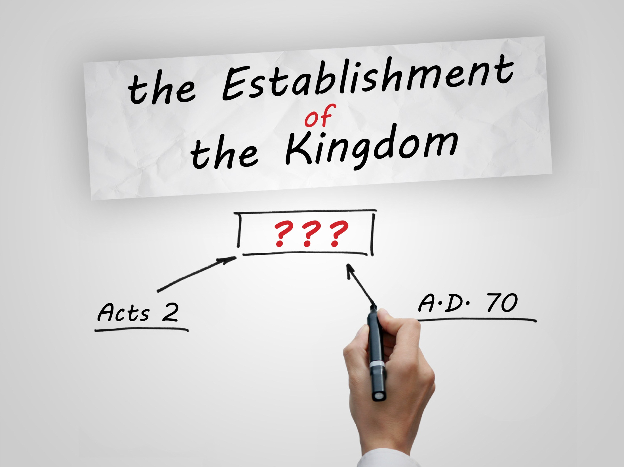

Slide 3
The Nature of the Kingdom
Is it literal or spiritual?
Spiritual.
“We need to change the landscape of evangelical Christianity in regard to the concept of the nature of the kingdom” –Don K. Preston
Mark 9:1; Luke 21:31–32

Slide 4
The Nature of the Kingdom
The prophecies concerning the coming kingdom were fulfilled with a spiritual kingdom.
Isaiah 2:1–3
Zechariah 12:10; 13:1
Daniel 2:44–45

Slide 5
The Establishment of the Kingdom
“We must be careful here, for the realized eschatologists do not contend that the kingdom did not come in any sense until a.d. 70. They concede that the kingdom came on Pentecost, but it was not in its glory; it was not in its power. It was not complete. It only received its glorious status, it only came with power, it only came in its completeness when God destroyed the Jewish Nation in a.d. 70”
–Wayne Jackson

Slide 6
The Establishment of the Kingdom
The immediacy of language.
Revelation 1:3
Some passages appear to say the kingdom is not fully established.
2 Timothy 4:18
2 Peter 1:10–11
Hebrews 12:28–29

Slide 7
Galatians 4:21–31
Hagar = Law of Moses Sarah = Gospel of Christ
Ishmael = physical kingdom of Israel Isaac = spiritual Israel.

Slide 8
“An element of confusion in prophecy is man’s inability to see two Israel’s born of Abraham. There is an Israel after the flesh, and an Israel after the spirit. This fact is clearly shown in the allegory of Ishmael and Isaac (Gal. 4:21–31). Both were born into the household of Abraham, but of one, (Ishmael) it is said that he was born after the FLESH, and of the other, (Isaac) it is said that he was born after the SPIRIT”
–Max King

Slide 9
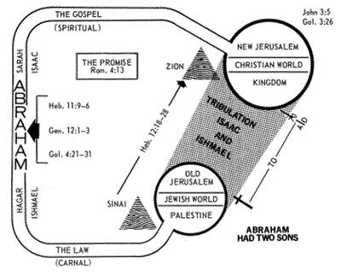

Slide 10
The Establishment of the Kingdom
The period of transition is the “Last Days.”

Slide 11
“My opinion is that the last days began after the four hundred years of biblical silence after the close of Malachi, and the coming of John the Baptist, whose work began six months before Jesus, and who introduced Jesus as the Messiah. Obviously, the last days of the Mosaic Age concluded with the destruction of Jerusalem in a.d. 70.”
–Samuel Dawson

Slide 12
“The term ‘the last days’ has nothing to do with the end of time or the end of the Christian age, or even as a definition of the entire Christian age. In my book, The Last Days Identified, I examine every major text that mentions the last days, and I show that not one of them refers to the Christian age”
–Don K. Preston

Slide 13
The Establishment of the Kingdom
The period of transition is the “Last Days.”
Joel 2:28–32
Peter declares that the last days had begun (Acts 2:16–21).
1 Corinthians 13:11

Slide 14
“What reward did Jesus give to every man on Pentecost day? Is the day of beginning the day of judgment? Would it not be more reasonable to put this judgment at the ‘end’ rather than the ‘beginning?’ Jesus came in the end of the Jewish age in judgment upon all who opposed his rule and authority… That was his coming in glory (Matt. 16:27) to reward every man according to his work… “Therefore, Mark 9:1; Matthew 16:27–28; Matthew 24:30; and Revelation 22:12 are concurrent passages and relate to the coming of Christ in his kingdom with power and in glory and judgment at the end of Judaism. Pentecost was the beginning of his kingdom, but the fall of Jerusalem was the climactic state of its development and manifestation in power, glory, and judgment.”
–Max King

Slide 15
The Establishment of the Kingdom
When did Jesus receive His authority?
Parable of the Minas (Luke 19).
“all authority” (Matthew 28:18).
Jesus could not fully reign as King until Israel—the final enemy needing to be destroyed—was taken and placed under the feet of Jesus the King.

Slide 16
Galatians 4
The problem with the R.E. position is that the text does not support it.
“Tell me, you who desire to be under the law, do you not listen to the law?” (v. 21).
The question was whether the Galatian brethren were going to hold themselves to the slavery of the Old Covenant or live under the liberty of the New Covenant.

Slide 17
When did Jesus receive His power?
Matthew 28:18
Ephesians 1:20–23
Jesus received His power and authority upon his resurrection.

Slide 18
When was the Kingdom established?
Ephesians 3:20–21
A present power (v. 20).
A present glory (v. 21).
What is the kingdom in 2 Timothy 4 and 2 Peter 1?
R.E. equates all uses of “kingdom” with the church.
“There is a phase of the kingdom that we enter after we leave this life” (Jackson).
These passages are qualified by “heavenly” and eternal.”

Slide 19
When was the Kingdom established?
The King had power prior to a.d. 70.
The kingdom was established prior to a.d. 70.
The kingdom had power and glory prior to a.d. 70.

Slide 20
What is the Kingdom?
Kingdom = Church?
Matthew 16:18–19
1 Thessalonians 2:11–12
The Kingdom is not always the church.
2 Timothy 4:18; 2 Peter 1:10–11
Acts 14:22
Kingdom: “royal power, rule; territory subject to the rule of a king; the reign of the Messiah”

Slide 21
“We miss the point re. kingdom when we think of people— the ‘party’—instead of ‘rule.’ … Think ‘rule,’ not ‘people,’ when you speak of Christ's kingdom.”
–Robert Turner
“When we see the word ‘kingdom’ we should think ‘rule.’ Then, after the idea of ‘rule’ is firmly planted in our mind, we may examine the context to see if, in this case, the word is extended to designate the realm of that rule , the people ruled, the nature of that rule (physical or spiritual), or some other extended use.”
–Robert Turner

Slide 22
What is the Kingdom?
The Kingdom of Christ is the rule or reign of Christ.
The church serves as a manifestation of that rule and reign of Christ.
Matthew 6:33
Matthew 12:28
Matthew 21:43

Slide 23
What is the Kingdom?
When Paul preaches the Kingdom, what is he preaching?
Acts 19:8
Acts 28:23, 30–31
Daniel 2:31–45
The “great mountain” fills the whole earth.
Did the church cover the entire earth by a.d. 70?
At judgment, who is accountable to the rule of Christ? All men? Or just the church?

Slide 24
What is the Kingdom?
“Therefore let us be grateful for receiving [the rule of Christ] that cannot be shaken, and thus let us offer to God acceptable worship, with reverence and awe, for our God is a consuming fire” (Hebrews 12:28–29).
“I charge you in the presence of God and of Christ Jesus, who is to judge the living and the dead, and by his appearing and his [rule]: preach the word; be ready in season and out of season; reprove, rebuke, and exhort, with complete patience and teaching” (2 Timothy 4:1–2).

Slide 25
Is there a future aspect to the kingdom?
Some prophecies concerning the kingdom are still being fulfilled.
Matthew 13:31–32
Matthew 13:33
Jesus will return to deliver up the kingdom to the Father (1 Corinthians 15:24–26).

Slide 26
Lessons for us as preachers…
We need to promote the truth on these matters.
We need to understand the importance of the destruction of Jerusalem.
We must handle the Word carefully and correctly.
We must know what we believe.

