Slide 1


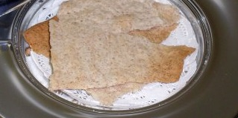

The
Lord’s
Supper
Calls for Change
Jeff Archer, ECIC 2013

Slide 2
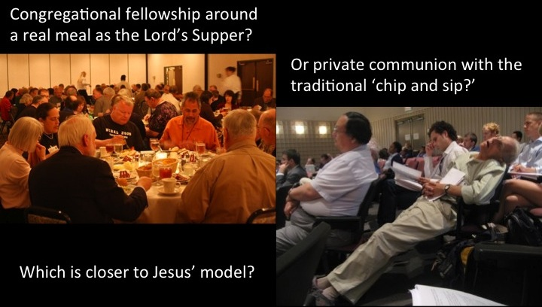
Varied Reinventions of the Lord’s Supper
Among Denominational Groups
The Fellowship of the Lamb http://lambblood.com/who-ordered-the-change-.html
Jeff Archer, ECIC 2013

Slide 3
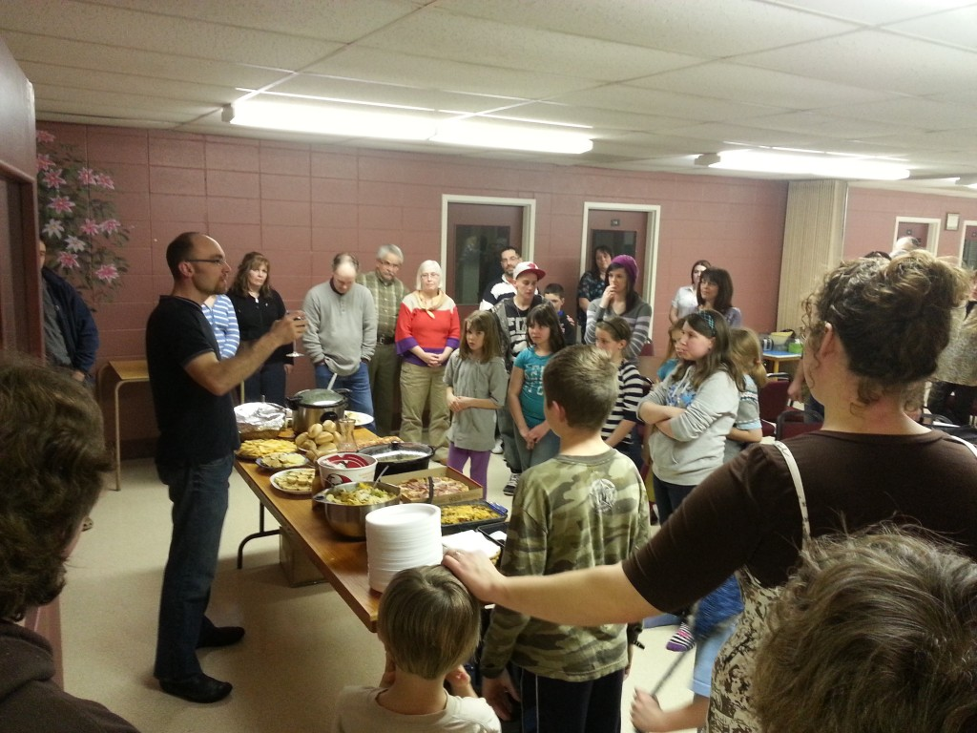
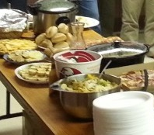
Varied Reinventions of the Lord’s Supper
Among Denominational Groups
http://blogs.ntm.org/duane-bakken/2013/03/31/church-without-walls/
Jeff Archer, ECIC 2013

Slide 4
Varied Reinventions of the Lord’s Supper
Among Denominational Groups
Elements – A common meal which includes bread and wine
Purpose –
Reminder to Jesus
Unity Creator
Fellowship
Frequency –
Some say – Weekly
Others say - Daily
Jeff Archer, ECIC 2013

Slide 5
Varied Reinventions of the Lord’s Supper
Among Institutional Churches of Christ
A la F. LaGard Smith
Elements – bread and cup in conjunction with a fellowship meal
Frequency – Weekly
Jeff Archer, ECIC 2013

Slide 6
Varied Reinventions of the Lord’s Supper
Among Institutional Churches of Christ
A la John Mark Hicks
Elements – a meal to include bread and wine
a “table” not an “altar”
Purpose –
Covenantal Memory
Covenantal Renewal
Covenantal Presence
Covenantal Fellowship
Covenantal Promise
Social Function
Future “Messianic Banquet”
Frequency – Daily turned Weekly
Jeff Archer, ECIC 2013

Slide 7
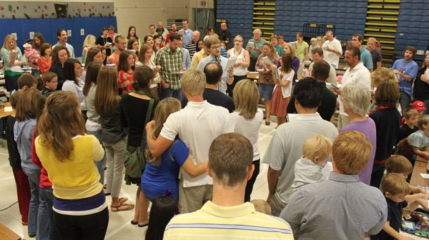
Varied Reinventions of the Lord’s Supper
Among Non-Institutional Churches of Christ
A la “The Church at Bowling Green”
http://www.thecabg.com/
Jeff Archer, ECIC 2013

Slide 8
Varied Reinventions of the Lord’s Supper
Among Non-Institutional Churches of Christ
A la “The Church at Bowling Green”
Elements – bread and grape juice in larger quantity
divide into groups of 10-12 around tables
men and women discuss the meaning
representative of each group address the assembly with a summation of discussion
(fellowship meal follows each service)
Purpose – memorial of Jesus’ death
Frequency – Weekly
Jeff Archer, ECIC 2013

Slide 9
The
Lord’s
Supper
The Biblical Pattern
Established during the Passover meal
Jeff Archer, ECIC 2013

Slide 10
Passover
The Lord’s Supper
Frequency – yearly
Frequency – weekly
Elements –
lamb
unleavened bread
bitter herbs
eaten in haste
Elements –
unleavened bread
fruit of the vine
Purpose – a memorial
Purpose – “this do in remembrance of Me”
individual aspect
communal aspect
Jeff Archer, ECIC 2013

Slide 11
The
Lord’s
Supper
The Biblical Pattern
What emotions are commanded?
Jeff Archer, ECIC 2013

Slide 12
The
Lord’s
Supper
The Biblical Pattern
As part of a meal, a full meal or a memorial?
Jeff Archer, ECIC 2013

Slide 13
The
Lord’s
Supper
The Biblical Pattern
Are we following the traditions of the Catholics or the Biblical pattern?
Jeff Archer, ECIC 2013

Slide 14
The
Lord’s
Supper
The Biblical Pattern
What are variation within the pattern?
Jeff Archer, ECIC 2013

