Slide 2
For through faith you have been saved by the grace, and this not of yourselves, it is God's gift; not of works, that no one should boast.

Slide 3
For through faith you have been saved by the grace, and this not of yourselves, it is God's gift; not of works, that no one should boast.

Slide 4
For through faith you have been saved by the grace, and this not of yourselves, it is God's gift; not of works, that no one should boast.

Slide 5
For through faith you have been saved by the grace, and this not of yourselves, it is God's gift; not of works, that no one should boast.

Slide 6
For through faith you have been saved by the grace, and this not of yourselves, it is God's gift; not of works, that no one should boast.

Slide 7
For through faith you have been saved by the grace, and this not of yourselves, it is God's gift; not of works, that no one should boast.

Slide 8
GRACE
χάρις charis
chairō rejoice
chara joy
charis “is what delights” -TDNT
English synonyms:
Charm (grace)
Charming (gracious)

Slide 9
GRACE
χάρις charis
Charm
BDAG: “a winning quality or attractiveness that invites a favorable reaction, graciousness, attractiveness, charm, winsomeness.”
In Euripides’ Hippolytus, Theseus speaks to his dying son, Hippolytus: “There is no charm of life to me,” i.e. “Life has no charm for me”
Col. 4:6 Let your speech be always with grace, seasoned with salt”
A Favourable Disposition (on the part of one for another)
“if I have found favor,” Gen. 30:27, 1 Bas. (Sam.) 16:22, 2 Bas. (Sam.) 14:22, Prov. 18:22, Gen. 6:8, Ex. 33:13, 2 Bas. (Sam.) 15:25, Ex. 3:21
An Act of Kindness, i.e. a “Favor”
The Sentiment or Motivation Behind an Act of Kindness
A Response, viz. Thanksgiving, to an Act of Kindess, 2 Cor. 2:14, 8:16
Gift, charisma, e.g. Ro. 6:23

Slide 10
GRACE
χάρις charis
“FAVOR”
Not always the favor of forgiveness in Christ Jesus:
Ephesians 3
⁶ to wit, that the Gentiles are fellow-heirs, and fellow-members of the body, and fellow-partakers of the promise in Christ Jesus through the gospel,
⁷ whereof I was made a minister, according to the gift of that grace of God which was given me according to the working of his power.
⁸ Unto me, who am less than the least of all saints, was this grace given, to preach unto the Gentiles the unsearchable riches of Christ;
Here, “grace” was the thing given, not merely the basis of the gift.
“Grace” is a particular favor, namely, the privilege of taking good news to the Gentiles.
Because of His grace, God gave me a gift according to the working of his power.
?
God gave me grace, as a gift, according to his power. The grace was that I get to tell the Gentiles good news!

Slide 11
GRACE
χάρις charis
“FAVOR”
Not necessarily “unmerited” favor:
Luke 2
⁴⁰ And the child grew, and waxed strong, filled with wisdom: and the grace of God was upon him.
⁵² And Jesus advanced in wisdom and stature, and in favor with God and men.
The particular favor God has done for us in Jesus Christ is indeed unmerited!
Rom 11:5-6
⁵ Even so then at this present time also there is a remnant according to the election of grace. ⁶ But if it is by grace, it is no more of works: otherwise grace is no more grace.

Slide 12
GRACE in Ephesians 1-2
1² Grace to you and peace from God our Father and the Lord Jesus Christ.
1⁶ to the praise of the glory of his grace, which he freely bestowed on us in the Beloved:
out of his grace arise redemption, forgiveness…
1⁷ in whom we have our redemption through his blood, the forgiveness of our trespasses, according to the riches of his grace,
2⁵ even when we were dead through our trespasses, made us alive together with Christ (by grace have ye been saved)
2⁷ that in the ages to come he might show the exceeding riches of his grace in kindness toward us in Christ Jesus:
2⁸ for by grace have ye been saved through faith;
Paul’s commentary on this was…
and that not of yourselves, it is the gift of God; ⁹ not of works, that no man should glory.
Notice here: “not of works” means “not of yourselves, that no one may glory.”
Judges 7:2
The Lord said to Gideon, “The people who are with you are too many for Me to give Midian into their hands, for Israel would become boastful, saying, ‘My own power has delivered me.’”

Slide 13
GRACE in Ephesians 1-2
1² Grace to you and peace from God our Father and the Lord Jesus Christ.
1⁶ to the praise of the glory of his grace, which he freely bestowed on us in the Beloved:
out of his grace arise redemption, forgiveness…
1⁷ in whom we have our redemption through his blood, the forgiveness of our trespasses, according to the riches of his grace,
2⁵ even when we were dead through our trespasses, made us alive together with Christ (by grace have ye been saved)
2⁷ that in the ages to come he might show the exceeding riches of his grace in kindness toward us in Christ Jesus:
2⁸ for by grace have ye been saved through faith;
Paul’s commentary on this was…
and that not of yourselves, it is the gift of God; ⁹ not of works, that no man should glory.
?

Slide 14
GRACE in Ephesians 1-2
1² Grace to you and peace from God our Father and the Lord Jesus Christ.
1⁶ to the praise of the glory of his grace, which he freely bestowed on us in the Beloved:
out of his grace arise redemption, forgiveness…
1⁷ in whom we have our redemption through his blood, the forgiveness of our trespasses, according to the riches of his grace,
2⁵ even when we were dead through our trespasses, made us alive together with Christ (by grace have ye been saved)
2⁷ that in the ages to come he might show the exceeding riches of his grace in kindness toward us in Christ Jesus:
2⁸ for by grace have ye been saved through faith;
Paul’s commentary on this was…
and that not of yourselves, it is the gift of God; ⁹ not of works, that no man should glory.
fem. chariti
fem. pisteōs
Neuter “this” often refers to a verbal idea
Eph. 6:1
“Children, obey your parents in the Lord, for this (touto) is righteous.”
this
x
masc. houtos
fem. hautē
neut. touto

Slide 15
GRACE in Ephesians 1-3
Grace as a motivation for good works
⁸ for by grace have ye been saved through faith; and that not of yourselves, it is the gift of God; ⁹ not of works, that no man should glory. ¹⁰ For we are his workmanship, created in Christ Jesus for good works, which God afore prepared that we should walk in them.
Chapters 1-3
God’s great grace toward you
followed by chapters 4-6
Therefore walk worthily

Slide 16
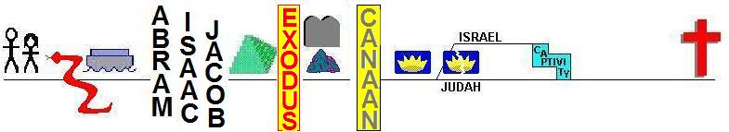
Isaiah 53
⁴Surely our griefs He Himself bore, And our sorrows He carried; Yet we ourselves esteemed Him stricken, Smitten of God, and afflicted. ⁵But He was pierced through for our transgressions, He was crushed for our iniquities; The chastening for our well-being fell upon Him, And by His scourging we are healed.
⁶All of us like sheep have gone astray,
Each of us has turned to his own way;
But the LORD has caused the iniquity of us all
To fall on Him
⁷He was oppressed and He was afflicted,
Yet He did not open His mouth;
Like a lamb that is led to slaughter, And like a sheep that is silent before its shearers, So He did not open His mouth.
Substitution
&
Transference
1 Peter 2
²² Who committed no sin, nor was any deceit found in His mouth; ²³ and while being reviled, He did not revile in return, while suffering, He uttered no threats, but kept entrusting Himself to Him who judges righteously; ²⁴ and He Himself bore our sins in His body on the cross, that we might die to sin and live to righteousness; for by His wounds you were healed. ²⁵ For you were continually straying like sheep, but now you are returned to the Shepherd and Guardian of your souls.
1 Peter 2
²² Who committed no sin, nor was any deceit found in His mouth; ²³ and while being reviled, He did not revile in return, while suffering, He uttered no threats, but kept entrusting Himself to Him who judges righteously; ²⁴ and He Himself bore our sins in His body on the cross, that we might die to sin and live to righteousness; for by His wounds you were healed. ²⁵ For you were continually straying like sheep, but now you are returned to the Shepherd and Guardian of your souls.
1 Peter 2
²² Who committed no sin, nor was any deceit found in His mouth; ²³ and while being reviled, He did not revile in return, while suffering, He uttered no threats, but kept entrusting Himself to Him who judges righteously; ²⁴ and He Himself bore our sins in His body on the cross, that we might die to sin and live to righteousness; for by His wounds you were healed. ²⁵ For you were continually straying like sheep, but now you are returned to the Shepherd and Guardian of your souls.
1 Peter 2
²² Who committed no sin, nor was any deceit found in His mouth; ²³ and while being reviled, He did not revile in return, while suffering, He uttered no threats, but kept entrusting Himself to Him who judges righteously; ²⁴ and He Himself bore our sins in His body on the cross, that we might die to sin and live to righteousness; for by His wounds you were healed. ²⁵ For you were continually straying like sheep, but now you are returned to the Shepherd and Guardian of your souls.
1 Peter 2
²² Who committed no sin, nor was any deceit found in His mouth; ²³ and while being reviled, He did not revile in return, while suffering, He uttered no threats, but kept entrusting Himself to Him who judges righteously; ²⁴ and He Himself bore our sins in His body on the cross, that we might die to sin and live to righteousness; for by His wounds you were healed. ²⁵ For you were continually straying like sheep, but now you are returned to the Shepherd and Guardian of your souls.
53:9
53:7
53:5
53:6

Slide 17
Isaiah 53
⁸By oppression and judgment He was taken away; And as for His generation, who considered That He was cut off out of the land of the living,
For the transgression of my people to whom the stroke was due?
⁹His grave was assigned to be with wicked men,
Yet with a rich man in His death;
Although He had done no violence,
Nor was there any deceit in His mouth.
Substitution
&
Transference

Slide 18
Isaiah 53
¹⁰But the LORD was pleased To crush Him, putting Him to grief;
If He would render Himself as a guilt offering ,
He will see His offspring,
He will prolong His days,
And the good pleasure of the LORD will prosper in His hand.
¹¹As a result of the anguish of His soul,
He will see it and be satisfied;
By His knowledge the Righteous One,
My Servant, will justify the many,
As He will bear their iniquities.
¹²Therefore, I will allot Him a portion with the great,
And He will divide the booty with the strong; Because He poured out Himself to death,
And was numbered with the transgressors;
Yet He Himself bore the sin of many,
And interceded for the transgressors.
Substitution
&
Transference

Slide 19
Isaiah 53
¹⁰But the LORD was pleased To crush Him, putting Him to grief;
If He would render Himself as a guilt offering ,
He will see His offspring,
He will prolong His days,
And the good pleasure of the LORD will prosper in His hand.
¹¹As a result of the anguish of His soul,
He will see it and be satisfied;
By His knowledge the Righteous One,
My Servant, will justify the many,
As He will bear their iniquities.
¹²Therefore, I will allot Him a portion with the great,
And He will divide the booty with the strong; Because He poured out Himself to death,
And was numbered with the transgressors;
Yet He Himself bore the sin of many,
And interceded for the transgressors.
Justice
Romans 3:26
Grace as motivation for works
Enhanced by appreciation of the cost

Slide 20
FAITH
πίστις pistis
TRUST

Slide 21
FAITH
πίστις pistis
πιστός, adj. faithful
“πιστός. In lit. this first means a. ‘trusting’ …”
πίστις, n. faith
“Along the lines of the use of “πιστός, πίστις means a. (abstr.) ‘confidence,’ ‘trust,’…”
πιστεύω, vb. believe
“πιστεύω (only from the 7th cent.), derived from πιστός, means ‘to trust,’ ‘to rely on.’" TDNT vol. 6 p. 177
“Since words can be the obj. of πιστεύειν, it can also mean ‘to believe,’ and in this sense it can have a personal obj. (dat.) or a material obj. (acc.).” TDNT, vol. 6, p. 178.

Slide 22
WORK
ἐργον ergon

Slide 23
WORK
ἐργον ergon
If one trusts God, he does what God says.
If one does not do what God says, he does not trust God.
Hence the truth of Heb. 5:9…
“author of eternal salvation to them that obey him”

Slide 24
WORK
ἐργον ergon
John 3:16ff
BELIEVES
not perish
has eternal life
is not judged
does the truth
comes to the light
works wrought in God
BELIEVES NOT
judged already
loved the darkness
works were evil
does evil
hates the light
doesn’t come to the light

Slide 25
WORK
ἐργον ergon
John 3:16ff
BELIEVES
loved the darkness
works were evil
does evil
hates the light
doesn’t come to the light
NO SUCH THING

Slide 26
WORK
ἐργον ergon
John 6
²⁷ “Do not work for the food which perishes, but for the food which endures to eternal life, which the Son of Man will give to you, for on Him the Father, God, has set His seal.”
²⁸ Therefore they said to Him, “What shall we do, so that we may work the works of God?” ²⁹ Jesus answered and said to them, “This is the work of God, that you believe in Him whom He has sent.”
Work for spiritual food
‘Man shall not live on bread alone, but on every word that proceeds out of the mouth of God.’
TRUST ME!
that you trust me!

Slide 27
JUSTIFICATION
Grace is the cause & the mechanism
Faith is the condition
Works are the manifestation of faith, the response of faith to Grace,
Where does baptism fit in?
Baptism
…isn’t a work as in Eph. 2:10
…is necessary! (OT typology, Ac 22:16, Jn 3:3-5, Ga 3:27, Ro 6:3)
…is laying the sin on the head of the goat!

Slide 28
JUSTIFICATION
Grace is the cause & the mechanism
Faith is the condition
Works are the manifestation of faith, the response of faith to Grace,
Romans 6
³ Or are ye ignorant that all we who were baptized into Christ Jesus were baptized into his death? ⁴ We were buried therefore with him through baptism unto death: that like as Christ was raised from the dead through the glory of the Father, so we also might walk in newness of life.

Slide 29
CONCLUSIONS
Reconciling Necessity of Works & Salvation by Grace thru Faith
working faith
If “faith” includes “works,”
How can Paul contrast the two?
“of works? Nay, but by a law of faith” (Rom. 3:27)
“him that works not, but believes” (Rom. 4:5)

Slide 30
CONCLUSIONS
Reconciling Necessity of Works & Salvation by Grace thru Faith
(The following are not mutually exclusive)
working faith
edited works

Slide 31
works...?
“By grace have ye been saved … not of yourselves, it is the gift of God, not of works” Eph.2.8
“not by works… which we did ourselves, but according to his mercy he saved us” Titus.3.5
“judged every man according to their works” Rv.20.12
“judgeth according to each man’s work” 1Ptr.1.17
“will render to each man according to his works” Rm.2.6
cf. Matt.25.31ff
Slide by Scott Smelser

Slide 32
Saved by? NO Judged by? YES
“By grace have ye been saved … not of yourselves, it is the gift of God, not of works” Eph.2.8
“not by works… which we did ourselves, but according to his mercy he saved us” Titus.3.5
“judged every man according to their works” Rv.20.12
“judgeth according to each man’s work” 1Ptr.1.17
“will render to each man according to his works” Rm.2.6
cf. Matt.25.31ff
Slide by Scott Smelser

Slide 33
CONTRASTING JUDGEMENT BY LAW & GRACE:
Slide by Scott Smelser

Slide 34
man A. man B.
+ + + - + - + + - - + + - + - - + - - + - - - + + - + - + + - - - + + - - - + - + + + - +
+ + + - + - + + - - + + - + - - + - - + - - - + + - + - + + - - - + + - - - + - + + + - +
Slide by Scott Smelser

Slide 35
man A. man B.
+ + + - + - + + - - + + - + - - + - - + - - - + + - + - + + - - - + + - - - + - + + + - +
+ + + - + - + + - - + + - + - - + - - + - - - + + - + - + + - - - + + - - - + - + + + - +
Slide by Scott Smelser

Slide 36
man A. man B.
+ + + - + - + + - - + + - + - - + - - + - - - + + - + - + + - - - + + - - - + - + + + - +
+ + + - + - + + - - + + - + - - + - - + - - - + + - + - + + - - - + + - - - + - + + + - +
Slide by Scott Smelser

Slide 37
man A. man B.
+ + + - + - + + - - + + - + - - + - - + - - - + + - + - + + - - - + + - - - + - + + + - +
+ + + - + - + + +- + + - + - - + +- + - +-+ + + + +- + + -+- + + - ++ + - + + + - +
Slide by Scott Smelser

Slide 38
man A. man B.
+ + + - + - + + - - + + - + - - + - - + - - - + + - + - + + - - - + + - - - + - + + + - +
+ + + - + - + + +- + + - + - - + +- + - +-+ + + + +- + + -+- + + - ++ + - + + + - +
Slide by Scott Smelser

Slide 39
man A. man B.
+ + + - + - + + - - + + - + - - + - - + - - - + + - + - + + - - - + + - - - + - + + + - +
+ + + - + - + + +- + + - + - - + +- + - +-+ + + + +- + + -+- + + - ++ + - + + + - +
Slide by Scott Smelser

Slide 40
man A. man B.
+ + + - + - + + - - + + - + - - + - - + - - - + + - + - + + - - - + + - - - + - + + + - +
+ + + - + - + + +- + + - + - - + +- + - +-+ + + + +- + + -+- + + - ++ + - + + + -- +
Slide by Scott Smelser

Slide 41
man A. man B.
+ + + - + - + + - - + + - + - - + - - + - - - + + - + - + + - - - + + - - - + - + + + - +
+ + + - + - + + - - + + - + - - + - - + - - - + + - + - + + - - - + + - - - + - + + + - +
Slide by Scott Smelser

Slide 42
man A. man B.
+ + + - + - + + - - + + - + - - + - - + - - - + + - + - + + - - - + + - - - + - + + + - +
+ + + - + - + + +- + + - + - - + +- + - +-+ + + + +- + + -+- + + - ++ + - + + + - +
Judged by his works, but saved by the blood of Christ
Judged by his works
Slide by Scott Smelser

Slide 43
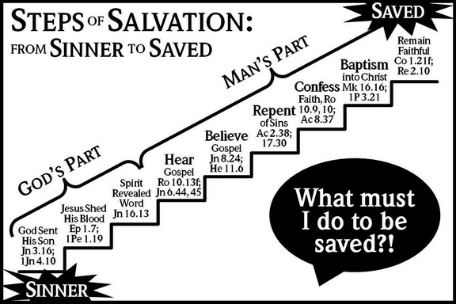
Less than ideal presentations
http://8thandleecoc.org/the-plan-of-salvation-is-taught-at-eighth-and-lee/

Slide 44
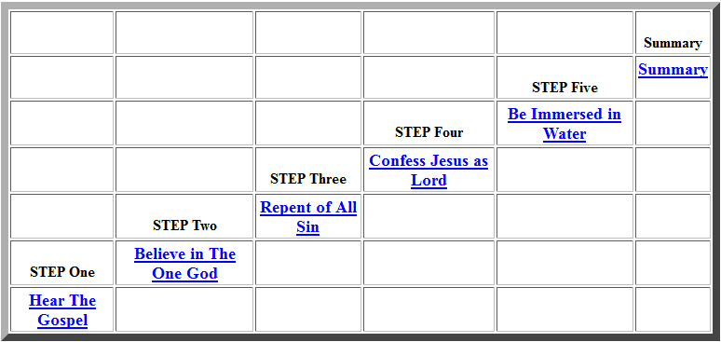
Less than ideal presentations
http://www.trustingodamerica.com/FiveStepsCov.htm

Slide 45
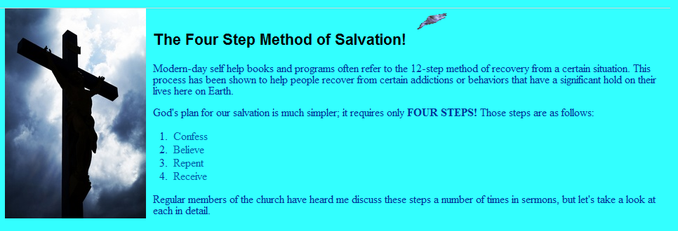
Less than ideal presentations
IS BAPTISM THE PROBLEM?
from a Baptist Site…
http://www.coronadosbc.com/4Step.html

Slide 46

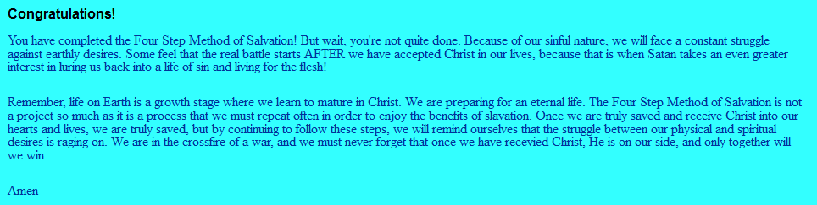
Less than ideal presentations
Unfortunate typo
http://www.coronadosbc.com/4Step.html

Slide 47
MAIN POINTS
All men who will be saved, before and after the cross, are saved by grace through faith.
OT pictures of deliverance and reward are meant to demonstrate the reliability of the God who promises us our deliverance and reward, and to provide a foretaste of our salvation
Joshua leads Israel into the promised land
His very name, YHWH saves
He is a prototype, a shadow of Jesus.
He leads Isreal to their rest (Ps. 95), which forshadows our rest (Heb. 4)
They were not to think their victories were of their own doing (Judges, Gideon)
They conquer the land by faith (Heb. 11:30)
But obviously, that faith involved them doing something, e.g., marching around Jericho.
This is a picture of how we are saved.

Slide 48
MAIN POINTS
Salvation by Grace through faith excludes boasting
Rom. 4
Eph. 2
Gideon

Slide 49
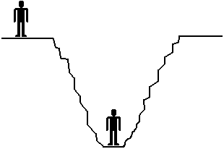
WHO NEEDS SALVATION?
MIGHT THE MAN IN THE PIT SAVE HIMSELF BY HIS WORKS?
Slide by Scott Smelser

Slide 50
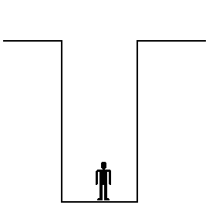
CAN THIS MAN SAVE HIMSELF?
IMPOSSIBLE.
THIS MAN NEEDS A SAVIOR.
Slide by Scott Smelser

Slide 51
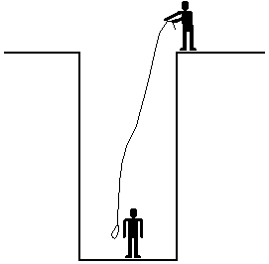
CAN THIS MAN SAVE HIMSELF?
Saved:
“by mercy”
“through faith”
nec. to respond; cf. Acts 2.40 (in a secondary sense): “save yourselves”
IMPOSSIBLE.
THIS MAN NEEDS A SAVIOR.
Slide by Scott Smelser

Slide 52
Primary | Secondary
by grace are ye saved … not of yourselves ... not of works Eph.2:8-9
Who then can be saved?… With man this is impossible Mt.19.26
not by works…but acc. to mercy Tt.3:5
save yourselves from the crooked generation Acts.2:40
like figure whereunto baptism doth also now save us” 1Ptr.3:21
“in doing this you will save both yourself and them that hear you” 1Tim.4:16
Slide by Scott Smelser

Slide 53
Paul
GOD’S
WORD
James
An
Error
religious formalism
absent piety
such as in Isaiah 1
Another
Error
self righteousness
as in Luke 18:11f

Slide 54
Joe
GOD’S
WORD
Moe
An
Error
Another
Error

Slide 55
Romans 10 & Confession

Slide 56
Romans 10
⁹ that if you confess with your mouth Jesus as Lord, and believe in your heart that God raised Him from the dead, you will be saved;

Slide 57
ROMANS 10
DEUTERONOMY 30:11-14
¹¹ “For this commandment which I command you today is not too difficult for you, nor is it out of reach.
¹² It is not in heaven, that you should say, ‘Who will go up to heaven for us to get it for us and make us hear it, that we may observe it?’
¹³ Nor is it beyond the sea, that you should say, ‘Who will cross the sea for us to get it for us and make us hear it, that we may observe it?’
¹⁴ But the word is very near you, in your mouth and in your heart, that you may observe it.”

Slide 58
ROMANS 10
DEUTERONOMY 30:11-14
¹¹ “For this commandment which I command you today is not too difficult for you, nor is it out of reach.
¹² It is not in heaven, that you should say, ‘Who will go up to heaven for us to get it for us and make us hear it, that we may observe it?’
¹³ Nor is it beyond the sea, that you should say, ‘Who will cross the sea for us to get it for us and make us hear it, that we may observe it?’
¹⁴ But the word is very near you, in your mouth and in your heart, that you may observe it.”
Deuteronomy 6
⁶ These words, which I am commanding you today, shall be on your heart. ⁷ You shall teach them diligently to your sons and shall talk of them when you sit in your house and when you walk by the way and when you lie down and when you rise up.
Deuteronomy 6
⁶ These words, which I am commanding you today, shall be on your heart. ⁷ You shall teach them diligently to your sons and shall talk of them when you sit in your house and when you walk by the way and when you lie down and when you rise up.
Deuteronomy 6
⁶ These words, which I am commanding you today, shall be on your heart. ⁷ You shall teach them diligently to your sons and shall talk of them when you sit in your house and when you walk by the way and when you lie down and when you rise up.

Slide 59
ROMANS 10
Paul substitutes abyss (abussos) for sea (thalassa)
Gen. 1:2, 7:11, 8:2
Ps. 106:9, Is. 51:10
“the deep” “waters”
Luke 8:31
Rev. 9:2, 9:11, 11:7, 17:8, 20:1-2
“netherworld”
Ps. 71:20
Romans 10:9
that if you confess with your mouth Jesus as Lord, and believe in your heart that God raised Him from the dead, you will be saved;
Does it require confession with the mouth?
Is it specifically about confession at the time of baptism?

