Slide 2
Two Paths Diverged: Where We Are, and How Did We Get Here?
Steve Wolfgang
1236 63rd Street, Downers Grove, IL 60516
jswolfgang@alumni.vanderbilt.edu or wolf@uky.edu
Exploring Current Issues Conference
2 October 2017

Slide 3
Christ’s Prayer for Unity John 17:20-21
Neither pray I for these alone, but for them also which shall believe on me through their word; 21 That they all may be one; as thou, Father, art in me, and I in thee, that they also may be one in us: that the world may believe that thou hast sent me.

Slide 4
Psalm 133:1-3
Behold, how good and how pleasant it is for brethren to dwell together in unity! 2 It is like the precious ointment upon the head, that ran down upon the beard, even Aaron’s beard: that went down to the skirts of his garments; 3 As the dew of Hermon, and as the dew that descended upon the mountains of Zion: for there the LORD commanded the blessing, even life for evermore.

Slide 5
Divisions
1 Corinthians 11:18
For, in the first place, when you come together as a church, I hear that divisions exist among you; and in part I believe it. ¹⁹ For there must also be factions among you, so that those who are approved may become evident among you. NASB

Slide 6
Division
1 John 2:19
They went out from us, but they were not of us; for if they had been of us, they would have continued with us. But they went out, that it might become plain that they all are not of us. ESV

Slide 7
Peter Berger on Ecumenical discussions
“Border negotiations between nonexistent nations”

Slide 8
Peter Berger on Ecumenical discussions
“Border negotiations between nonexistent nations”
Three “universal lies:”
“Your check is in the mail”
“It’s only until the divorce”

Slide 9
Peter Berger on Ecumenical discussions
“Border negotiations between nonexistent nations”
Three “universal lies:”
“Your check is in the mail”
“It’s only until the divorce”
(For academics): “I’ll be brief”

Slide 10
What’s Happening Now?
GA editor reached out
Can we talk?
May 19 meeting – Nashville
OWL

Slide 11
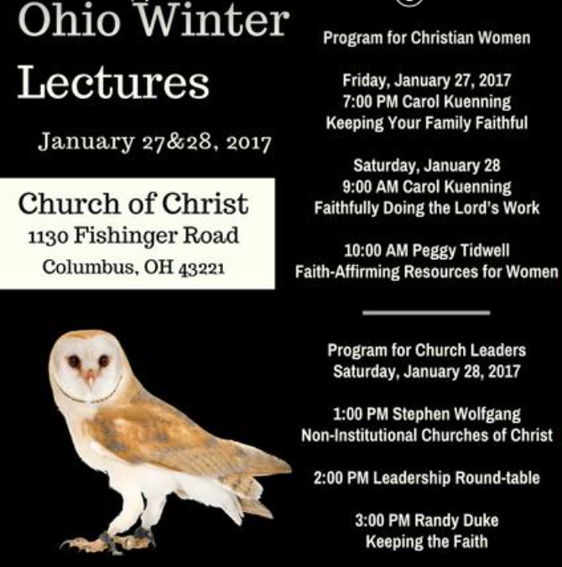
OWL

Slide 12
Recent-Past Events
Gospel Advocate meeting – 5/19/16
Harding University Lectures – 9/24-26/16
Ohio Winter Lectures – 01/27/17
Faulkner University Lectures – 03/02/17
ACU-Texas Normal Singing School – 07/17
ECIC – Cullman, AL – 10/2-5/17
Future?

Slide 13
Arlington Meeting January 1968
Reuel Lemmons Roy Cogdill
Hulen Jackson James W. Adams
Johnny Ramsey Harry Pickup, Jr.
Roy Lanier, Sr. Robert F. Turner
J.D. Thomas Franklin T. Puckett
Eldred Stevens Stanley Lovett
Gus Nichols Bryan Vinson
Hardeman Nichols Floyd Thompson
Bill Humble W.L. Wharton
Alan Highers Clinton Hamilton
Buster Dobbs Melvin Curry
Jimmy Allen Harold Fite
Lewis Hale Dudley Ross Spears

Slide 14
Gospel Advocate Editorial May 10, 1979
“We plead with all ‘anti’ brethren to come on back home. Come on back to the old paths and again send your children to Lipscomb, Abilene, Freed-Hardeman, Harding, Alabama Christian, Oklahoma, Michigan Christian, Northeastern Christian, Pepperdine, Ohio Valley, Lubbock, York, Crowley Ridge, etc.”
“We need that 5% back in the fold…”
Ira North, “Our Anti-Cooperation Brethren Should Come Back Home,” Gospel Advocate, 121:19 (May 10, 1979), pp. 290, 294.

Slide 15
Gospel Advocate Editorial May 10, 1979
“Come back home and preach again in the great churches, such as Hillsboro, West End, Granny White, Searcy, Bammel Road, Memorial Drive, etc.”
“If the past has proven anything, it has proven the ‘anti’ doctrine cannot build great churches, inspire missionaries, and encourage pure and undefiled religion.”
Ira North, “Our Anti-Cooperation Brethren Should Come Back Home,” Gospel Advocate, 121:19 (May 10, 1979), pp. 290, 294.

Slide 16
“The Narrow, Crooked Pig-path of Radicalism”
Those who teach that Christians could “visit the fatherless and widows by taking them in your home” have “taken the narrow, crooked, pig-path of radicalism.”
Tom Holland, Challenge of the Commission: Sermon Outlines on Acts (Brentwood, TN: Penman Press, 1980), p.20.

Slide 17
Nashville Meeting December 1988
Reuel Lemmons James W. Adams
Johnny Ramsey Clinton Hamilton
Lewis Hale Robert F. Turner
Roy Lanier, Jr. Harry Pickup, Jr.
Stafford North Ferrell Jenkins
Rubel Shelly Colly Caldwell
Cecil May L.A. Stauffer
Calvin Warpula Paul Earnhart
Richard Rogers Dan King
Randy Mayeux Mike Willis
Bill Swetmon Karl Diestelkamp
Mac Lynn Robert Jackson
Dennis Petrillo John Clark

Slide 18
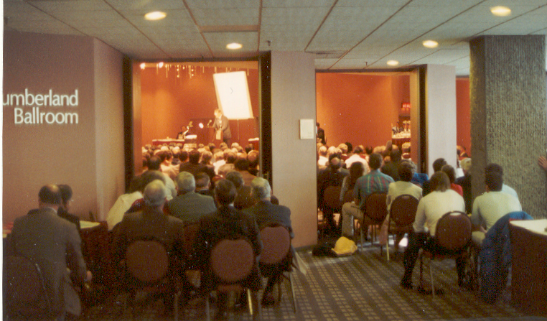
Nashville Meeting, 1988

Slide 19
Dallas Meeting July 1990
Roy Lanier, Jr. Robert F. Turner
Stafford North Paul Earnhart
Lewis Hale Ferrell Jenkins
Furman Kearley Colly Caldwell
Hulen Jackson Bob Owen
Adron Doran Ed Harrell
Cecil May John Clark
Hardeman Nichols Melvin Curry
Jimmy Jividen Maurice Barnett
Wendell Winkler Robert Harkrider
Curtis Camp Weldon Warnock
Buster Dobbs Tom Roberts
Maxie Boren Foy Vinson
Gary Workman Ron Halbrook

Slide 20
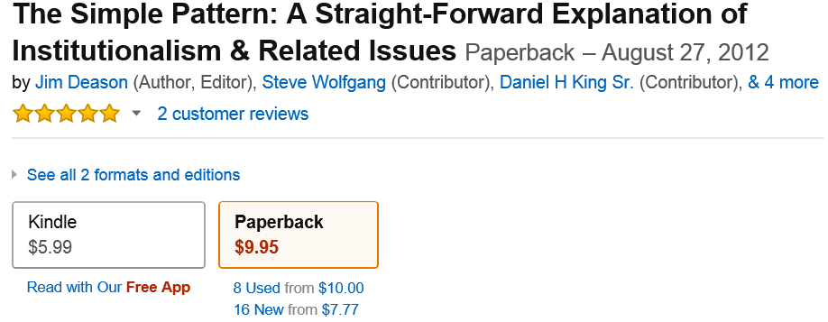
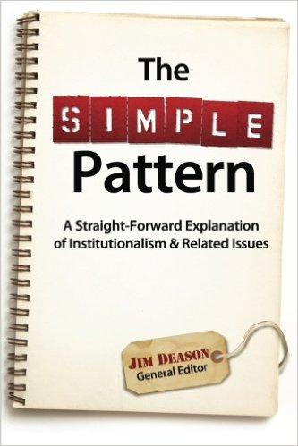
Paul Earnhart
Bill Hall
Dan King
L.A. Stauffer
Carroll Sutton
Steve Wolfgang

Slide 21
ECIC 2017
Greg Tidwell Steve Wolfgang
Doug Burleson Doy Moyer
Glenn Ramsey Curtis Pope
Randy Duke Buddy Payne
Chad Ramsey Donnie Rader
Donnie DeBord Allen Dvorak
Matthew Morine David Diestelkamp
CalvinWarpula Paul Earnhart
Randy Daw L.A. Stauffer
Cecil May Dan King

Slide 22
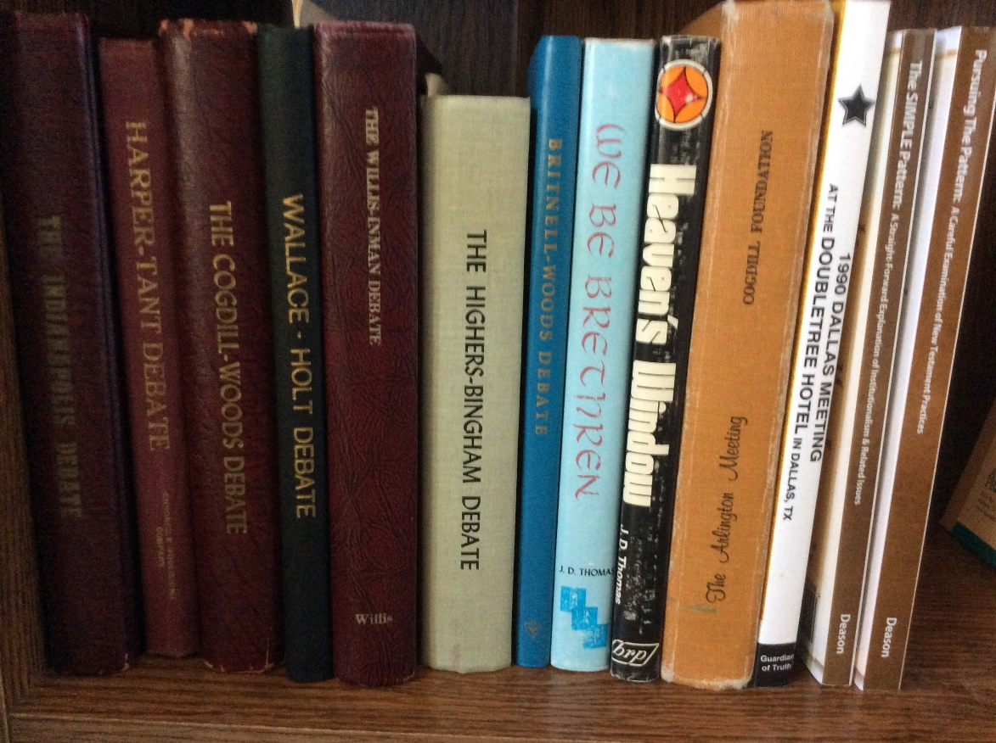
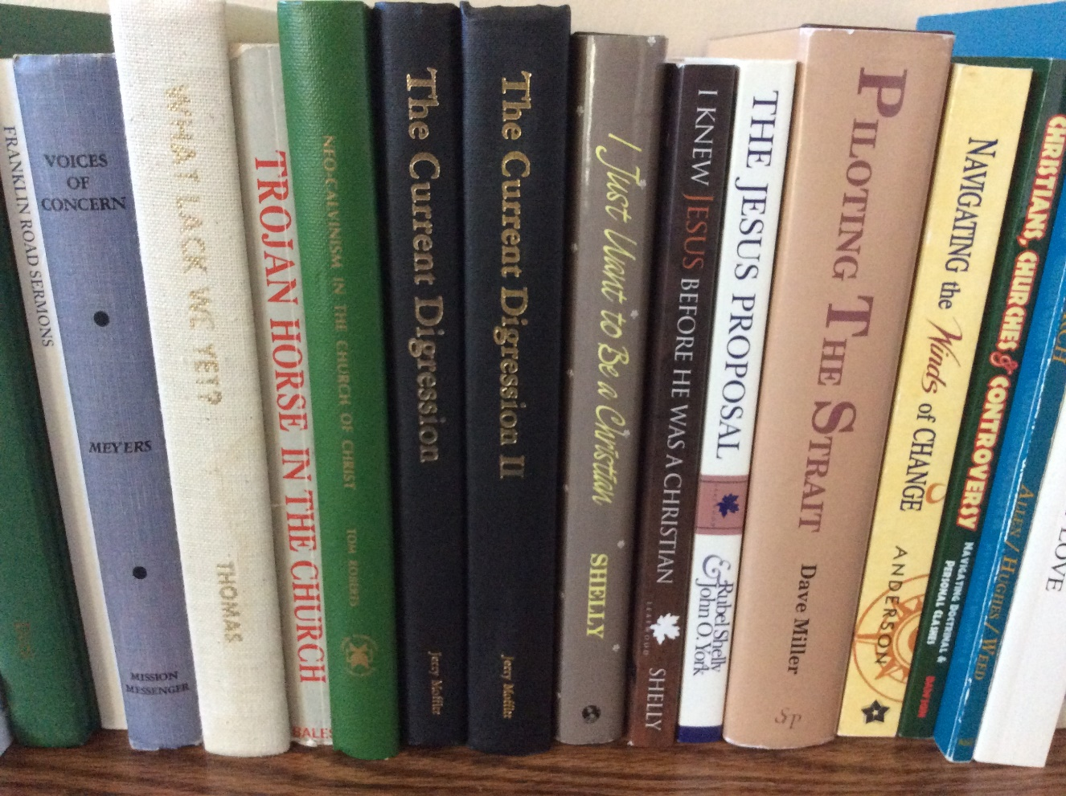
Of the Making of Many Books…

Slide 23
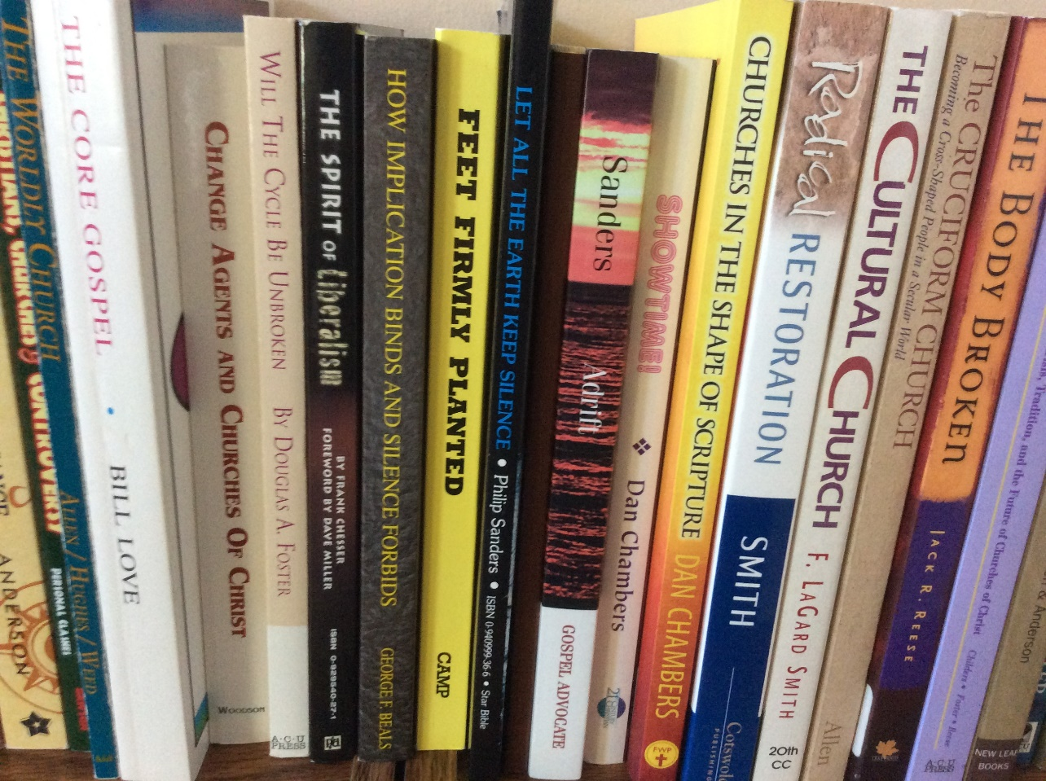
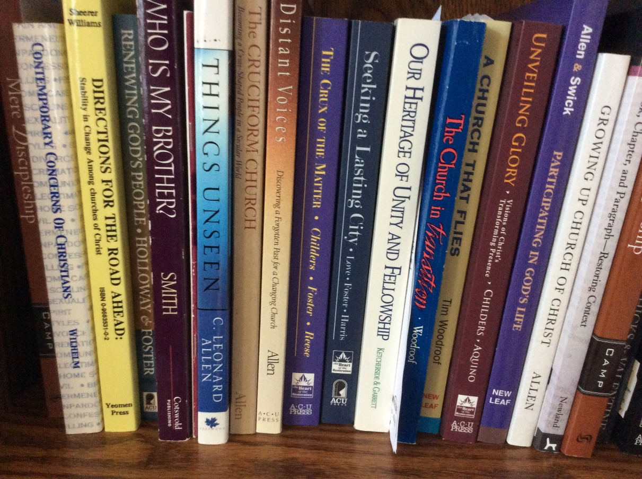
Ecclesiastes 12:12b

Slide 24
My Topics
How did we get here?
History repeats: 3-group cycle
NB: This applies to “NI” churches
“Worldly Church”
Questions going forward

Slide 25
Judges 2:6-7
When Joshua had dismissed the people, the sons of Israel went each to his inheritance to possess the land. 7 And the people served the LORD all the days of Joshua, and all the days of the elders who survived Joshua, who had seen all the great work of the LORD which He had done for Israel. NASB

Slide 26
Judges 2:8-10
Then Joshua the son of Nun, the servant of the LORD, died at the age of one hundred and ten. 9 And they buried him in the territory of his inheritance…in the hill country of Ephraim... 10 And all that generation also were gathered to their fathers; and there arose another generation after them who did not know the LORD, nor yet the work which He had done for Israel.

Slide 27
Judges 2:11-12
Then the sons of Israel did evil in the sight of the LORD, and served the Baals, 12 and they forsook the LORD, the God of their fathers, who had brought them out of the land of Egypt, and followed other gods from among the gods of the peoples who were around them, and bowed themselves down to them; thus they provoked the LORD to anger.

Slide 28
Judges 2:13-15
So they forsook the LORD and served Baal and the Ashtaroth. 14 And the anger of the LORD burned against Israel, and He gave them into the hands of plunderers who plundered them; and He sold them into the hands of their enemies around them, so that they could no longer stand before their enemies. 15 Wherever they went, the hand of the LORD was against them for evil, as the LORD had spoken and as the LORD had sworn to them, so that they were severely distressed.

Slide 29
Judges 2:16-17
Then the LORD raised up judges who delivered them from the hands of those who plundered them. 17 And yet they did not listen to their judges, for they played the harlot after other gods and bowed themselves down to them. They turned aside quickly from the way in which their fathers had walked in obeying the commandments of the LORD; they did not do as their fathers.

Slide 30
Generational Divisions
1830’s – Baptists or Christians?
Local churches or hierarchies?
Churches or human agencies?
1890’s – Worship (instrumental music?) and service (human societies or churches?)
1950’s – Churches or parachurch agencies (evangelism, caregiving institutions?)

Slide 31
Process of Division
“Issues” – 1890’s – IM, MS
Doctrinal “undercurrents”
Social/economic foundations
Exodus of 10-15%
Growth of minority
Shrinkage of majority – Over Time
“Second Exodus” – 1930s – “baggage”
Rough numerical parity – 1940’s
Stage set for next division – 1950’s
If ungrounded
“Living memory” erased

Slide 32
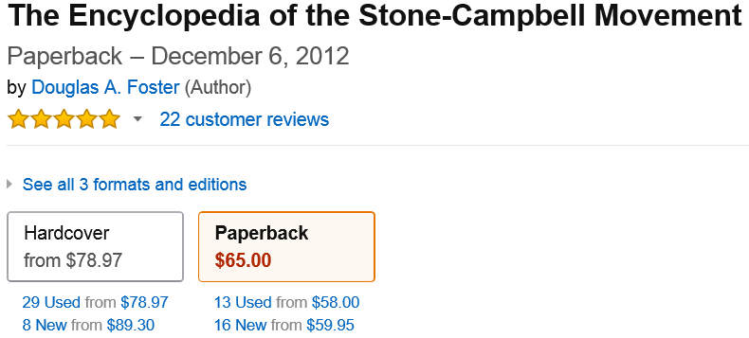
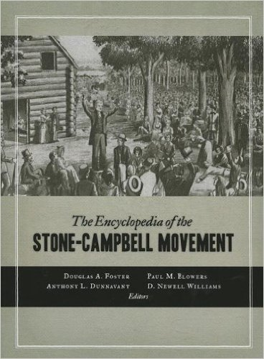

Slide 33
Christian Churches
Christian Church
(Disciples of Christ)
1968 Restructure
Indianapolis
“Independent”
Christian Churches
North American
Christian Convention
“Undenominational
Fellowship of
Christian Churches
and Churches
of Christ”

Slide 34
W.E. Garrison Heritage and Destiny
“The infiltration of a different view of the Bible had already begun, however. It manifested itself in an increasing tolerance for it even by those who did not openly accept it, in a tendency away from the authoritarian type of preaching which buttressed every proposition with by the citation of a proof text, and by a friendlier attitude toward other denominations.”
Winfred Ernest Garrison, Heritage and Destiny: An American Religious Movement Looks Ahead (St. Louis: The Bethany Press, 1961), pp. 108-109.

Slide 35
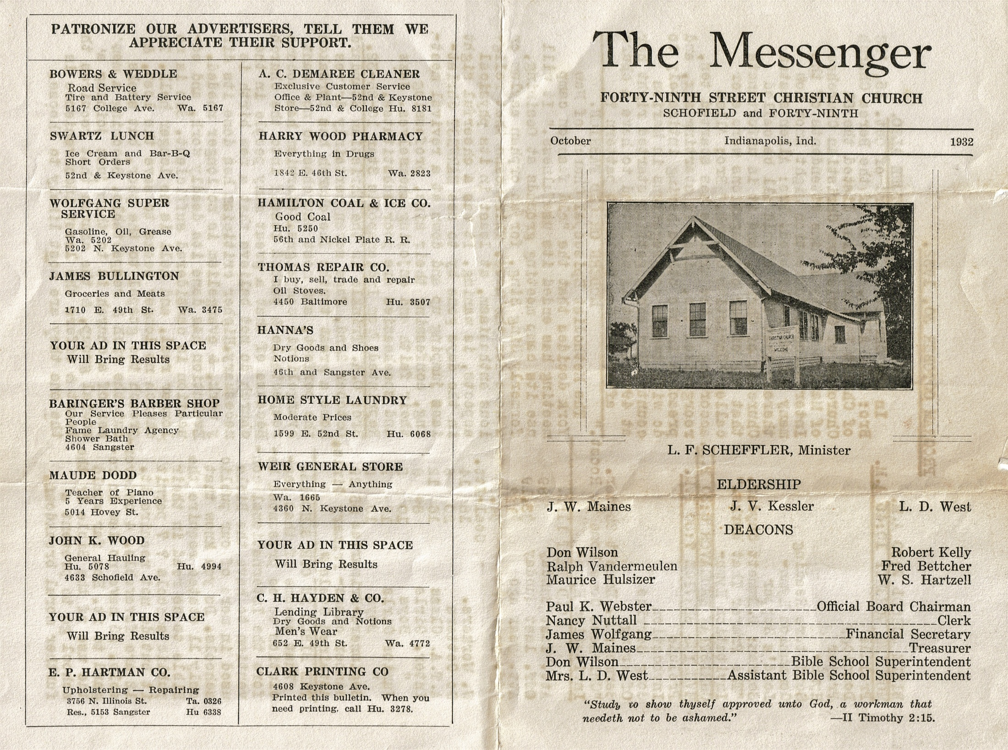

Slide 36
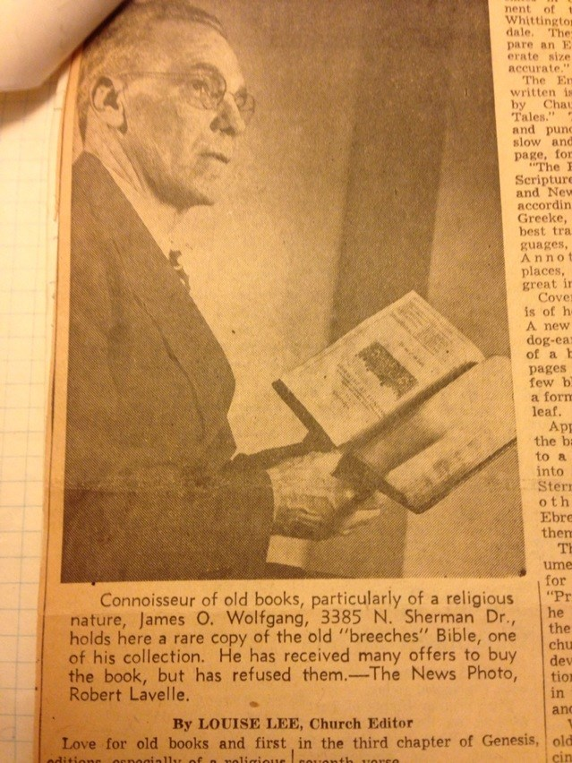
James Otto Wolfgang 1896-1975 Indianapolis News article re: 1599 Geneva Bible

Slide 37
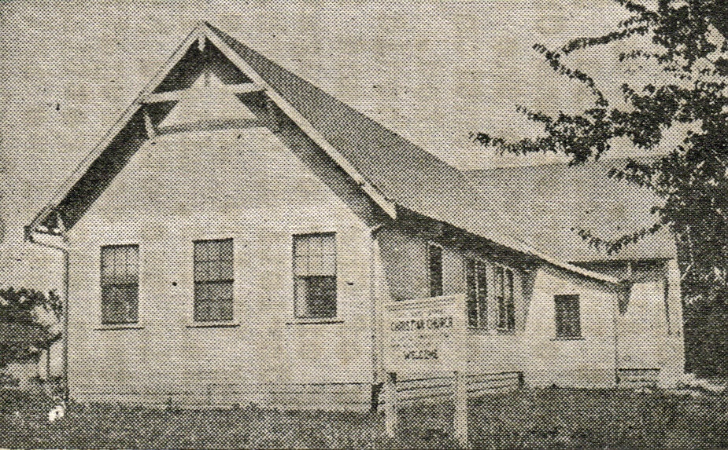
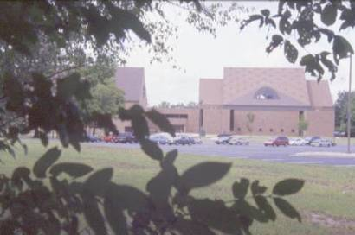
Church Growth

Slide 38
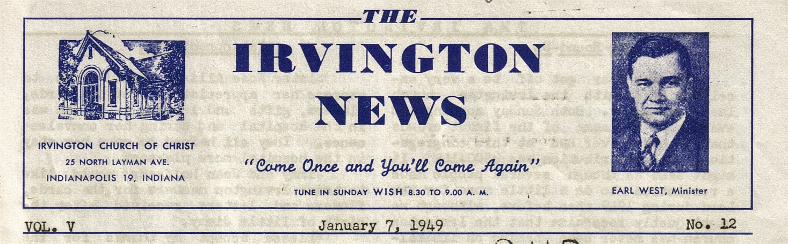
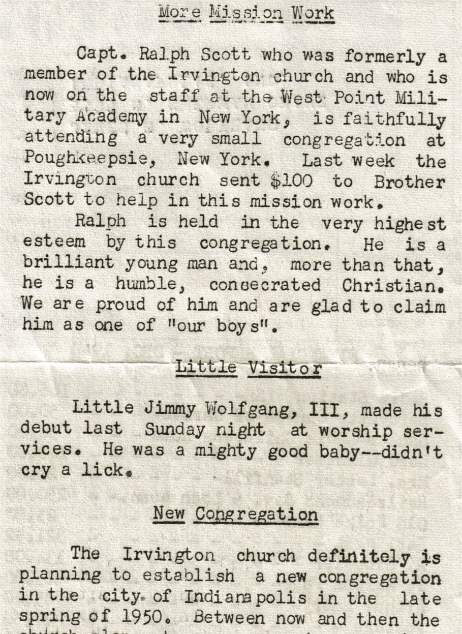

Slide 39
Church Growth

Slide 40
“E 91”
E91 = East 91st Street Christian Church, Indianapolis
#6 on Outreach Magazine’s “Top 25 Evangelistic MegaChurches”
About 4,000 attendance – 50 on staff
Two concurrent services of about 1,000 each, one contemporary, one traditional
Evangelistic: start one church every year – generally out of state
Waukesha, WI, begun about 5 years ago – averages 1,000+ now

Slide 41
Ministries/Activities
Jireh Sports – Equipment, partnering for 15 passenger van
Allendale Christian Camp – Camperships to help children go to camp.
Paracetian - As this ministry has grown we have assisted
Young Life - Start up funds for Lawrence Young Life and its staffing needs.
Habitat For Humanity – Funds for volunteers needs & building materials.
Suicide Prevention (provided from a Donor Advised Fund)
Loaves & Fishes – Working with the Church Federation for benevolence
Lighthouse Ministry – Helping men return to the community for jobs, church, and family.
INRoads – Serving as a bridge between “Bridge kids” and a caring community in the Broad Ripple area.

Slide 42
Missionary Societies
Wrong because of undue pressure on churches? Concentration of wealth? Inefficient operation? Other “abuses?”
Would they be scriptural if abuses removed?
No – they are an inherently unscriptural cooperative of churches
BUT “if God does not specify the means we are free as to methods” how are they wrong?

Slide 43
Which is Paramount?
A human institution?
Or fellowship among brothers?
Even those who oppose institutions?
David Filbeck, The First Fifty Years: A Brief History of the Direct-Support Missionary Movement (Joplin: College Press, 1980).

Slide 44
Alan Highers
“The conclusion of the whole matter (with respect to instrumental music) is this: unity with those who use the instrument is predicated upon a single choice – either they give up the instrument, or we give up our opposition to it. What other alternatives are there?”
Spiritual Sword, April 1988, p. 48

Slide 45
Generational Divisions
1830’s – Baptists or Christians?
Local churches or hierarchies?
Churches or human agencies?
1890’s – Worship (instrumental music?) and service (human societies or churches?)
1950’s – Churches or parachurch agencies (evangelism, caregiving institutions?)
20_ _’s – What does the future hold?

Slide 46
Division: 19th-20th Centuries Missionary Societies & Instrumental Music
Christian Churches Churches of Christ
“Progressives” “Antis”
“Liberals” “Conservatives”
“Digressives” “Mossbacks”

Slide 47
Christian Churches
Christian Church
(Disciples of Christ)
1968 Restructure
Indianapolis
“Independent”
Christian Churches
North American
Christian Convention
“Undenominational
Fellowship of
Christian Churches
and Churches
of Christ”

Slide 48
“Churches of Christ”
“Institutional” “Non-Institutional”

Slide 49
“Churches of Christ”
“Institutional” “Non-Institutional”
“Liberal” “Conservative”

Slide 50
“Churches of Christ”
“Institutional” “Non-Institutional”
“Liberal” “Moderate” “Conservative”

Slide 51
“Churches of Christ”
“Institutional” “Non-Institutional”
“Liberal” “Moderate” “Anti”
“Progressive” “Mainstream” “Conservative”

Slide 52
Churches of Christ: Post-WWII
New generation of leadership
Upward socio-economic spiral
Institutional “boom”
Colleges – GI Bill
Orphanages -- 5 in1940; to 50+
“Sponsoring” churches
Television ministries

Slide 53
Yellow Tag of Quarantine
Pressure to “Line Up”
On institutions (Florida College, CEI)
On Churches – anti foreign evangelism
-- won’t help starving orphans
-- send $10 to show not “anti”
-- write check or resign
On Preachers – No anti need apply
-- “Confessions” in the GA
-- Firings, meetings cancelled
Miscellaneous – Fertilizer bags in pulpit
-- Only anti church in Bible: Antioch
-- Lawsuits, scuffles, fisticuffs

Slide 54
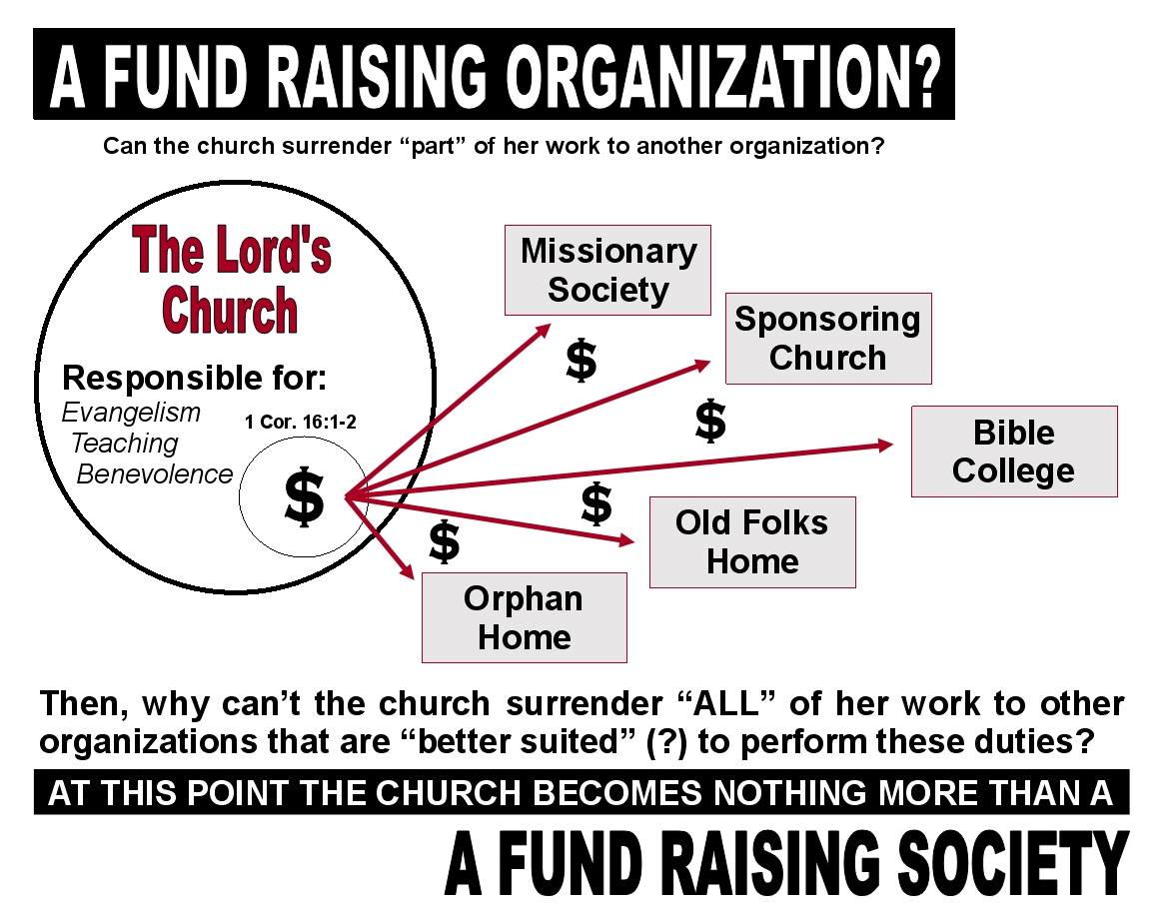

Slide 55
Television Evangelism
Churches of Christ found that they could not expect to compete effectively in the denominational free-market of souls unless they embraced the sort of peace of mind piety that had dominated the national religious landscape for more than a decade

Slide 56
Herald of Truth
“With increasing frequency the show explained to national radio or television audiences how to achieve spiritual growth and peace of mind, how to develop healthy family relationships, and how to cope with anxiety and fear, or the various stages along life’s way.”

Slide 57
TV Game Show Preaching
“Increasingly, leading preachers turn to the language, props and forms of television shows in narrating sermons. Popular television game show formats provide the form for the sermon content. Preachers become characters from popular television sitcoms, along with featured replica props, again to narrate ideas or create a dialogue with the congregation to convey the ideas of the sermon.”

Slide 58
“User-Friendly Gospel”
“Preaching in rural and urban grace-oriented Churches of Christ, and in some large suburban congregations, has transformed its focus from what Alexander Campbell called the “gospel fact” to a “user-friendly” gospel.”
Michael W. Casey, “Preaching: Churches of Christ,” ECSM, p. 608. See also Casey’s Saddlebags, City Streets, and Cyberspace: A History of Preaching in the Churches of Christ (Abilene, TX: ACU Press, 1995).

Slide 59
“Seeker Models”
“Given the impressive results of seeker churches like Willow Creek and Saddleback, the pull to mimic their direction is nearly irresistible. . . . One need only read the classified ads of churches looking for ministers in the Christian Chronicle to see the influence of seeker models on our thinking about evangelism.”
Mark Love, “The Church that Connects at Calvary,” in Allen and Anderson, eds., The Transforming of a Tradition: Churches of Christ in the New Millennium, p. 144.

Slide 60
Like Those Around Us
“Just when churches up and down the street are re-evaluating their denominational status and seeking to be more nondenominational, many among us are abandoning the goal of nondenominational Christianity and seeking to be more like other denominational churches... That we have become what we once despised is undeniable” (emphasis mine – JSW)
Rob McRay, “The Last Will and Testament of the Churches of Christ,” in Allen and Anderson, eds., The Transforming of a Tradition: Churches of Christ in the New Millennium, p. 44

Slide 61
“Doctoral Ministry”
“Nor is it an unexpected development among those who believe it is a work of the church to financially support ‘the ministry of continuing study toward a doctorate.’”
Bill Flatt, "Harding Graduate School of Religion Commencement, 1975" Gospel Advocate 117:26 (June 26, 1975), p. 404. On the preoccupation with academic degrees and “scholarship” among institutional preachers, see Ralph T. Henley, “Scholarship,” Spiritual Sword 6:3 (April 1975), 35ff.; and Henley, “How to Get A Cheap Degree Cheap,” Gospel Advocate 119:18 (May 5,1977), 276-277.

Slide 62
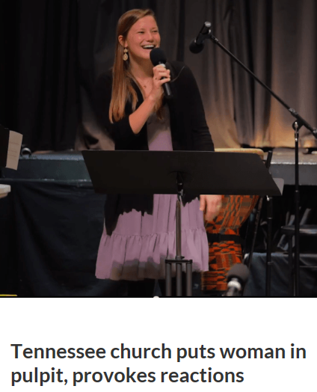
Tennessee Church Hires Woman Preacher
Fourth Avenue church
Franklin, TN
Lauren King
David Lipscomb
University senior

Slide 63
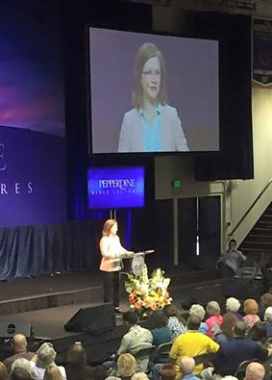
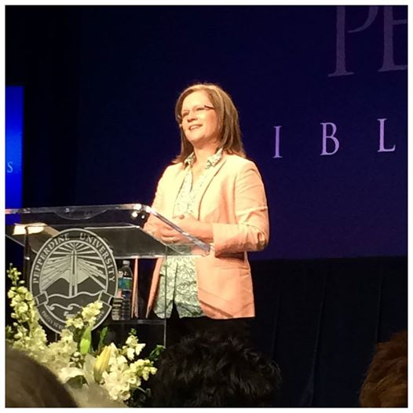
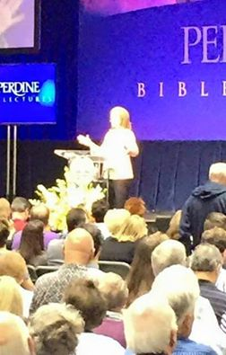
Pepperdine University Chaplain – 2015

Slide 64

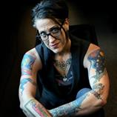
Tattooed Lesbian Lutheran Preacher
Nadia Bolz-Weber
Her “liberal, foulmouthed articulation of Christianity” – as described by the Washington Post – includes “Beer & Hymns”
Pepperdine University Lectureship Speaker – 2015

Slide 65
Worldliness
“By worldliness I mean not merely the disregard of fundamentalist taboos against smoking, drinking, dancing, movie-going, gambling, and the like, but more expansively such matters as materialism, pleasure-seeking, indiscriminate enjoyment of salacious and violent entertainment, immodesty of dress, voyeurism, sexual laxity, and divorce...”
Gundry, Jesus the Word … p.77n18.

Slide 66
Questions
How deep/broad is the “progressive” digression?
I hear contradictory answers
How widespread is willingness to work with “antis?”
Some still think “anti-ism” is as big a sin as “liberalism
What would have to happen to make it practical?
Yes, we have some things in common – BUT:
How big are our differences?

Slide 67
“Why Anti-ism is Sinful”
“Bravura performances of the mental gymnastics necessary to elucidate how”
“Opposing Support for Colleges from the Church Treasury is Not Anti-ism” or
Negating the question “Are We Holding a Form of Anti-ism Because we Oppose False Doctrine and False Teachers in ACU, OCU, Harding U, FHU, Lipscomb U, and the like?”
Or “When we Oppose The Church of Christ Disaster Relief Agency?”
Houston-area 2006 Spring (TX) Contending for the Faith Lectureship, “Anti-ism: From God or Man” (February 26 - March 2, 2006) – http://www.churchesofchrist.com

Slide 68
Questions
Are institutions bad ONLY when they go astray or sap congregational resources?
These might be considered “abuses” of a principle; but is the principle itself Biblical?
Is it the model of multiple-church “cooperation” and organization by one large church accepting funds from many other churches to do a work for all of them a scriptural concept?
This was, and is, central to the controversy which divided churches in the 1950’s.

Slide 69
Questions
Were the 1950’s really that much of a “Golden Era?”
I doubt very many “NI” folk would see it that way – especially if they lived through it.
Big question: where’s the division?
This paper makes it sound as if there was very little controversy of any kind in the 1950’s and later.

Slide 70
Brotherhood? Or “Church-hood?”
Difficulties in keeping our thinking “non-denominational”
“Anti” NOT a “collection of churches”
Individual Christians who have found ways to work together conscientiously

Slide 71
What “Antis” DO
Examples: Institutions supported by individuals, not churches
Sacred Selections
Sumphonia
Leaving the Pit
Florida College
Truth Publications

Slide 72
What Can We Do Together?
Examples: Institutions supported by individuals, not churches
Sacred Selections
Sumphonia
Leaving the Pit
Florida College
Truth Publications

Slide 74
What Kind of Church Does Jesus Want?
Did Christ die for:
Day-care Centers
Job Placement Bureau
Adult Education Courses
Medical-Dental Clinics
English as 2nd Language Classes

Slide 75
The Church’s Mission?
Entertainment
Social Service
Medical Care
Secular Education
Job Placement
Scripture?____________

Slide 76
What Is The Church?
Social Service Agency?
Entertainment Center?
Modified Country Club?
Human Invention?
Divine Institution?

Slide 77
“Restoration Movement”
A movement to unite Christians by
abandoning denominationalism and
restoring New Testament Christianity

Slide 78
Restoration Principles
Divine Authority vs. Human Opinions
Scripture vs. Human Creeds
Revelation vs. Family Traditions
“Christian” vs. Human Labels
New Testament Christianity vs.
Denominationalism

Slide 79
“Issues”
History and Background
Ascertaining Biblical Authority
The Work/Mission of Churches
Individuals and Churches
Institutions and Churches
Cooperation of Churches
Fellowship with Christians and Churches

Slide 80
Post-Modern Preaching Style
Lucado “adapted the narrative capabilities of his mentor, Lynn Anderson” (Herald of Truth speaker)
Noting that “narrative or storytelling is the primary technique in Lucado’s preaching,” Casey reports
“occasionally he has simply told a story for the entire sermon”

Slide 81
Post-Modern Preaching Style
Lucado “once moved the pulpit out of the way and sat in a big chair and narrated a fable that he had written”
Casey notes that “the post-modern style of preaching is increasingly prevalent in both Church of Christ and in the wider evangelical world”

Slide 83
What Can We Do Together?
Examples: Institutions supported by individuals, not churches

Slide 84
What Can We Do Together?
Examples: Institutions supported by individuals, not churches
Sacred Selections
Sumphonia
Leaving the Pit
Florida College
Truth Publications

Slide 85
What Can We Do Together?
Examples: Institutions supported by individuals, not churches
Sacred Selections

Slide 86

Sacred Selections Adoptions

Slide 87
What Can We Do Together?
Examples: Institutions supported by individuals, not churches
Sacred Selections
Sumphonia

Slide 88
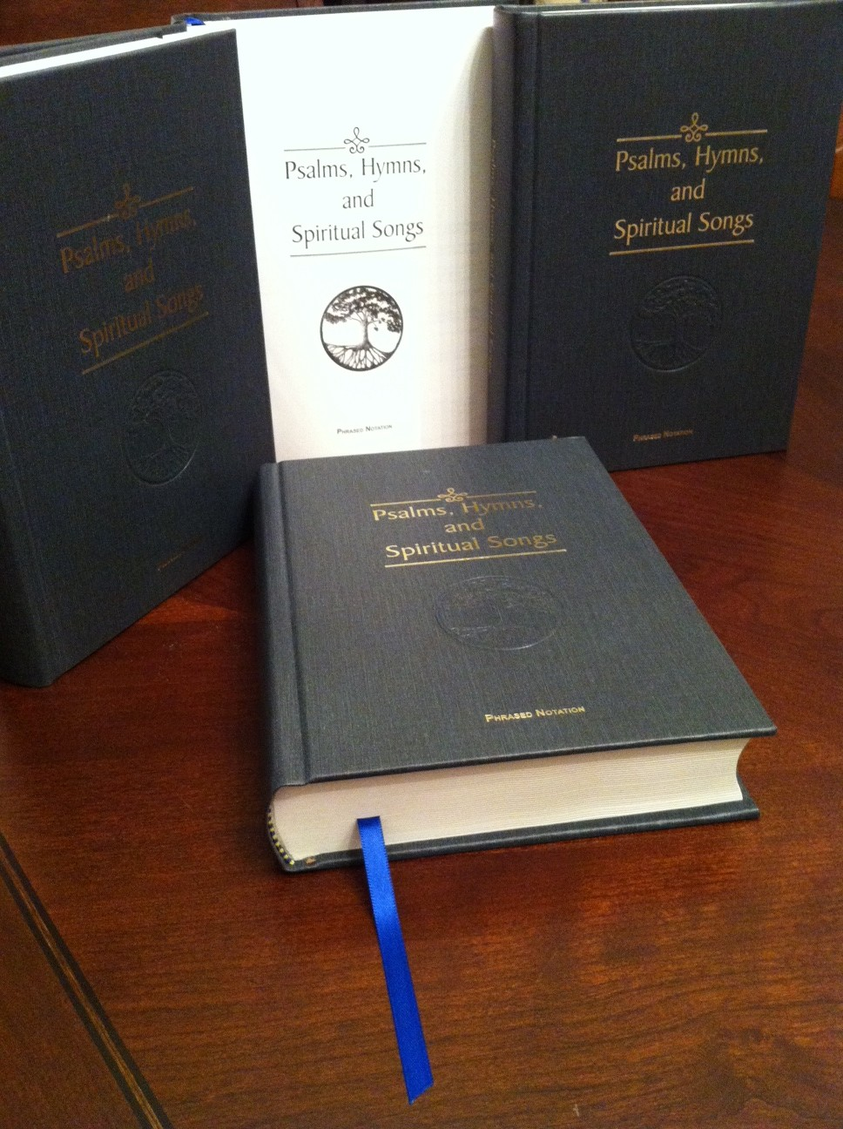

Psalms, Hymns, and Spiritual Songs

Slide 89
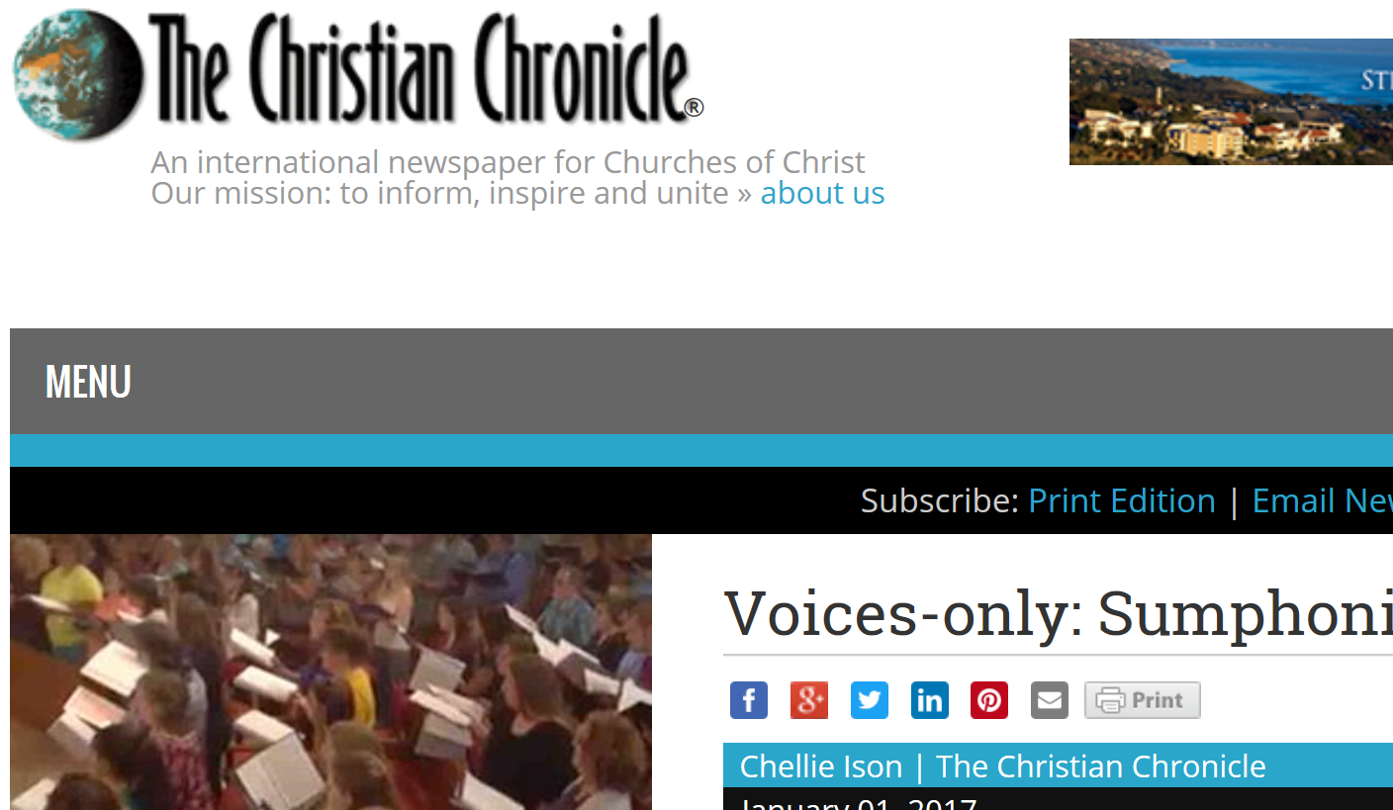
Christian Chronicle - Voices Only

Slide 90
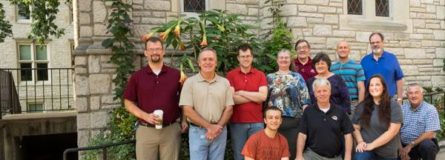
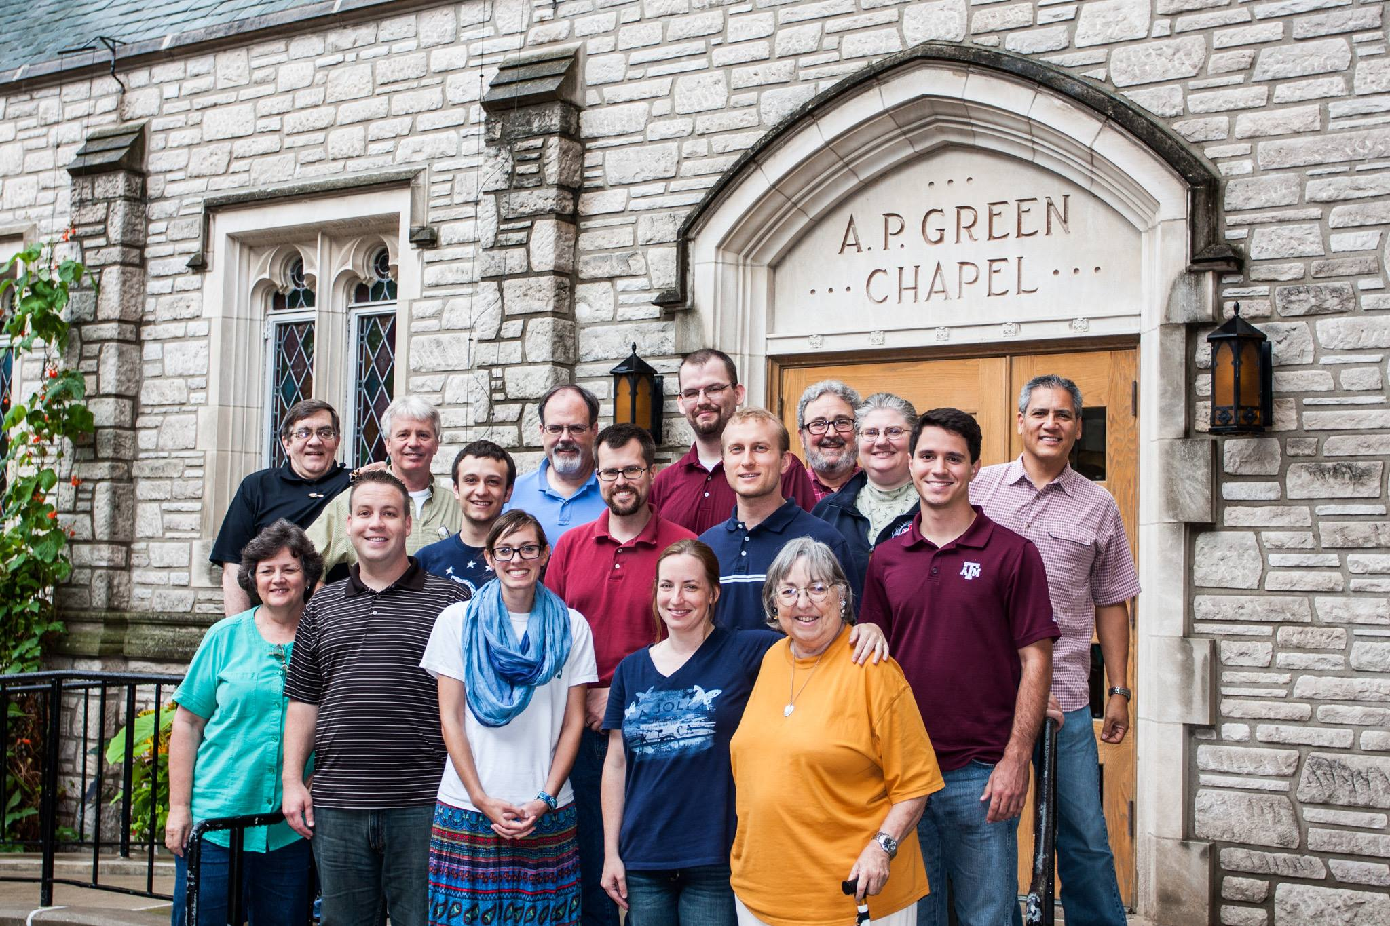
Hymn Writers Workshop University of Missouri

Slide 91
What Can We Do Together?
Examples: Institutions supported by individuals, not churches
Sacred Selections
Sumphonia
Leaving the Pit

Slide 92
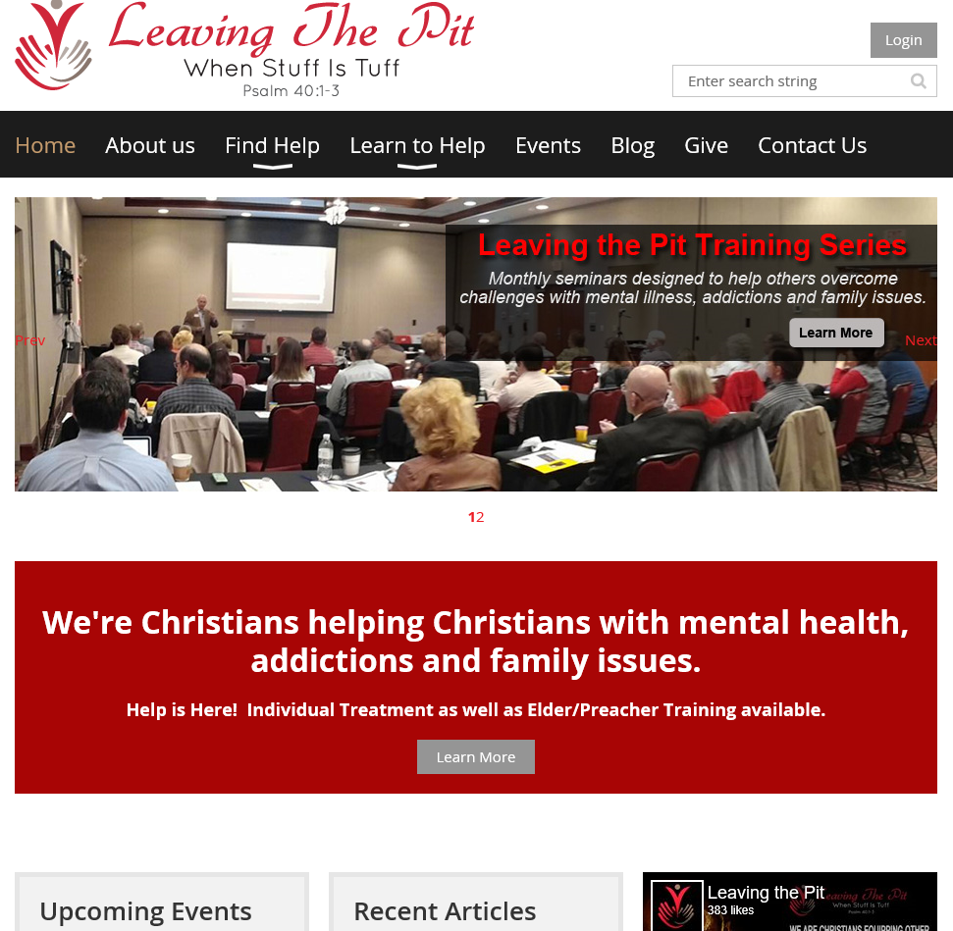
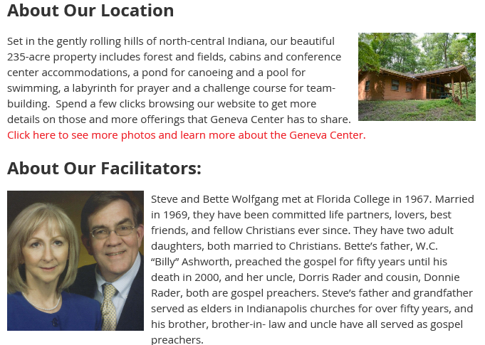

Slide 93
Introducing Leaving the Pit
Sample Monthly Training Topics, 2016
May 21 - Depression
June 18 – Grief, Loss & Betrayal
July 16 – Schizophrenia & Other Psychotic Disorders
August 20 – Crisis Intervention
September 17 – Parenting in Today’s World
October 15 – Coping with Anger
November 19 – ADD, ADHD, Asperger's & Autism
December 17 – Coping with Family Dysfunction

Slide 94

Leaving the Pit
Education
Online Support Groups
Consulting Services
Retreats
Residential Treatment
Trainer Certification

Slide 95
What Can We Do Together?
Examples: Institutions supported by individuals, not churches
Sacred Selections
Sumphonia
Leaving the Pit
Florida College

Slide 96
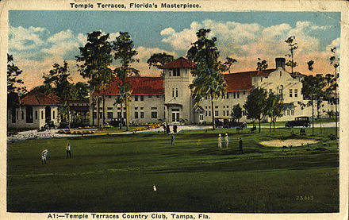

Florida College

Slide 97
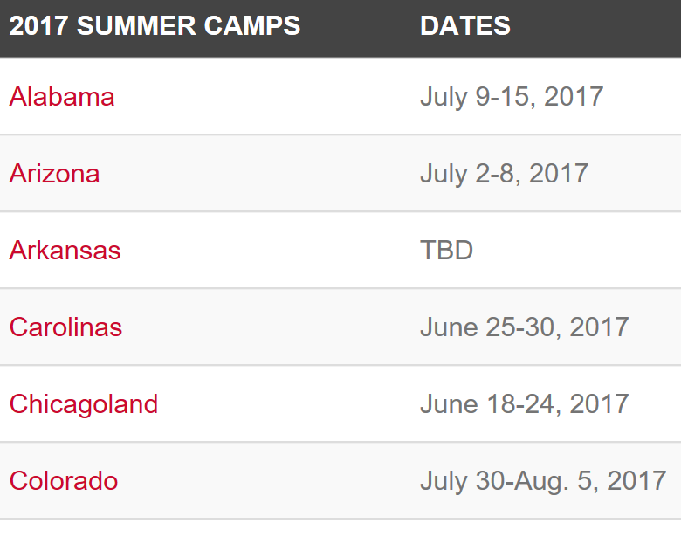
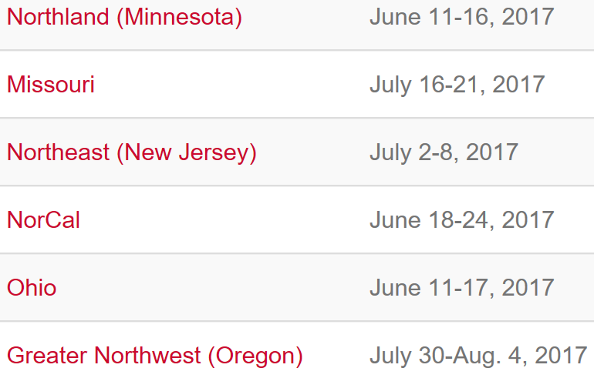
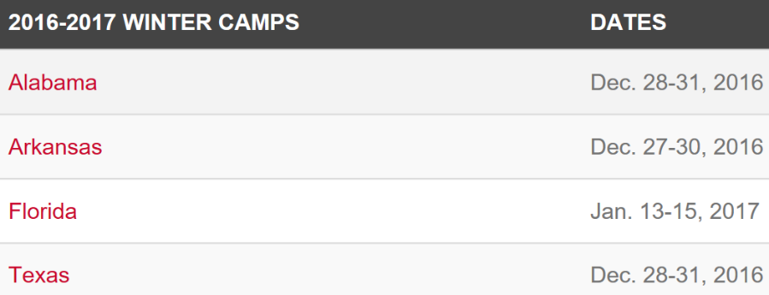
Florida College Camps

Slide 98
What Can We Do Together?
Examples: Institutions supported by individuals, not churches
Sacred Selections
Sumphonia
Leaving the Pit
Florida College
Truth Publications

Slide 99
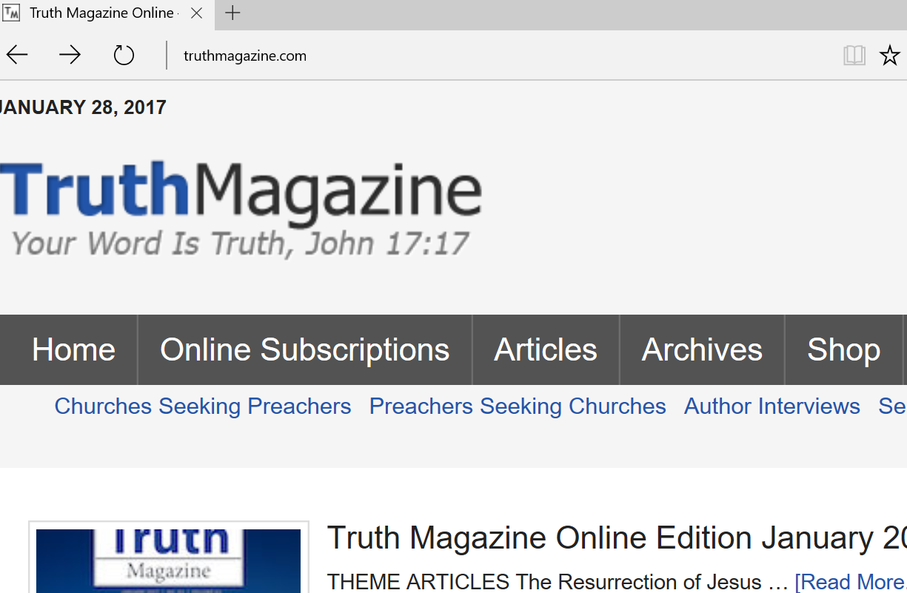
Truth Magazine Print / Digital / ElectronicArchive

Slide 100
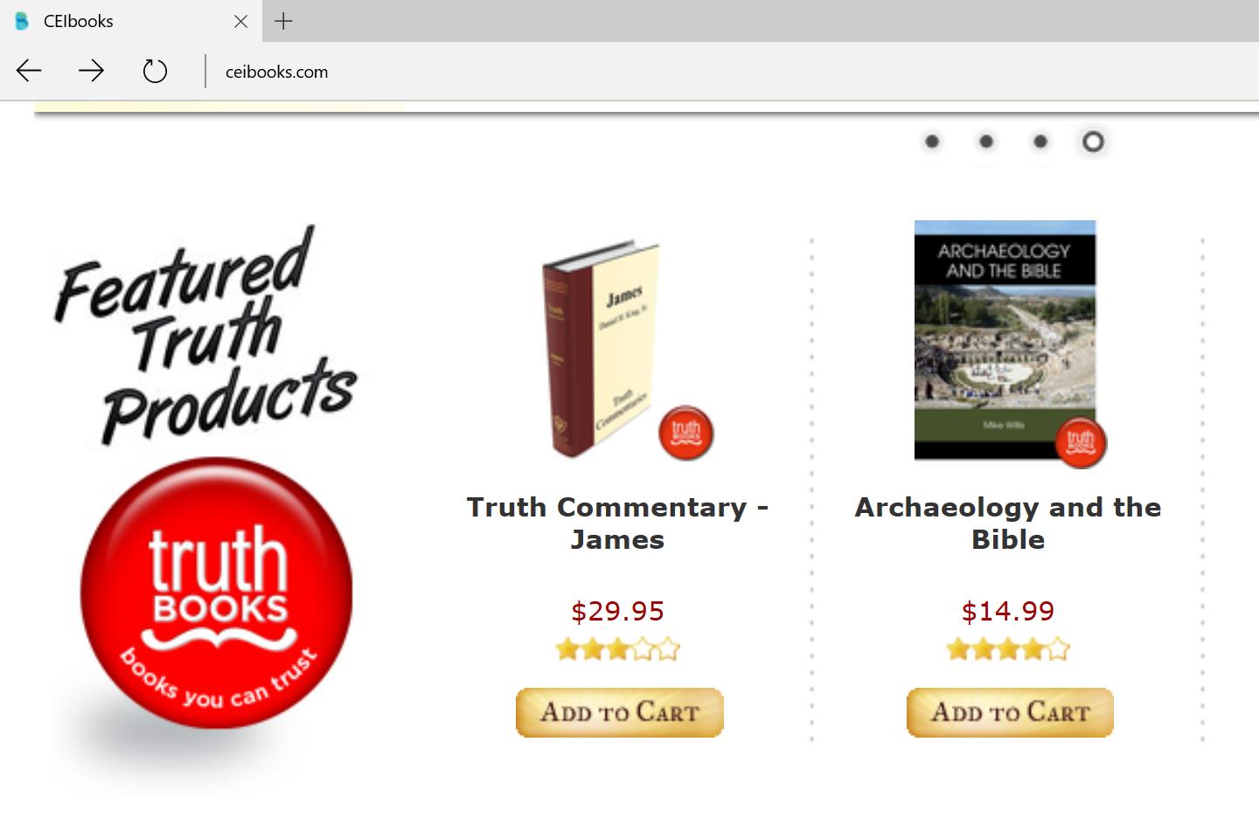
Truth Publications

Slide 103
Lipscomb-Apostasies
“Apostasies come – and will come. When they come, they come in the midst of an untaught, ease-loving, and self-serving generation.”

Slide 104
A More Accurate Lipscomb?
“Apostasies come and will come. They come where the cause is popular, where an ease-loving and popularity-seeking spirit prevails, and always manifest themselves among those who avoid controversy and discussion. To suppress discussion is to deprive truth of all its vantage ground.” David Lipscomb, May 29, 1930
Franklin Road News and Views, Volume 9 #18, May 9, 1961, p. 1
Charles M. Campbell, evangelist

Slide 106
12 Basic Concepts
1. That God has revealed in Scripture certain patterns for believers to follow in executing their collective duties in congregational work and worship (Hebrews 8:5)

Slide 107
12 Basic Concepts
2. That these “binding” patterns are expressed by
“generic” or “specific” statements;
specific accounts of action, and
necessary conclusions drawn from Scripture (cf. Acts 15)

Slide 108
12 Basic Concepts
3. That the “general” or more “generic” statements or commands allow differing optional or expedient ways of obeying those requirements, while specific statements or examples provide more restrictive instructions and do not authorize alternative procedures.

Slide 109
12 Basic Concepts
4. That the differences between “general and specific” can be detected, and distinguished from incidentals, or from a variety of expedient ways, by correctly following common sense hermeneutical principles

Slide 110
12 Basic Concepts
5. That the Scriptures enjoin upon Christians a broad range of individual duties, obligations and privileges which can be carried out in a variety of optional and expedient ways, that God may be glorified.

Slide 111
12 Basic Concepts
6. That, by contrast, the collective duties enjoined upon Christians in their collective congregational capacity, are fairly limited and consist of (a) assembling to worship God through prayer, vocal music, Bible study, proclamation of the gospel, and the first day of the week observance of the Lord’s Supper and financial collection to enable the congregation to carry out its collective responsibilities in discharging its own edificational and teaching duties, (b) assisting needy saints, (c) supporting preachers in their work of proclamation and teaching.

Slide 112
12 Basic Concepts
7. That, while some collective duties may overlap individual obligations (e.g., teaching, singing, prayer), individual and collective (congregational) activity are not identical and can be clearly distinguished one from the other.

Slide 113
12 Basic Concepts
8. That collective activity, requiring (a) a common mind, (b) acceptance and agreement of common supervision (by elders, if qualified), and (c) the pooling of resources (usually financial), should be limited to those activities clearly enjoined upon Christians acting together as a congregation, and while often fraught with possibilities of disagreement in matters of detail, should respect the conscience of others, even of weak or untaught brethren (Romans 14)

Slide 114
12 Basic Concepts
9. That, in regard to preaching the gospel, Scripture reveals that evangelism was accomplished by individual preachers, self-supported or remunerated by congregations (by example, directly, without the use of some intermediary or “sponsoring” church, or “missionary society,” whether called by that name or identified as a “steering committee” or other terminology – 2 Corinthians 11:8-9; Philippians 4:15-18

Slide 115
12 Basic Concepts
10. That Scripture nine times records that churches assisted their own needy saints, or sent funds for the temporary relief of congregations in “want,” – but that such relief was (a) temporary, (b) not sent from one prosperous church to another, and (c) never for purposes of evangelism in which each congregation has equal obligations to the limit of its ability. Most “conservatives” have stressed the independence and autonomy of each local congregation, insisting that twentieth-century “sponsoring-church” conglomerates or other centralizing tendencies, no less than missionary societies or Baptist associations and conventions, compromise New Testament principles regarding the nature of Christ’s church

Slide 116
12 Basic Concepts
11. That the church Jesus died to purchase is a spiritual institution with a uniquely spiritual function, and is therefore not to be remade into a hybrid welfare organization/country club responsible for alleviating social ills or for the entertainment of its members.

Slide 117
12 Basic Concepts
12. That human societies and institutions (hospitals, orphanages, colleges, publishing companies, etc.) which may be utilized as expedient means on a fee-for-service basis, are not be appended to the church and maintain their livelihood by church donations, and that all such attempts to make them parachurch or church-related institutions is foreign to the New Testament.

Slide 119
Institutional Growth
Orphanages
1909: Tennessee OH, Spring Hill
1914: Potter OH, Bowling Green, KY
Colleges and Churches
ACC 1919 (Henry E. Speck)
ACC 1938 (G.C. Brewer)
Orphanage-College Linkage
1947: N.B. Hardeman article
1962: B.B. Baxter tract-“stand/fall together”
Sponsoring Churches
Post WWII Missions: Japan, Italy, Germany
Television ministries

Slide 121
Religious Decline
“as denominations have modernized their doctrines and embraced temporal values, they have gone into decline . . . the message becomes more worldly, and is held with less certainty as religion becomes the focus of scholarly critique and attention . . . [the decline starts when they] begin to lift restrictions on behavior and to soften doctrines that had served to set [the group] apart from its social environment”
Roger Finke and Rodney Starke, The Churching of America, 1776-1990: Winners and Losers in Our Religious Economy (New Brunswick, NJ: Rutgers University Press, 1992), pp. 18, 84, 150, 169, 238; cf. pp. 249-55.

Slide 122
Religious Decline
“as the general affluence and social standing of a group rises, otherworldliness -- as expressed through tension with the environment -- becomes perceived as increasingly costly . . . religious organizations are stronger to the degree that they impose significant costs in terms of sacrifice and even stigma upon their members.”
Roger Finke and Rodney Starke, The Churching of America, 1776-1990: Winners and Losers in Our Religious Economy (New Brunswick, NJ: Rutgers University Press, 1992), pp. 18, 84, 150, 169, 238; cf. pp. 249-55.

Slide 123
Worldliness
“By worldliness I mean not merely the disregard of fundamentalist taboos against smoking, drinking, dancing, movie-going, gambling, and the like, but more expansively such matters as materialism, pleasure-seeking, indiscriminate enjoyment of salacious and violent entertainment, immodesty of dress, voyeurism, sexual laxity, and divorce...”
Gundry, Jesus the Word … p.77n18.

Slide 124
Expression of Concern
“We are deeply disturbed over the liberalism that is so evident in the brotherhood today. By ‘liberalism we mean especially the following items:
A. There is a drifting from the Bible-centered, definitive, distinctive doctrine that once characterized our preaching…many of our people, including preachers and elders, no longer know the difference between true Christianity and the corrupted forms of it so prevalent among us.”

Slide 125
Expression of Concern
There is a concerted effort on the part of some brethren to restructure the organization, worship and work of the church along sectarian lines…
A spirit of doctrinal compromise and fellowshipping of those in blatant religious error has permeated our ranks.

Slide 126
Expression of Concern
The world has made alarming inroads into the church. Instead of the church influencing the world for righteousness, the world has adversely affected many brethren in matters of morality and conduct of life.

Slide 127
Expression of Concern
E. The typical emphasis of the denominational world on recreation, entertainment, and solving the social ills of society has been incorporated into the programs of many congregations, supplanting the God-given work of meeting the spiritual needs of those both within and without the body of Christ.”

Slide 128
“Innocent” Beginnings
In the words of a widely-respected older preacher, “instrumental music only lets the cat out of the bag . . . After they bring in the instrument, baptism is no longer essential, and the church is just another denomination among denominations.”
Charles Hodge, “Facing the Instrumental Music Question Again,” Gospel Advocate 140 (February 1998), p. 24.

Slide 129
Willard Collins: The People Person Nashville: 20th Century Christian, 1986, 116-18
Asked to compare church members in the 1980’s with the 1930’s:
“I don’t think they see the glory of the church, unencumbered with denominationalism, as I did when I was growing up…
“I don’t think the members of the church see it as different from Protestantism”

Slide 130
Willard Collins: The People Person Nashville: 20th Century Christian, 1986, 116-18
Asked to compare church members in the 1980’s with the 1930’s:
When I started preaching, a lot of members of the church believed Protestants needed to be saved…
At an earlier time, they felt the church was a lot better than Protestantism.”

Slide 131
Incorrect in Details?
“It is consistent to believe that the Bible is authoritative in matters of faith and practice, but may be incorrect in geographical or historical details. Once a person abandons the concept of divine dictation, he must abandon the idea of inerrancy.”
John T. Willis, review of William J. Abraham, The Divine Inspiration of Scripture, in Restoration Quarterly 29:3 (Third Quarter, 1987) p. 169.

Slide 132
Incorrect in Details?
I would like to believe that this is a misprint, or that I have somehow misunderstood the author, but it would not be the first instance of doubt being cast upon the veracity of Scripture by those who are freely accepted and granted the “right hand of fellowship” by institutional brethren.
Steve Wolfgang, The Simple Pattern

Slide 133
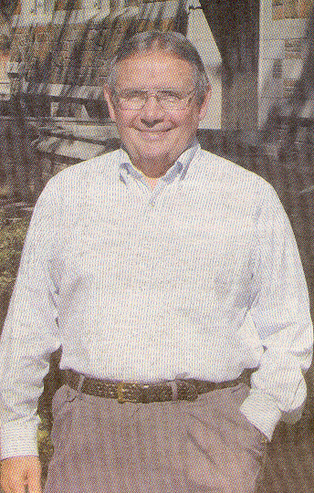
Abraham J.
Malherbe
Buckingham
Professor of
New Testament
Interpretation,
Yale University
BA, ACU
PhD, Harvard

Slide 134
Abraham J. Malherbe Christian Chronicle, February 2002
CC: What are some of your concerns for our fellowship?
AM: My major concern is our cozying up to those evangelicals who put a premium on feeling at the expense of reason...Evangelical priorities and language have come to suffuse much of preaching in our fellowship.
When the same, non-expository approach is followed in a church’s Bible classes, any Restorationist nuance easily disappears.

Slide 135
Abraham J. Malherbe Christian Chronicle, February 2002
“combined with the style of preaching, common in all churches these days, that is narratival and anecdotal rather than expository, results in sermons that are as theologically thin gruel as are many of the so-called praise songs we sing. It seems that the goal of many services is to achieve an emotional response without imparting biblical knowledge.”

Slide 136
What Is The Church?
Social Service Agency?
Entertainment Center?
Modified Country Club?
Human Invention?
Divine Institution?

Slide 137
The Church’s Mission?
Entertainment
Social Service
Medical Care
Secular Education
Job Placement
Scripture?____________

Slide 138
What Kind of Church Does Jesus Want?
Did Christ die for:
Day-care Centers
Job Placement Bureau
Adult Education Courses
Medical-Dental Clinics
English as 2nd Language Classes

Slide 139
Lipscomb-Apostasies
“Apostasies come – and will come. When they come, they come in the midst of an untaught, ease-loving, and self-serving generation.”

Slide 140
A More Accurate Lipscomb?
“Apostasies come and will come. They come where the cause is popular, where an ease-loving and popularity-seeking spirit prevails, and always manifest themselves among those who avoid controversy and discussion. To suppress discussion is to deprive truth of all its vantage ground.” David Lipscomb, May 29, 1930
Franklin Road News and Views, Volume 9 #18, May 9, 1961, p. 1
Charles M. Campbell, evangelist

Slide 142
Institutional “Issues” Defined
Papers
Gospel Advocate (1855) Bible Banner (1938)
Firm Foundation (1884) Gospel Guardian (1949)
Spiritual Sword (1958) Truth Magazine (1956)
Searching the Scriptures (1960)

Slide 143
Institutional “Issues” Defined
Papers
Gospel Advocate (1855) Bible Banner (1938)
Firm Foundation (1884) Gospel Guardian (1949)
Spiritual Sword (1958) Truth Magazine (1956)
Searching the Scriptures (1960)

Slide 144
Institutional “Issues” Defined
Papers
Gospel Advocate (1855) Bible Banner (1938)
Firm Foundation (1884) Gospel Guardian (1949)
Spiritual Sword (1958) Truth Magazine (1956)
Searching the Scriptures (1960)
Debates
Holt-Totty, Indianapolis, October 1954
Harper-Tant, Lufkin/Abilene, TX, Apr-Oct 1955
Porter-Woods, Indianapolis, January 1956
Cogdill-Woods, Birmingham, November 1957
Wallace-Holt, Florence, AL, December 1959

Slide 145
Beyond Debates
Arlington Meeting, 1968
Nashville Meeting, 1988
Dallas Meeting, 1990
The Simple Pattern / ECIC, 2011
Gospel Advocate meeting, May 2016

Slide 147
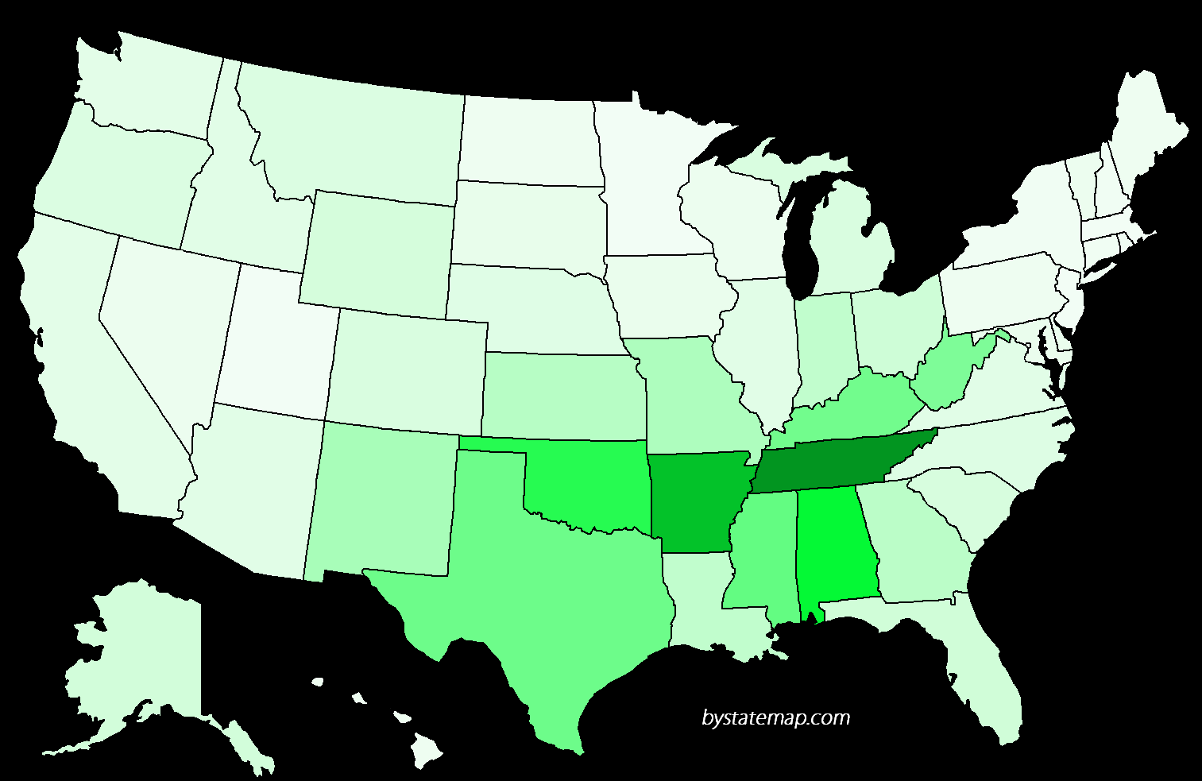
Churches of Christ – by State

Slide 148
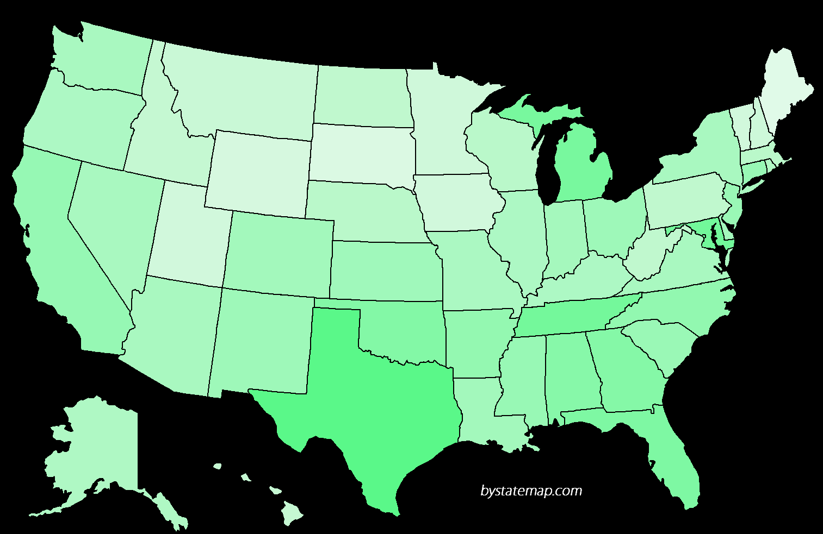
Churches of Christ – Size of Congregations

Slide 149
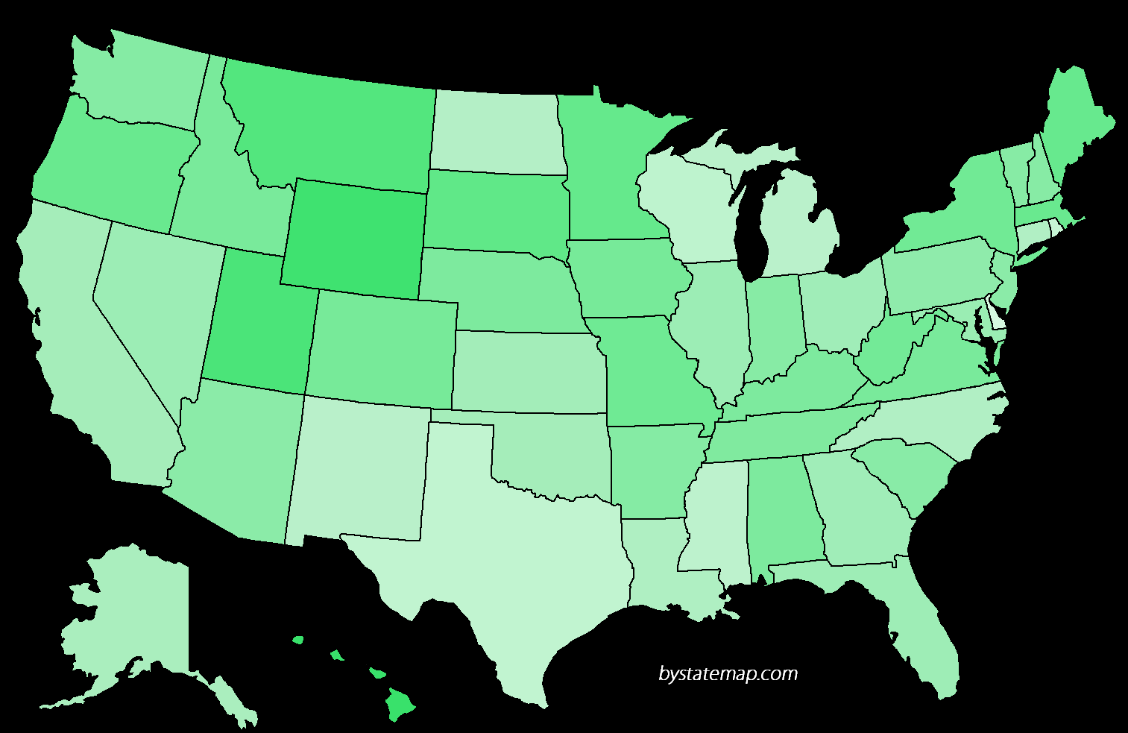
Churches of Christ by Attendance

Slide 150
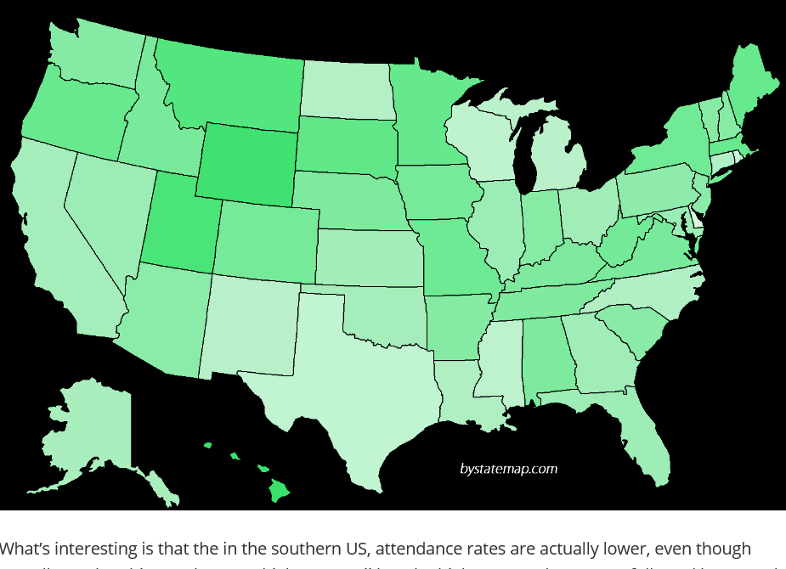

Slide 151
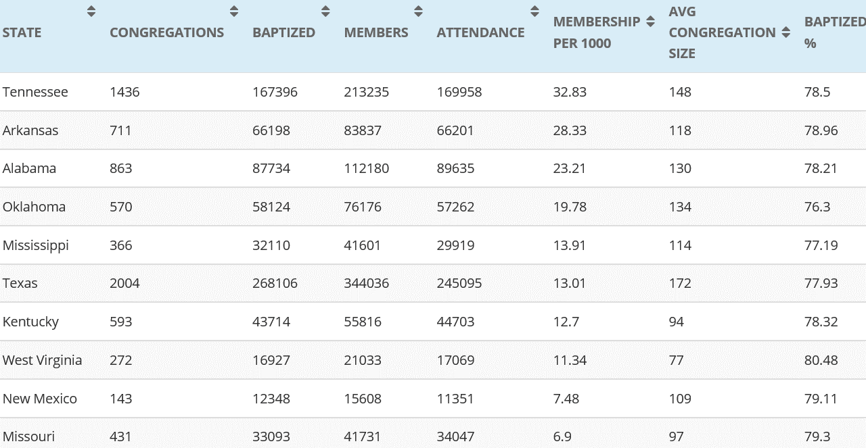
Data Set 21st Century Christian

Slide 152
Size of Congregations
Among all the congregations of the Churches of Christ in the United States, 34.6 % have fewer than 50 members; 63.3% have fewer than 100 members.

Slide 153
Number of Congregations
Of the 14 largest religious groups in America, ranked by number of congregations
Only three largest denominations have more congregatiosn than Churches of Christ
Those denominations are the United Methodist Church, the Southern Baptist Convention, and the Roman Catholic Church

Slide 154
Division and Dissent: Lutherans
Three Lutheran bodies merged in the 1980’s
ALC, LCA, AELC merged into the Evangelical Lutheran Church in America
Even after the merger, there remained 13 more Lutheran denominations in the US

Slide 155
Division and Dissent: Baptists
Southern Baptist Convention FAR more diverse beliefs than many other groups (including Churches of Christ)
Plus, more than 30 other separate Baptist denominations

Slide 156
Division and Dissent: Presbyterians
In the 1980’s, the PC in the USA merged with the United PC in the USA to form the Presbyterian Church in the USA
After merger, there were six other Presbyterian denominations

Slide 157
Division and Dissent
Methodists: 11 separate denominations
Mennonites: 11 separate denominations
Friends/Quakers: 7 separate denominations

Slide 159




The “UN-Cola”

Slide 160
What Does “Church” Mean?
Ekklesia = ek + kaleo
“called out, called together”
Called Out – 1 Peter 2:9
Usage = “Assembly”
Purpose – Acts 19:32,39,41
1 Corinthians 1:2,9,24;
Colossians 3:15

Slide 161
Two Meanings of “Church”
All saved, everywhere, of all time
“Universal” church
Hebrews 12:22-24
Non-Functional
Local congregation
Galatians 1:22, 1 Corinthians 16:1
Only Functioning Unit

Slide 162
Basic Ideas
God intended his church to be founded by His Son, organized and taught by chosen apostles who had authority to do so
God gave instructions which His creatures, whom He created in His image, can understand
These churches functioned as local congregations

Slide 164
What Is the Church of Christ?
Organization (Phil 1:1)
Officers (Acts 14:23)
-- Qualifications (1 Tim 3/Titus 1)
-- Responsibilities (1 Peter 5:1-4)
Assemblies (Heb 10:25, 1Cor 1:18)

Slide 165
What Is The Church of Christ?
Activities:
Sing (1 Cor 14:15)
Pray (Acts 12:5; 1 Cor 14:15)
Teach (Acts 20:7)
Lord’s Supper (1 Cor 11)
Give (1 Cor 16:1-2)

Slide 166
What Is The Church of Christ?
Activities:
Sing (1 Cor 14:15)
Pray (Acts 12:5; 1 Cor 14:15)
Teach (Acts 20:7)
Lord’s Supper (1 Cor 11)
Give (1 Cor 16:1-2)
Financial Activities (Acts 5:3-4)
Support Preaching (2 Cor 11:8)
Assist Needy Saints (Nine examples)
Edify the Body (Ephesians 4:12)

Slide 167
What Is The Church of Christ?
Activities:
Sing (1 Cor 14:15)
Pray (Acts 12:5; 1 Cor 14:15)
Teach (Acts 20:7)
Lord’s Supper (1 Cor 11)
Give (1 Cor 16:1-2)
Financial Activities (Acts 5:3-4)
Support Preaching (2 Cor 11:8)
Assist Needy Saints (Nine examples)
Edify the Body (Ephesians 4:12)
Discipline Members (1 Cor 5:1-13)

Slide 168
What Is The Church of Christ?
Activities:
Sing (1 Cor 14:15)
Pray (Acts 12:5; 1 Cor 14:15)
Teach (Acts 20:7)
Lord’s Supper (1 Cor 11)
Give (1 Cor 16:1-2)
Financial Activities (Acts 5:3-4)
Support Preaching (2 Cor 11:8)
Assist Needy Saints (Nine examples)
Edify the Body (Ephesians 4:12)
Discipline Members (1 Cor 5:1-13)
OTHER??________________

Slide 169
What Is The Church of Christ?
Organization
Officers
Assembly Times
Activities
Pooled Resources (Financial)
Disciplinary Procedures
Other??__________________

Slide 170
What Is The Church?
Social Service Agency?
Entertainment Center?
Modified Country Club?
Human Invention?
Divine Institution?

Slide 171
The Church’s Mission?
Entertainment
Social Service
Medical Care
Secular Education
Job Placement
Scripture?____________

Slide 172
Church of Christ Denominationalism
The Church: Spiritual or Social?
Worship: Worship Styles,
Entertainment, Women’s Roles?
Baptism: Just Another Doctrine?
Salvation: By Faith Only?
Fellowship: Moral Conservatives?

Slide 173
Restoration Principles
Divine Authority vs. Human
Opinions
Scripture vs. Human Creeds
Revelation vs. Family Traditions
“Christian” vs. Human Labels
New Testament Christianity vs.
Denominationalism

Slide 175
What “Church” Does Ephesians 4:11-16
Assembles
Evangelizes
“Ministries”
Edifies
Individual and Collective
Social Welfare? Relieve All?
Entertain? Cure Disease?
“Faith-Based?”

Slide 176
What is a Christian?
Believes in uniqueness of Jesus
Believes Jesus provided redemption of humankind by his death
Believes Jesus resurrected from dead
Baptism as initiation
Communion meal
Source: Hopfe and Woodward,
Religions of the World, p. 278

