Slide 1
DVR

Slide 2
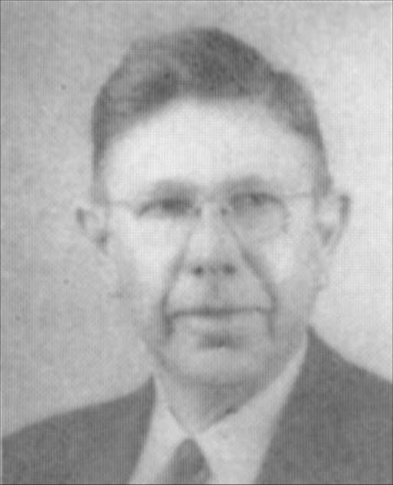

One issue between
non-institutional and institutional churches of Christ:
Can the church (out of its treasury) help those who are non-Christians?
1950’s – 1960’s – the scope of benevolence was not the dividing issue
Men like W. Curtis Porter refused to debate the question
In time men like A. C. Grider felt that it was an issue and debated it

Slide 3
The Scope of
Church Benevolence

Slide 4
The Scope of
Church Benevolence
The Issue

Slide 5
The Issue
The Issue is Not:
  Should care be given to the needy?
  Is the church obligated to some?
  Can individuals care for non-saints?
  Will care be provided for orphan children?
  Do non-saints deserve help?
  What are non-institutional brethren doing?
The Issue is:
  Can the church, out of its treasury, help those who are non-saints or can it help only saints?

Slide 6
The Scope of
Church Benevolence
The Issue
Who Can The Church Help?

Slide 7
Who Can The Church Help?
Acts 2:44-45 – believers
Acts 4:32-35 - believer
Acts 6:1-7 - disciples
Acts 11:27-30 – brethren
Romans 15:25-31 - saints
1 Corinthians 16:1-2 - saints
2 Corinthians 8:1-4 - saints
2 Corinthians 9:1-15 - saints
1 Timothy 5:16 – widow indeed

Slide 8
Who Can The Church Help?
Acts 2:44-45 – believers

Slide 9
Acts 2:44–45
⁴⁴ Now all who believed were together, and had all things in common,
⁴⁵ and sold their possessions and goods, and divided them among all, as anyone had need.

Slide 10
Who Can The Church Help?
Acts 2:44-45 – believers
Acts 4:32-35 - believers

Slide 11
Acts 4:32–35
³² Now the multitude of those who believed were of one heart and one soul; neither did anyone say that any of the things he possessed was his own, but they had all things in common.
³³ And with great power the apostles gave witness to the resurrection of the Lord Jesus. And great grace was upon them all.
³⁴ Nor was there anyone among them who lacked; for all who were possessors of lands or houses sold them, and brought the proceeds of the things that were sold, ³⁵ and laid them at the apostles’ feet; and they distributed to each as anyone had need.

Slide 12
Who Can The Church Help?
Acts 2:44-45 – believers
Acts 4:32-35 - believer
Acts 6:1-7 - disciples

Slide 13
Acts 6:1–7
Now in those days, when the number of the disciples was multiplying, there arose a complaint against the Hebrews by the Hellenists, because their widows were neglected in the daily distribution.
² Then the twelve summoned the multitude of the disciples and said, “It is not desirable that we should leave the word of God and serve tables….

Slide 14
Who Can The Church Help?
Acts 2:44-45 – believers
Acts 4:32-35 - believer
Acts 6:1-7 - disciples
Acts 11:27-30 – brethren

Slide 15
Acts 11:27–30
²⁷ And in these days prophets came from Jerusalem to Antioch.
²⁸ Then one of them, named Agabus, stood up and showed by the Spirit that there was going to be a great famine throughout all the world, which also happened in the days of Claudius Caesar.
²⁹ Then the disciples, each according to his ability, determined to send relief to the brethren dwelling in Judea.
³⁰ This they also did, and sent it to the elders by the hands of Barnabas and Saul.

Slide 16
Who Can The Church Help?
Acts 2:44-45 – believers
Acts 4:32-35 - believer
Acts 6:1-7 - disciples
Acts 11:27-30 – brethren
Romans 15:25-31 - saints

Slide 17
Romans 15:25–31
²⁵ But now I am going to Jerusalem to minister to the saints.
²⁶ For it pleased those from Macedonia and Achaia to make a certain contribution for the poor among the saints who are in Jerusalem.
²⁷ It pleased them indeed, and they are their debtors. For if the Gentiles have been partakers of their spiritual things, their duty is also to minister to them in material things.
²⁸ Therefore, when I have performed this and have sealed to them this fruit, I shall go by way of you to Spain.

Slide 18
Romans 15:25–31
²⁹ But I know that when I come to you, I shall come in the fullness of the blessing of the gospel of Christ.
³⁰ Now I beg you, brethren, through the Lord Jesus Christ, and through the love of the Spirit, that you strive together with me in prayers to God for me,
³¹ that I may be delivered from those in Judea who do not believe, and that my service for Jerusalem may be acceptable to the saints,

Slide 19
Who Can The Church Help?
Acts 2:44-45 – believers
Acts 4:32-35 - believer
Acts 6:1-7 - disciples
Acts 11:27-30 – brethren
Romans 15:25-31 - saints
1 Corinthians 16:1-2 - saints

Slide 20
1 Corinthians 16:1–2
Now concerning the collection for the saints, as I have given orders to the churches of Galatia, so you must do also:
² On the first day of the week let each one of you lay something aside, storing up as he may prosper, that there be no collections when I come.

Slide 21
Who Can The Church Help?
Acts 2:44-45 – believers
Acts 4:32-35 - believer
Acts 6:1-7 - disciples
Acts 11:27-30 – brethren
Romans 15:25-31 - saints
1 Corinthians 16:1-2 - saints
2 Corinthians 8:1-4 - saints

Slide 22
2 Corinthians 8:1–4
Moreover, brethren, we make known to you the grace of God bestowed on the churches of Macedonia:
² that in a great trial of affliction the abundance of their joy and their deep poverty abounded in the riches of their liberality.
³ For I bear witness that according to their ability, yes, and beyond their ability, they were freely willing,
⁴ imploring us with much urgency that we would receive the gift and the fellowship of the ministering to the saints.

Slide 23
Who Can The Church Help?
Acts 2:44-45 – believers
Acts 4:32-35 - believer
Acts 6:1-7 - disciples
Acts 11:27-30 – brethren
Romans 15:25-31 - saints
1 Corinthians 16:1-2 - saints
2 Corinthians 8:1-4 - saints
2 Corinthians 9:1-15 - saints

Slide 24
2 Corinthians 9:1-15
Now concerning the ministering to the saints, it is superfluous for me to write to you...
¹² For the administration of this service not only supplies the needs of the saints, but also is abounding through many thanksgivings to God…”

Slide 25
Who Can The Church Help?
Acts 2:44-45 – believers
Acts 4:32-35 - believer
Acts 6:1-7 - disciples
Acts 11:27-30 – brethren
Romans 15:25-31 - saints
1 Corinthians 16:1-2 - saints
2 Corinthians 8:1-4 - saints
2 Corinthians 9:1-15 - saints
1 Timothy 5:16 – widow indeed

Slide 26
1 Timothy 5:16
¹⁶ If any believing man or woman has widows, let them relieve them, and do not let the church be burdened, that it may relieve those who are really widows.
“really widows”
(“widows indeed” KJV)
=
“trusts in God”
(v. 5)

Slide 27
Who Can The Church Help?
Acts 2:44-45 – believers
Acts 4:32-35 - believer
Acts 6:1-7 - disciples
Acts 11:27-30 – brethren
Romans 15:25-31 - saints
1 Corinthians 16:1-2 - saints
2 Corinthians 8:1-4 - saints
2 Corinthians 9:1-15 - saints
1 Timothy 5:16 – widow indeed
Same Case / Event

Slide 28
Who Can The Church Relieve?
Saints
Non-Saints
Acts 2:44-45
Acts 4:32-35
Acts 6:1-7
Acts 11:27-30
Romans 15:25-31
1 Corinthians 16:1-2
2 Corinthians 8:1-4
2 Corinthians 9:1-15
1 Timothy 5:16
?
No Passage says, “Saints only” – but they only say “saints”

Slide 29
What Music Can We Offer?
Singing
Instrumental Music
Matt. 26:30
Mark 14:26
Acts 16:25
Rom. 15:9
1 Cor. 14:15
Eph. 5:19
Col. 3:16
Heb. 2:12
Heb. 13:15
Jas. 5:13
?
No Passage says, “sing only” – but they only say “sing”

Slide 30
The Scope of
Church Benevolence
The Issue
Who Can The Church Help?
Distinction Between the Individual and the Church

Slide 31
Distinction Between the Individual and the Church
Misconceptions about the church and individual
  “Individual is a church”
  “What the individual can do the church can do”
  “When individuals act, the church is acting”

Slide 32
Distinction Between the Individual and the Church
Misconceptions about the church and individual
The individual and the church are not the same
  The body has many members

Slide 33









  The body has many members
Individual
Church
“For as the body is one and has many members, but all the members of that one body, being many, are one body, so also is Christ” (1 Cor. 12:12).

Slide 34
  The body has many members
Individual
Church
Member
Many Members
“For in fact the body is not one member but many” (1 Cor.12:14)

Slide 35
  The body has many members
Individual
Church
Member
Many Members
“Now you are the body of Christ, and members individually” (1 Cor. 12:27)

Slide 36
  The body has many members
Individual
Church
“I wrote to the church, but Diotrephes, who loves to have the preeminence among them, does not receive us.
(3 John 9)
Diotrephes

Slide 37
Distinction Between the Individual and the Church
Misconceptions about the church and individual
The individual and the church are not the same
  The body has many members
  The role of the individual and the church are not the same

Slide 38
  The role of the individual and the church are not the same
Individual
Church
“If any believing man or woman has widows, let them relieve them…”
(1 Tim. 5:16)
“...and do not let the church be burdened, that it may relieve those who are really widows” (1 Tim. 5:16)

Slide 39
Distinction Between the Individual and the Church
Misconceptions about the church and individual
The individual and the church are not the same
  The body has many members
  The role of the individual and the church are not the same
  There is a difference in individual action, individuals acting together and collective action

Slide 40
  There is a difference in individual action, individuals acting together and collective action
Individual
Church
“Moreover if your brother sins against you, go and tell him his fault between you and him alone. If he hears you, you have gained your brother. But if he will not hear, take with you one or two more, that ‘by the mouth of two or three witnesses every word may be established’…”
“…And if he refuses to hear them, tell it to the church. But if he refuses even to hear the church, let him be to you like a heathen and a tax collector.
(Matt. 18:15-17)

Slide 41
  There is a difference in individual action, individuals acting together and collective action
Individual
Individuals
Church
“Moreover if your brother sins against you, go and tell him his fault between you and him alone. If he hears you, you have gained your brother.”
“…And if he refuses to hear them, tell it to the church. But if he refuses even to hear the church, let him be to you like a heathen and a tax collector.”
“But if he will not hear, take with you one or two more, that ‘by the mouth of two or three witnesses every word may be established’”

Slide 42
Distinction Between the Individual and the Church
Misconceptions about the church and individual
The individual and the church are not the same
Areas wherein the individual and the church differ
  They differ in work and responsibility

Slide 43
  They differ in work and responsibility
Individual
Church
“If any believing man or woman has widows, let them relieve them…”
(1 Tim. 5:16)
“...and do not let the church be burdened, that it may relieve those who are really widows” (1 Tim. 5:16)

Slide 44
Distinction Between the Individual and the Church
Misconceptions about the church and individual
The individual and the church are not the same
Areas wherein the individual and the church differ
  They differ in work and responsibility
  They differ in how money is obtained

Slide 45
  They differ in how money is obtained
Individual
Church
Get Money
Buy & Sell
(Jas. 4:13)
Get Money
Freewill Contribution
(1 Cor. 16:1-2)

Slide 46
Distinction Between the Individual and the Church
Misconceptions about the church and individual
The individual and the church are not the same
Areas wherein the individual and the church differ
  They differ in work and responsibility
  They differ in how money is obtained
  They differ in name

Slide 47
  They differ in name
Individual
Church
Name
Christian
(Acts 11:26
1 Pet. 4:16)
Name
Church of God
(1 Cor. 1:2)
Church of Christ
(Rom. 16:16)

Slide 48
Distinction Between the Individual and the Church
Misconceptions about the church and individual
The individual and the church are not the same
Areas wherein the individual and the church differ
Difference in individual and collective action

Slide 49
Link
Links
Chain

Slide 50
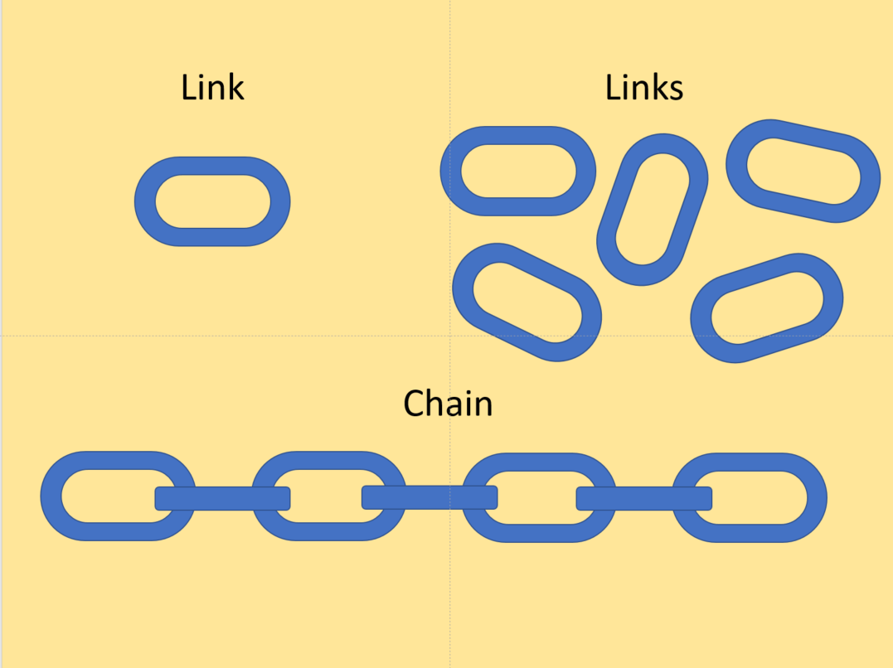
Individuals
Individual
Church

Slide 51
The “Church” May Act in:
Collective Sense
“denoting a number of persons or things considered as one group or whole flock is a collective word.”
https://www.merriam-webster.com/dictionary/collective
Distributive Sense
“referring singly and without exception to the members of a group each, either, and none are distributive.”
https://www.merriam-webster.com/dictionary/distributive

Slide 52
The “Church” May Act in:
Collective Sense
“..that it may relieve…”
(1 Tim. 5:16)
Acting as a unit
Distributive Sense
“…church… those who were scattered…”(KJV “they”)
(Acts 8:3-4)
Members acting – but not as a unit

Slide 53
  Summary
Individual
Church
Member
Care of Own
Individ. Kept Private
Buy & Sell
Christian
Diotrephes
Many Members
Church Not Burdened
Individ. Matters to Church
Contribution
“church of Christ”
Church = Them

Slide 54
  Conclusion
Individual
Church
The responsibility of the individual is not the responsibility of the church
What the individual does is not the actions of the church
Passages that address individual responsibility do not apply to the church

Slide 55
The Scope of
Church Benevolence
The Issue
Who Can The Church Help?
Distinction Between the Individual and the Church
Passages Used to Justify Benevolence to Non-Saints

Slide 56
Passages Used to Justify Benevolence to Non-Saints
James 1:27
Pure and undefiled religion before God and the Father is this: to visit orphans and widows in their trouble, and to keep oneself unspotted from the world.

Slide 57
Jas. 1:27
Pure and undefiled religion before God and the Father is this: to visit orphans and widows in their trouble, and to keep oneself unspotted from the world.
“…us…we…” (v. 18)
“…every man…” (v. 19)
“…man…” (v. 20)
“…your souls….” (v. 21)
“…yourselves…” (v. 22)
“…anyone…he…man...his…” (v. 23)
“…he…himself… man he….” (v. 24)
“…he…this one… he….” (v. 25)
“…anyone…he...his…his…one’s…” (v. 26)
“…oneself…” (v. 27)

Slide 58
Jas. 1:27
Pure and undefiled religion before God and the Father is this: to visit orphans and widows in their trouble, and to keep oneself unspotted from the world.
Individual?
or
Church?
to visit orphans and widows in their trouble,
and
to keep oneself unspotted from the world.
“oneself” (“himself” KJV) = Individual

Slide 59
Jas. 1:27
John 15:5
“…us…we…” (v. 18)
“…every man…” (v. 19)
“…man…” (v. 20)
“…your souls….” (v. 21)
“…yourselves…” (v. 22)
“…anyone…he…man...his…” (v. 23)
“…he…himself… man he….” (v. 24)
“…he…this one… he….” (v. 25)
“…anyone…he...his…his…one’s…” (v. 26)
“…oneself…” (v. 27)
“…you…you...” (v. 3)
“…branch...you…you…” (v. 4)
“…you are the branches…you…” (v. 5)
“…anyone…he…” (v. 6)
“…you…you, you…you.” (v. 7)
“…you…you will be my disciples.” (v. 8)

Slide 60
Passages Used to Justify Benevolence to Non-Saints
James 1:27
Galatians 6:10
Therefore, as we have opportunity, let us do good to all, especially to those who are of the household of faith.

Slide 61
Gal. 6:10
Therefore, as we have opportunity, let us do good to all, especially to those who are of the household of faith.
“…you who are spiritual…considering yourself lest you also be tempted (v. 1)
“…anyone…himself...he…he…” (v. 3)
“…let each one examine his own work…” (v. 4)
“…each one shall bear his own load” (v. 5)
“Let him who is taught in the word…” (v. 6)
“…whatever a man sows, that he will also reap” (v. 7)
“For he who sows to his flesh will of the flesh reap corruption…” (v. 8)
“…these would compel you to be circumcised…” (v. 12)

Slide 62
Gal. 6:10
Therefore, as we have opportunity, let us do good to all, especially to those who are of the household of faith.
“Let us do good to all…”
“Us” is first person plural
The speaker is included in the noun class
Was Paul an individual or a church?

Slide 63
Passages Used to Justify Benevolence to Non-Saints
James 1:27
Galatians 6:10
2 Corinthians 9:13
while, through the proof of this ministry, they glorify God for the obedience of your confession to the gospel of Christ, and for your liberal sharing with them and all men,
Saints
Non-Saints?

Slide 64
2 Cor. 9:13
while, through the proof of this ministry, they glorify God for the obedience of your confession to the gospel of Christ, and for your liberal sharing with them and all men,
When money was raised, it was for poor “saints” (Rom. 15:25; 1 Cor. 16:1)
Context (v. 1) – benevolence to saints
Those relieved:
  Offered thanksgiving (v. 12)
  Glorified God (v. 13)
  Received it with prayer (v. 14)
Those relieved had “fellowship” (cf. 8:4; 9:13)
Is “all men” limited at all?

Slide 65
Limited by Context
Universal
Acts 5:11
Gal. 6:10
1 Thess. 3:12
1 Thess. 5:15
Heb. 2:9
Limited
1 Tim. 5:20
Acts 2:45
Acts 4:33
Heb. 8:11
Gal. 3:26
“all”
(pantas)
?
2 Cor. 9:13

Slide 66
Parallels
1 Timothy 5:20
Those who are sinning rebuke in the presence of all, that the rest also may fear.
“them” (KJV) = saints (elders)
Does not demand non-saints
2 Corinthians 9:13
while, through the proof of this ministry, they glorify God for the obedience of your confession to the gospel of Christ, and for your liberal sharing with them and all men,
Saints at Jer.
Does not demand non-saints

Slide 67
Matthew 3:5 (KJV)
Then went out to him Jerusalem, and all Judaea, and all the region round about Jordan,
“An interesting grammatical parallel to this part-and-whole concept in 2 Corinthians 9:13 may be found in Matthew 3:5, which speaks of ‘Jerusalem and all Judea’ (Ierosoluma kai pasa hē Ioudaia) the city of Jerusalem is located within the providence of Judea. Possibly, Paul might be using kai in the ascensive sense, which would yield the following translation: ‘unto them, even unto all [of them].”
Curry, Melvin, Truth Commentaries, The Book of 2 Corinthians, 301, Bowling Green: Guardian of Truth Foundation.

Slide 68
2 Cor. 9:13
while, through the proof of this ministry, they glorify God for the obedience of your confession to the gospel of Christ, and for your liberal sharing with them and all men,
When money was raised, it was for poor “saints” (Rom. 15:25; 1 Cor. 16:1)
Context (v. 1) – benevolence to saints
Those relieved:
  Offered thanksgiving (v. 12)
  Glorified God (v. 13)
  Received it with prayer (v. 14)
Those relieved has “fellowship” (cf. 8:4; 9:13)
Is “all men” limited at all?
To whom does “all men” refer?

Slide 69
“them and all men”
Saints at Jerusalem
Other saints
Secondly, the saints are seen as glorifying God “also for the single-mindedness of (your) fellowship with them and with all,” i.e., all other saints.
Lenski, R. C. H. (1963). The interpretation of St. Paul’s First and Second epistle to the Corinthians (p. 1185). Minneapolis, MN: Augsburg Publishing House.

Slide 70
“them and all men”
Saints at Jerusalem
Other saints
Paul uses this word, κοινωνία, in speaking of the collection at 8:4; Rom. 15:26) with them, and with all (that is, with all Christians; Paul is not here thinking of charity beyond the bounds of the Christian society, within which there is a special mutuality of love; cf. Gal. 6:10). That is, they glorify God not simply for a share (this is behind the word fellowship) in the Corinthians’ resources, but for the quality of Christian life exemplified in it; not only because the Corinthians show this quality to them, but because they manifest it universally (though not in all cases in the same way, that is, by a gift of money).
Barrett, C. K. (1973). The Second Epistle to the Corinthians (p. 241). London: Continuum.

Slide 71
“them and all men”
Saints at Jerusalem
Other saints
Seeing their obedience and fidelity to the gospel of Christ, and their liberality to the poor saints in Jerusalem in the offerings they made, prompted them to glorify God for their professed subjection to the gospel of Christ, and their beneficence to all men, for their liberality showed that they excluded no Christian from their fellowship.
Lipscomb, David, New Testament Commentaries, II Corinthians and Galatians, 195. Nashville: Gospel Advocate Company,

Slide 72
“them and all men”
Saints at Jerusalem
Other saints
The interpolation all men (KJV, NKJV) unreasonably implies, contrary to the context, that Paul at the end of this discussion of the collection for the poor saints in Jerusalem suddenly includes unbelievers in the scope of benevolence.
Curry, Melvin, ibid., 301.

Slide 73
“them and all men”
Saints at Jerusalem
Other saints
While the demonstration of fellowship took the form of a contribution, for Paul the contribution was a sign of fellowship. Several interpretations and translations are possible: “the sincerity of your fellowship with them”; “the generosity of your fellowship with them” (NVSR, TEV,); “the generosity with which you are united with them” (LPD, NBE).
The pronoun them refers to the “saints” in Jerusalem. All others refers to Christians in other places.
Omanson, R. L., & Ellington, J. (1993). A Handbook on Paul’s Second Letter to the Corinthians (p. 172). New York: United Bible Societies.

Slide 74
The Scope of
Church Benevolence
The Issue
Who Can The Church Help?
Distinction Between the Individual and the Church
Passages Used to Justify Benevolence to Non-Saints
All of Us Believe in Limited Benevolence

Slide 75
All of Us Believe in Limited Benevolence
Church Cannot
Relieve
Lazy Man
(2 Thess. 3:10)
Church Cannot
Relieve
Individual’s Widow
(1 Tim. 5:16)
All Agree
Doesn’t mean that anyone is heartless
Doesn’t mean we don’t believe in helping the needy
Doesn’t mean that church can’t relieve some
Emotional pleas – will apply to these as well!

Slide 76
The Scope of
Church Benevolence
The Issue
Who Can The Church Help?
Distinction Between the Individual and the Church
Passages Used to Justify Benevolence to Non-Saints
All of Us Believe in Limited Benevolence

Slide 78

The Premise
1 Cor. 11
Instructions
Lord’s Supper
Therefore
Jas. 1:27
Gal. 6:10
V. 28
V. 33

Slide 79
Command to Observe
the Lord’s Supper
Applies
Some commands (by their nature) involve individual responsibility, yet done in conjunction with others
  Lord’s Supper
  Singing
  Giving
  Praying
  Withdrawing
Nothing in Jas. 1:27 or Gal. 6:10 – that shows these are done in the assembly or in conjunction with others!

Slide 80
1 Corinthians 11:26–28
²⁶ For as often as you eat this bread and drink this cup, you proclaim the Lord’s death till He comes.
²⁷ Therefore whoever eats this bread or drinks this cup of the Lord in an unworthy manner will be guilty of the body and blood of the Lord.
²⁸ But let a man examine himself, and so let him eat of the bread and drink of the cup.
While Done In The Assembly
Eating
&
Examining
Are Individual Actions!
Or
Is the Examination
Done Collectively?

Slide 81
The Premise Applied
1 Cor. 11
Instructions
Lord’s Supper
Therefore
Care Own Widow
(1 Tim. 5:16)
Love wife
(Eph. 5:25)
Name Christian
(1 Pet. 4:16)
V. 28
V. 33

Slide 83
If Jas. 1:27
Is Only Individual Action
If Jas. 1:27
Applies to Church Action
Each person must provide for fatherless and widows
Those unable to do so are not able to exhibit such religion before God
Terms are plural: thus each individual must provide for a plurality of widows and orphans
Each church must provide for fatherless and widows
Those unable to do so are not able to exhibit such religion before God
Terms are plural: thus each church must provide for a plurality of widows and orphans

Slide 84
If Jas. 1:27
Is Only Individual Action
If 1 Tim. 5:16a
Is Only Individual Action
Each person must provide for fatherless and widows
Those unable to do so are not able to exhibit such religion before God
Terms are plural: thus each individual must provide for a plurality of widows and orphans
Each person must provide for widows
Term “widows” is plural: thus each individual must provide for a plurality of widows

Slide 85
If Jas. 1:27
Is Only Individual Action
What is the Point?
Sounds like saying that Jas. 1:27 cannot be fulfilled unless it is applied to church!
Each person must provide for fatherless and widows
Those unable to do so are not able to exhibit such religion before God
Terms are plural: thus each individual must provide for a plurality of widows and orphans
“James tell us WHAT IS TO BE DONE, and Paul tell us WHO IS TO DO IT!”

