Slide 1
The Role of Women In The Local Church
The Gender Inclusive Movement

Slide 2
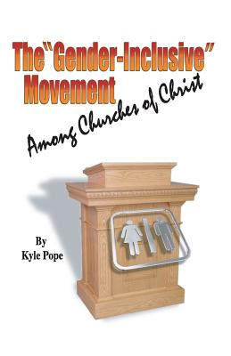
The Role of Women in the Local Church
“If history is any indication what begins in the mainstream doesn’t take long to creep in even among those who once were the most conservative. May we prepare ourselves to face this emotional and culturally explosive issue with love, courage, and a fervent love for God and His word.”

Slide 3
Is There A Threat?
Website:
“Where the Spirit Leads” maintained by Willy Clarkson expresses the objectives of the movement which he describes as a call to “Gender Equality and Inclusivity in the Churches of Christ.”

Slide 4
Is There A Threat?
Criteria to be met to be on the list:
Does this church use women in the worship to help lead by leading prayer, giving communion talks, leading singing, etc.?
Are women used to their fullest capabilities to teach all groups regardless of gender in Bible classes?
Do women serve in leadership positions such as pulpit minister, worship leader, deacon, and elder?
Does the church publish a clear statement of purpose to be an egalitarian church or gender inclusive church on their website?
Is a woman serving only in the position of Children’s Minister or Women’s Minister and none of the above apply?

Slide 5
Is There A Threat?
Clarkson predicts, “The issue of women’s roles in the teaching, worship, ministry and leadership of the Churches of Christ…will be the single most discussed and divisive issue in the first few years of the 21st Century.”

Slide 6
How Did We Get To This Place?
Royce Money: “Is it coincidence that we developed a controversy about the role of women in the assembly about the time we developed the idea of a new hermeneutic? It is certainly true that you cannot biblically justify the leadership role of women in the assembly by using the old hermeneutic! If you cannot prove that it is right to do something with the old hermeneutic, you must adopt a new one, or abandon the idea” (Christian Chronicle, 5/93).

Slide 7
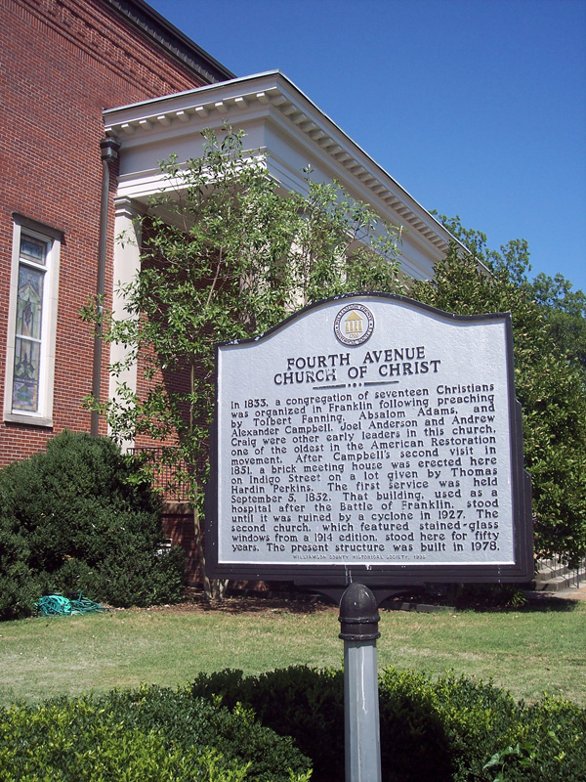
How Did We Get To This Place?
Tragedy of an Emotionally Driven Hermeneutic:
“The Lord made it very clear to me through prayer and discernment that I should put an emphasis on preaching…the way I perceive the Lord’s will is when I have peace…when I have peace the Lord is telling me ‘Yes.’”

Slide 8
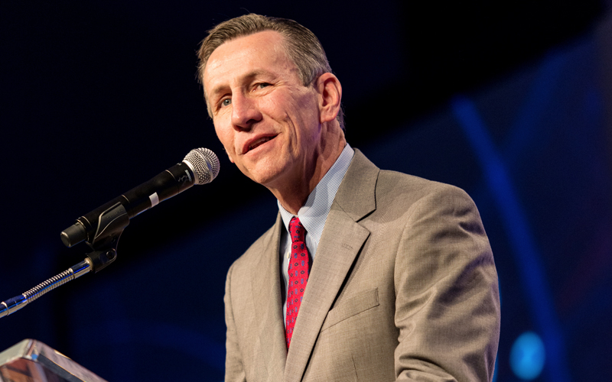
How Did We Get To This Place?
Rick Atchley made the following statement regarding his reasoning: “Right there at that spot about 1994 the Holy Spirit said to me in the middle of my sermon, ‘and that is what you and all the preachers like you were doing, who have not for years believed that the worship of God with instruments is wrong. But you continue by your silence to let people think its wrong…’”

Slide 9
How Did We Get To This Place?
“Is there any doubt in your minds that the Holy Spirit is alive and well and calling God’s Church to open itself to all those whom Jesus loves? We don’t worship a God who is all locked up in Scripture 2000 years ago” (Robinson, 2006)
Robinson once again attributed his position regarding homosexuality, in spite of scriptural condemnation of such conduct to the progressive leading of the Holy Spirit, according to Cathy Lynn Grossman of USA Today in an article entitled, “Gay Episcopal Bishop says, ‘Holy Spirit Led Us.’”

Slide 10
How Did We Get To This Place?
She went on to report the following in the article, “The openly gay Episcopal bishop whose ordination threatens to fracture the worldwide Anglican Communion said Wednesday he ‘genuinely and deeply regrets’ the pain this caused some believers, but he sees no need to repent because ‘the Holy Spirit led us’” (Grossman, 2004).

Slide 11
How Did We Get To This Place?
The Need To Emphasize the Significant Role of Godly Women:
Prophesied (Acts 2:17-18; 21:9; I Cor. 11:5).
Offered correction (Acts 18:26).
Mentor younger women (Tit. 2:6-8).
Co-workers and supporters of preachers (Rom. 16:2, 6, 12; Phil. 4:2, 3 I Tim. 5:3-16).

Slide 12
A Possible List of Women Preachers?
Mary of Nazareth
Anna, a prophetess
Four women at the tomb
Samaritan Woman
Joanna and Susanna
Martha and Mary
Mary Magdalene
Tabitha
Mary, John Mark's mother
Lydia
Priscilla
Philip's four daughters
Mary of Rome
Tryphena and Tryphosa
Rufus' mother
Euodia and Syntyche
Prophet’s wives
Eunice & Lois
Aged women
When did any of these women preach in an assembly of the local church?
Which did the work of an evangelist (II Timothy 4:5)?
Which ever taught over a man (I Timothy 2:12)?
Which of them taught with “all authority? (Titus 2:15)?
When did a woman take on the office and work of an elder?

Slide 13
How Did We Get To This Place?
The Word of God Must Determine Our Belief and Practice

Slide 14
What Is The Issue?
The Issue Is Not:
Are women and men of equal value in the sight of God?
Are women gifted by God’s providence?
Are women an integral part of the well being of a local church?
Are women insightful and knowledgeable bible students?

Slide 15
What Is The Issue?
The Issue Is:
Understanding God prescribed and authorized will for various roles within the local church.
Recognizing the power and freedom of submission (Phil. 2:5-8).
God’s design and purpose (I Tim. 2:9-15).

Slide 16
Equality In Christ
Does Oneness in Nature and Purpose Deny Diversity of Function?
Examination of Galatians 3:28
Jesus is equal to the Father in nature, but submits to Him in function (Heb. 1:3, 8; John 14:28).
Submit to civil authorities (Rom. 13:1).
Members submit to shepherds (Heb. 13:17)
Godly wife submits to her husband (I Peter 3:7; Eph. 5:22-33).

Slide 17
Acts 18:24-26 | I Tim. 2:11-13 | I Cor. 14
Teaching outside of the assembly Aquila and Priscilla both explained the truth to Apollos Priscilla is permitted to submissively teach a man | Demeanor of godliness Modest behavior Learn in quietness Do not usurp authority over a man in spiritual matters Includes, but is not exhausted by the assembly | “When you come together as a church” (11:18; 14:23) “In the church” Congregational assembly (11:18, 22; 12:28; 14:4, 5, 12, 19, 23, 28, 35) Women are to be silent in the assembly (34, 35)

Slide 18
Restrictions of Text
Tongue speaker without an interpreter is to be silent (14:28).
Prophet was to be silent until the other prophet finished speaking (14:30).
Women are to be silent (14:34, 35).
Exceptions: Singing (Col. 3:16; Eph. 5:19); confessing faith (Matt. 10:32, 33; Rom. 10:9-10).

Slide 19
When Are We In The Church?
Universal (Matt. 16:18; Acts 2:47).
Local (Phil. 1:1; I Cor. 1:2; Acts 9:26).
Assembly (Matthew 18:17; Col. 4:16; I Cor. 11:18; 14:28, 34, 35).
Not merely individual believers (Matt. 18:15-17; I Tim. 5:16).
Not merely a group of Christians participating in an act.
If the stated purpose of an assembly is that a congregation has “come together as a church” the principles of I Cor. 14:34, 35 must be applied.

Slide 20
Women as Elders and Deacons?
Elders and Deacons must be the “husband of one wife” (I Tim. 3:2, 12).
Were there deaconesses in the N.T.
Technical vs. Non-technical usage of the term.
Phoebe was a servant of the church in a non-technical and generic sense.

Slide 21
“Do not sharply rebuke an older man, but rather appeal to him as a father, to the younger men as brothers, the older women as mothers, and the younger women as sisters in all purity”
(I Timothy 5:1, 2).

