Slide 2
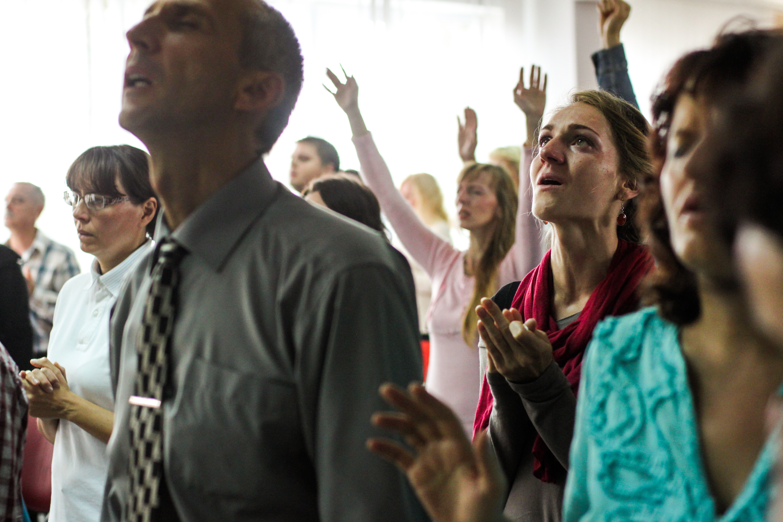
Neo-Pentecostalism • Emotionalism
ECI • Oct. 1-2, 2018 • Cullman, AL

Slide 3

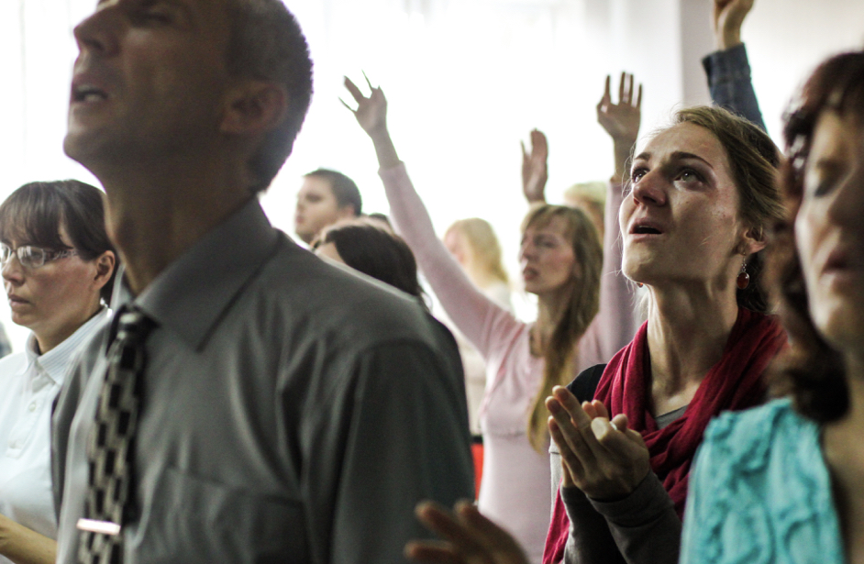
Neo-Pentecostalism • Emotionalism
Tenets & Consequences
Where are we going?
Pentecost - Biblical origin (OT)
Pentecost - Biblical significance (NT)
Definitions - P/NP/E
Pentecostalism - Primary Emphasis
Emotionalism - Roots/Thoughts
Pentecostalism - Our attitudes and response

Slide 4
Neo-Pentecostalism • Emotionalism
Tenets & Consequences
Pentecost - Biblical origin (OT)
Pentecost
“Pentecost, Feast Of. In Lv. 23:16 LXX reads penteœkonta heœmeras for the Heb. hΩ∞mis¥s¥ˆîm yo®m, ‘fifty days,’ referring to the number of days from the offering of the barley sheaf at the beginning of the Passover. On the 50th day was the Feast of Pentecost. Since the time elapsed was 7 weeks, it was called hΩagœ s¥aœb≈u{o®t≈, ‘feast of weeks’ (Ex. 34:22; Dt. 16:10). It marks the completion of the barley harvest, which began when the sickle was first put to the grain (Dt. 16:9), and when the sheaf was waved ‘the morrow after the sabbath’ (Lv. 23:11). It is also called hΩagœ haqqaœsΩˆîr, ‘feast of harvest’, and yo®m habbikku®rˆîm, ‘day of the first fruits’ (Ex. 23:16; Nu. 28:26). The feast is not limited to the times of the Pentateuch, but its observance is indicated in the days of Solomon (2 Ch. 8:13), as the second of the three annual festivals (cf. Dt. 16:16). [“Pentecost, Feast Of,” NBD, 898-899.]

Slide 5
Neo-Pentecostalism • Emotionalism
Tenets & Consequences
Pentecost - Biblical origin (OT)
Pentecost
The feast was proclaimed as a ‘holy convocation’ on which no servile work was to be done, and at which every male Israelite was required to appear at the sanctuary (Lv. 23:21). Two baked loaves of new, fine, leavened flour were brought out of the dwellings and waved by the priest before the Lord, together with the offerings of animal sacrifice for sin- and peace-offerings (Lv. 23:17–20). As a day of joy (Dt. 16:16) it is evident that on it the devout Israelite expressed gratitude for the blessings of the grain harvest and experienced heartfelt fear of the Lord (Je. 5:24). But it was the thanksgiving and fear of a redeemed people, for the service was not without sin- and peace-offerings, and was, moreover, a reminder of their deliverance from Egypt (Dt. 16:12) as God’s covenant people (Lv. 23:22). The ground of acceptance of the offering presupposes the removal of sin and reconciliation with God. [“Pentecost, Feast Of,” NBD, 898-899.]

Slide 6
Neo-Pentecostalism • Emotionalism
Tenets & Consequences
Pentecost - Biblical origin (OT)
Pentecost
In the intertestamental period and later, Pentecost was regarded as the anniversary of the law-giving at Sinai (Jubilees 1:1 with 6:17; TB, PesahΩim 68b; Midrash, TanhΩuma 26c). The Sadducees celebrated it on the 50th day (inclusive reckoning) from the first Sunday after Passover (taking the ‘sabbath’ of Lv. 23:15 to be the weekly sabbath); their reckoning regulated the public observance so long as the Temple stood, and the church is therefore justified in commemorating the first Christian Pentecost on a Sunday (Whit Sunday). The Pharisees, however, interpreted the ‘sabbath’ of Lv. 23:15 as the Festival of Unleavened Bread (cf. Lv. 23:7), and their reckoning became normative in Judaism after AD 70, so that in the Jewish calendar Pentecost now falls on various days of the week. [“Pentecost, Feast Of,” NBD, 898-899.]

Slide 7
Neo-Pentecostalism • Emotionalism
Tenets & Consequences
Pentecost - Biblical origin (OT)
Pentecost
In the NT there are three references to Pentecost: (1) Acts 2:1 (Gk. teœn heœmeran teœs penteœkosteœs). On this day, after the resurrection and ascension of Christ (c. AD 30), the disciples were gathered in a house in Jerusalem, and were visited with signs from heaven. The Holy Spirit descended upon them, and new life, power and blessing was evident, which Peter explained was in fulfilment of the prophecy of Joel. (2) Acts 20:16. Paul was determined not to spend time in Asia and made speed to be in Jerusalem by the day of Pentecost (AD 57). (3) 1 Cor. 16:8. Paul purposed to stay at Ephesus until Pentecost (AD 54 or 55), because an effectual door was opened to him for his ministry.” [“Pentecost, Feast Of,” NBD, 898-899.]

Slide 8
Neo-Pentecostalism • Emotionalism
Tenets & Consequences
Pentecost - Biblical origin (OT)
Three feasts
Deut. 16:16 “Three times a year all your males shall appear before the LORD your God in the place which He chooses: at the Feast of Unleavened Bread, at the Feast of Weeks, and at the Feast of Tabernacles; and they shall not appear before the LORD empty-handed.
Feast of Unleavened Bread • Passover
Feast of Weeks • Feast of Harvest • Pentecost
Feast of Tabernacles • Feast of Booths • Feast of Ingathering

Slide 9
Neo-Pentecostalism • Emotionalism
Tenets & Consequences
Pentecost - Biblical origin (OT)
Feast of harvest
Ex. 23:16 “and the Feast of Harvest, the firstfruits of your labors which you have sown in the field; and the Feast of Ingathering at the end of the year, when you have gathered in the fruit of your labors from the field.”
Feast of weeks
Lev. 23:15-21 “And you shall count for yourselves from the day after the Sabbath, from the day that you brought the sheaf of the wave offering: seven Sabbaths shall be completed. Count fifty days to the day after the seventh Sabbath; then you shall offer a new grain offering to the LORD….” (cf. Deut. 16.9-12)

Slide 10
Neo-Pentecostalism • Emotionalism
Tenets & Consequences
Pentecost - Biblical origin (OT)
Feast of weeks/harvest - significance
all three feasts emphasized
agricultural bounty • God’s historical acts/deliverance for/of Israel
Feast of Harvest, 50 days after first ripened grain, emphasized
Israel: blessed by God • worship of God • offerings to God
first fruits • memorial • care for the poor • care for the stranger
remembrance of Egyptian bondage & Exodus

Slide 11
Neo-Pentecostalism • Emotionalism
Tenets & Consequences
Pentecost - Biblical significance (NT)
Fulfillment:
Promise of the Spirit to the apostles • Joel’s prophecy fulfilled
God’s plans in/through Christ fulfilled • David prophecies fulfilled
Resurrection prophecies fulfilled
Exaltation of Christ fulfilled • Jesus made Lord & Christ
Good news fully opened to the world
Spirit given to obedient souls added to Christ • Salvation to all through Christ
Abrahamic promise fulfilled

Slide 12
Neo-Pentecostalism • Emotionalism
Tenets & Consequences
Pentecost - Biblical significance (NT)
The greatest number of pilgrims attended the Feast of Pentecost, as that time of the year was best suited to travel … [Williams, Acts, UBC, 39]
By the time of the first Christian century, however, it was considered the anniversary of the giving of the law at Mount Sinai (as deduced from the chronological note at Exod 19:1) and as a time for the annual renewal of the Mosaic covenant (Jub 6:17; b Peshaim 68b; M Tanchuma 26c);…” [Longenecker, Acts, EBC]

Slide 13
Neo-Pentecostalism • Emotionalism
Tenets & Consequences
Definitions - P/NP/E
Pentecostalism
Pentecostalism. As a general term, Pentecostalism designates a modern Protestant movement that affirms that the dramatic spiritual gifts of the original Pentecost, as described in Acts 2, are still bestowed upon Christians today. Most Pentecostals trace their origins to Charles F. *Parham and Bethel Bible College, where on January 1, 1901, both teacher and students spoke in tongues and felt that this experience was definite evidence of the baptism of the Holy Spirit. Parham’s school moved to Houston, Texas, where an African American preacher, William J. *Seymour, embraced the Pentecostal movement. A short time later, Seymour brought the movement to Los Angeles, establishing the 1906 *Azusa Street revival to which most American charismatic or Pentecostal fellowships are directly related.” [“Pentecostalism,” Pocket Dictionary of Church History, 112.]

Slide 14
Neo-Pentecostalism • Emotionalism
Tenets & Consequences
Definitions - P/NP/E
Pentecostalism
Parham, Charles F. (1873–1929). The founder of American *Pentecostalism, Parham began ministry with the Methodist Episcopal Church and soon embraced holiness doctrine and became a revivalist. Parham founded the Bethel Bible School in Topeka, Kansas, where on January 1, 1901, his student Agnes Ozman both spoke in tongues and affirmed that that gift was the key indicator of baptism in the Holy Spirit. In 1905 Parham moved his school to Houston, Texas, from where Pentecostalism spread to Los Angeles in the preaching of William J. *Seymour, leader of the highly influential *Azusa Street revival. Parham’s influence ebbed following charges of sexual misconduct and his vocal advocacy of “British Israelism.” [“Parham, Charles F. (1873–1929),” Pocket Dictionary of Church History, 110.]

Slide 15
Neo-Pentecostalism • Emotionalism
Tenets & Consequences
Definitions - P/NP/E
Pentecostalism
“Seymour, William J. (1870–1922). Leading revivalist of the *Azusa Street revival and pastor of the Apostolic Faith Gospel Mission in Los Angeles, Seymour rose from being the son of slaves to become one of the most influential personalities in the modern *Pentecostal movement. After studies in Charles F. *Parham’s school in Houston, Texas, Seymour was invited to hold meetings in the Los Angeles area. It was there that a charismatic revival began in 1906, lasting one thousand days with at least three meetings per day.” [“Seymour, William J. (1870–1922),” Pocket Dictionary of Church History, 125.]

Slide 16
Neo-Pentecostalism • Emotionalism
Tenets & Consequences
Definitions - P/NP/E
Pentecostalism
“Azusa Street revival (1906). The site of the greatest revival in modern *Pentecostal history, an abandoned warehouse used as a livery stable in downtown Los Angeles, subsequently called the Apostolic Faith Mission, became the focal point of the growing Pentecostal movement between 1906 and 1909. African American holiness preacher William J. *Seymour, recently arrived from Charles F. *Parham’s school in Houston, Texas, was holding services in a residence on Bonnie Brae Street when speaking in tongues began. Soon the fellowship had to move to 312 Azusa Street, where services were held daily (sometimes three times a day) for three years. Most modern Pentecostal fellowships in America can trace their history back to Azusa Street.” [“Azusa Street revival (1906),” Pocket Dictionary of Church History, 20.]

Slide 17
Neo-Pentecostalism • Emotionalism
Tenets & Consequences
Definitions - P/NP/E
Pentecostalism
“Pentecost, Pentecostalism. Originally the culmination of the OT Feast of Weeks, the church celebrates Pentecost as the anniversary of the coming of the Holy Spirit on the disciples fifty days after Jesus’ resurrection. Pentecostalism is a movement that began in the early twentieth century that emphasizes a postconversion “baptism in the Holy Spirit” for all believers, with glossolalia (speaking in tongues) as the initial evidence of such baptism. Historically, Pentecostals have been a missionary-minded people, due in part to the fact that the first Pentecostals taught that one central purpose of baptism in the Spirit was to endow the believer with power for evangelism.” [“Pentecost, Pentecostalism,” Pocket Dictionary of Theological Terms, 90.]

Slide 18
Neo-Pentecostalism • Emotionalism
Tenets & Consequences
Definitions - P/NP/E
Pentecostalism (associated movements/groups)
Azusa Street revival
Kansas City Prophets
Toronto Holy Laughter
John Wimber • Vineyard Fellowship • Fuller Theological Seminary

Slide 19
Neo-Pentecostalism • Emotionalism
Tenets & Consequences
Pentecostalism - Primary Emphasis
General Statement
The Statement of Fundamental Truths by the General Council of the Assemblies of God says: ―All believers are entitled to and should ardently expect and earnestly seek the promise of the Father, the baptism in the Holy Spirit and fire, according to the command of our Lord Jesus Christ . . . with it comes the endowment of power for life and service, the bestowment of the gifts and their uses in the work of the ministry. [http://agchurches.org/ Sitefiles/Default/RSS/AG.org%20TOP/Beliefs/SFT _2011.pdf]

Slide 20
Neo-Pentecostalism • Emotionalism
Tenets & Consequences
Pentecostalism - Primary Emphasis
Usual associated principles/practices of Pentecostalism
Outpouring of the Spirit
Speaking in tongues
Outward manifestation of signs
Signs as witness of divine authority
For apostles
For apostolic message

Slide 21
Neo-Pentecostalism • Emotionalism
Tenets & Consequences
Emotionalism - Roots/Thoughts
Emotionalism connections
Irrationalism • Romanticism
Existential • Experiential • Individual • Subjective
Sensualism • Sense oriented • Feeling centric
Fantasy • Imagination centric • Transcendental
Enlightened/Illumination • Graced • Freed

Slide 22
Neo-Pentecostalism • Emotionalism
Tenets & Consequences
God’s Nature | Creation
reason | √
emotion | √
morality | √
will | √
behavior | √
eternal/immortal | √

Slide 23
Neo-Pentecostalism • Emotionalism
Tenets & Consequences
God’s Nature | Man’s Nature
reason | √
emotion | √
morality | √
will | √
behavior | √
eternal /immortal | √

Slide 24
Neo-Pentecostalism • Emotionalism
Tenets & Consequences
God’s Nature | God’s Word
reason | √
emotion | √
morality | √
will | √
behavior | √
eternal /immortal | √

Slide 25
Neo-Pentecostalism • Emotionalism
Tenets & Consequences
God’s Nature | God’s Church
reason | √
emotion | √
morality | √
will | √
behavior | √
eternal /immortal | √

Slide 26
Neo-Pentecostalism • Emotionalism
Tenets & Consequences
God’s Nature | Mind of Man
reason | characteristic of soul
emotion | characteristic of soul
morality | characteristic of soul
will | characteristic of soul
behavior | characteristic of soul
eternal | characteristic of soul

Slide 27
Neo-Pentecostalism • Emotionalism
Tenets & Consequences
God’s Nature | Word of God
reason | characteristic of Scripture
emotion | characteristic of Scripture
morality | characteristic of Scripture
will | characteristic of Scripture
behavior | characteristic of Scripture
eternal | characteristic of Scripture

Slide 28
Neo-Pentecostalism • Emotionalism
Tenets & Consequences
God | Creation | Man | Word
reason | √ | √ | √
emotion | √ | √ | √
morality | √ | √ | √
will | √ | √ | √
behavior | √ | √ | √
eternal/imm. | √ | √ | √

Slide 29
Neo-Pentecostalism • Emotionalism
Tenets & Consequences
God’s Nature | God’s Word | Man’s Mind
reason | shared characteristic
emotion | shared characteristic
morality | shared characteristic
will | shared characteristic
behavior | shared characteristic
eternal | shared characteristic

Slide 30
Neo-Pentecostalism • Emotionalism
Tenets & Consequences
God | Creation | Man | Word | Church
reason | √ | √ | √ | √
emotion | √ | √ | √ | √
morality | √ | √ | √ | √
will | √ | √ | √ | √
behavior | √ | √ | √ | √
eternal/imm. | √ | √ | √ | √

Slide 31
Neo-Pentecostalism • Emotionalism
Tenets & Consequences
God | Creation • Man • Word • Church
reason | shared characteristic
emotion | shared characteristic
morality | shared characteristic
will | shared characteristic
behavior | shared characteristic
eternal | shared characteristic

Slide 32
Neo-Pentecostalism • Emotionalism
Tenets & Consequences
God • World • Man • Word • Church
• God wants us to think like Him.
• God wants us to feel like Him.
• God wants us to have a conscience like His.
• God wants us to choose like Him.
• God wants us to act like Him.
• God wants us to be with Him - now and forever.

Slide 33
Neo-Pentecostalism • Emotionalism
Tenets & Consequences
Our Concern
• is for the souls of men
• because they were created by God
• because they are loved by God
• because every man is my neighbor
• because I am to love my neighbor as myself

Slide 34
Neo-Pentecostalism • Emotionalism
Tenets & Consequences
Let’s consider the nature of God and Christ:
in reason, they are both in perfect harmony
in emotion, they are both in perfect harmony
in morals, they are both in perfect harmony
in will, they are both in perfect harmony
in actions, they are both in perfect harmony

Slide 36
Neo-Pentecostalism • Emotionalism
Tenets & Consequences
Let’s consider the ideal Christian:
in reason, in harmony with God and Christ
in emotion, in harmony with God and Christ
in morals, in harmony with God & Christ
in will, in harmony with God & Christ
in actions, in harmony with God and Christ

Slide 38
Neo-Pentecostalism • Emotionalism
Tenets & Consequences
Let’s consider Joe:
an intelligent man, doesn’t think reason plays a significant role in religion
a “typical” male, whose passion for most things borders on boredom, not a passionate Christian
morally, Joe is just above average, just slightly more likely to tell the truth than to lie
Joe’s will outpaces every aspect of his nature, but not always for the sake of God’s glory
Joe’s actions show he gets his way 2/3 times, his actions not always consistent with God’s will

Slide 40
Neo-Pentecostalism • Emotionalism
Tenets & Consequences
Let’s consider Bill:
an intelligent man, knows reason plays a significant role in religion
more than the “typical” male, Bill shows slightly more passion for spiritual things
morally, Bill does well, but he’s still not perfect
Bill doesn’t assert himself too much, but he’s not a wallflower either
Bill’s actions show he gets his way 2/3 times, more likely to act like God wants than not

Slide 44
Neo-Pentecostalism • Emotionalism
Tenets & Consequences
Let’s consider the ideal Church:
in reason, in harmony with God and Christ
in emotion, in harmony with God and Christ
in morals, in harmony with God & Christ
in will, in harmony with God & Christ
in actions, in harmony with God and Christ

Slide 46
Neo-Pentecostalism • Emotionalism
Tenets & Consequences
Let’s consider Church 1:
an intelligent church, doesn’t think reason plays a significant role in religion
a “typical” church, whose passion for most things borders on boredom, not a passionate church
morally, church 1 is just above average, just slightly more likely to tell the truth than to lie
Church 1’s will outpaces every aspect of its nature, but not always for the sake of God’s glory
Church 1’s actions show it gets his way 2/3 times, actions not always consistent with God’s will

Slide 48
Neo-Pentecostalism • Emotionalism
Tenets & Consequences
Let’s consider Church 2:
an intelligent church, knows reason plays a significant role in religion
more than the “typical” church, church 2 shows slightly more passion for spiritual things
morally, church 2 does well, but it’s still not perfect
church 2 doesn’t assert himself too much, but he’s not a wallflower either
church 2’s actions show it gets his way 2/3 times, more likely to act like God wants than not

Slide 52
Neo-Pentecostalism • Emotionalism
Tenets & Consequences
Pentecostalism - Repercussions & Concerns
Emphasis on praxis before/without principle
Emphasis on external before internal
Emphasis on emotion before/without reason
Emphasis on grace before/without faith
Emphasis on union/unity before/without Scripture
Pentecostalism - Underpinning Theology (Vondey)
Pentecostalism - Our attitudes and response

