Slide 1
Are Alien Sinners Amenable To The Law of Christ on MDR

Slide 2
What Standard Will We Use?
Christ must come before all of our relationships (Luke 14:26).
Danger of allowing our emotions to determine our understanding of Biblical teaching (Pro. 14:12; Isa. 55:8-9; Jer. 10:23).
Our standard must be the word of God (2 Tim. 2:15; 3:16-17).

Slide 3
What Standard Will We Use?
    H.E. Phillips said it well: “The marriage, divorce and remarriage issue will probably never be resolved for all. It is not because the word of God is not clear on the matter, nor does the real issue hang on the definition of some words used in the Bible. The issue is difficult to resolve because of human involvement and situations with emotional overtones that cry out for some favorable answer from the word of God to justify the human element. Many doctrines reign from that same background.”
    (“Introduction” to Smith-Lovelady Debate, i).

Slide 4
Understanding the Position
    The position under consideration advocates the notion that Jesus’ teaching concerning marriage, divorce, and remarriage only applies to those who are Christians.

Slide 5
Examples of the Teaching
    E.C. Fuqua:
      “All His law and legislation are exerted in the church, and over its members exclusively; so that the world is in no sense under the law of Christ.” (Fuqua, 5).
      While in the world, people cannot be with or without ‘a Scriptural cause’ for anything, seeing they are not under Christian law, but under Civil Law exclusively.” (Fuqua, 6).

Slide 6
Examples of the Teaching
    “Thus if a man marries a woman, then leaves her in destitution for another, he sins against civil law—God’s only law in the world.” (Fuqua, 6).
    “They were not ‘living in adultery’ in the world, because adultery is a violation of God’s specific law; and people in the world are not under any specific law from God. They are not therefore required to repent of any specific sins.” (Fuqua, 3).

Slide 7

Examples of the Teaching
      “In considering Matthew 19:3-9, it should be carefully noted that Jesus is talking to Jews, men in covenant relationship with God…Gentile people out of covenant relationship with God are not under consideration”
      (Hailey, 55).

Slide 8
Examples of the Teaching
      “It appears that nothing could be clearer than that Matthew 19:3-10 referred not to the world, but to the citizens of ‘the kingdom of heaven’, the kingdom He came to establish.”
      (Hailey, 55)

Slide 9
Examples of the Teaching
      “The alien, not being under Christ’s covenant, is not judged by its laws, but is judged by the universal moral law under which he lives”
      (Hailey, 25).

Slide 10

Non-Christians Are Amenable To The Law of Christ
    The term “amenable” simply refers to being accountable and responsible to the law of Christ.
    One is responsible before the law of Christ regardless of whether or not they choose to submit to His teaching.

Slide 11
Non-Christians Are Amenable To The Law of Christ
    Jesus Christ has sovereign authority over the entire world (Matt. 28:18; John 12:48; 17:2; Acts 17:30-31; I Tim. 6:16).
    The world is responsible to obey the law of Christ (Matt. 28:18-20; Mark 16:15; Rom. 8:2; 2 Thess. 1:7-8).
    How did the alien sinner initially become a sinner (Rom. 4:15; I John 3:4; 5:17)?

Slide 12
God Has One Body of Truth For All Humanity
    The gospel is preached to alien sinners (Mark 16:15; Rom. 10:14-17) and to Christians (Gal. 2:14).
    The word of God is addressed to the alien sinner (Acts 13:5-7) and the Christian (2 Tim. 4:2).
    The faith was delivered to the non-Christian (Acts 6:7) and the Christian (Jude 3).

Slide 13
What Law Are Non-Christians Under Today?
    Building of the Case
    There was a universal moral law that condemned the Gentiles.
    The universal moral law is still in effect for all alien sinners.
    Non-Christians are not under the law of Christ.

Slide 14
What Law Are Non-Christians Under Today?
    “For when Gentiles who do not have the Law do instinctively the things of the Law, these, not having the Law, are a law to themselves, in that they show the work of the Law written in their hearts, their conscience bearing witness and their thoughts alternately accusing or else defending them, on the day when, according to my gospel, God will judge the secrets of men through Christ Jesus”
    (Romans 2:14-16)

Slide 15
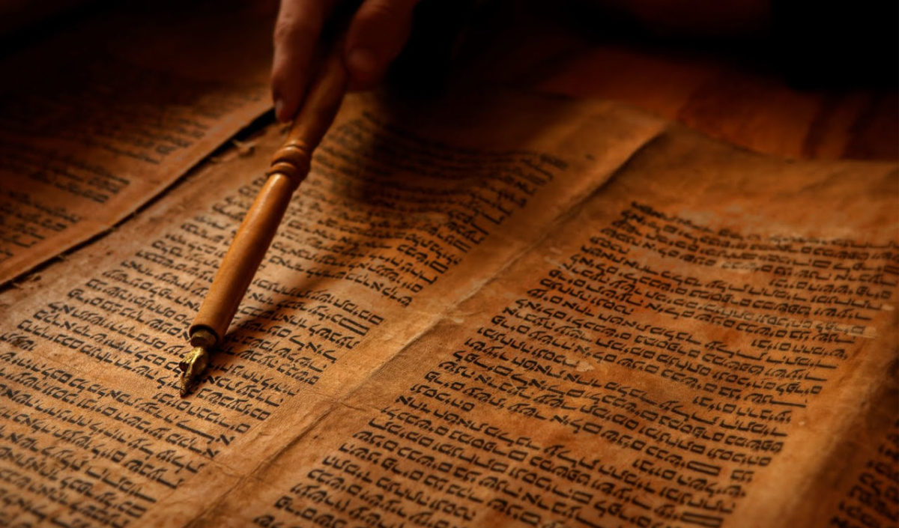
What Law Are Non-Christians Under Today?
    The Gentiles did not have a codified law like the Jews and, therefore, are described as those “without the Law” (Rom. 2:12).
    It is important to notice that Paul does not describe all Gentiles in light of Romans 1:18-32.

Slide 16
What Law Are Non-Christians Under Today?
    “Some have supposed the reference to be a natural sense of right inherent in all men, a sense either innate in the soul or springing up spontaneously in it as the inner life unfolds. The reference certainly is to a sense of knowledge of right relative to certain duties. But how came the Gentiles by that sense? I should rather think it formed on unperished traditions of the divine will, communicated to the early fathers of mankind … a natural or inborn sense of right … I deem a very hazardous assumption”
    (Moses Lard, 88-89).

Slide 17
What Passages Speak of a Universal Moral Law Today?
    Romans 8:2 – The “law of sin and death” is not referring to a universal moral law, but to the ruling principle of sin and death (Rom. 7:23).
    I Corinthians 15:56-57 – The term “law” refers to any law, which once violated brings condemnation, including the law of Christ (Acts 8:19-24; James 5:19-20; I Cor. 5:1-13).
    We are under the “law of Christ” (I Cor. 9:20-21; Gal. 6:2; James 1:25).

Slide 18
All Are Subject To Christ’s Law on MDR
      Jesus’ teaching in Matthew 5:31-32; 19:3-9; Mark 10:11-12; and Luke 16:18 cannot be restricted to only those under the Law of Moses, nor can it be limited to only Christians.
      The question Jesus was asked was, “Is it lawful for a man to divorce his wife for any reason at all?” (Matt. 19:3)
      When Jesus answers the question He grounds His response in God’s creation of marriage (Gen. 2:24).

Slide 19
All Are Subject To Christ’s Law on MDR
      The Lord’s response to the Pharisees argument from Deuteronomy 24 was to quote from Scripture that preceded the giving of the Law of Moses.
      He emphasizes, “From the beginning it was not so” (Matt. 19:8).
      Christ was not simply explaining the Law of Moses, but He was stating His law, which was grounded in the original intent of the Creator from the beginning.

Slide 20
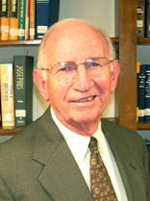
All Are Subject To Christ’s Law on MDR
      “The current disposition of some to justify divorce for any reason if there is no remarriage causes me to stress that the sin Jesus speaks of here rests in divorce, not remarriage. Such a divorce is wrong on three counts. It is wrong because it shows no love for the mate. It is wrong because it could push the divorced mate into a damning relationship. And it is wrong because it could involve another otherwise innocent person in adultery…”

Slide 21
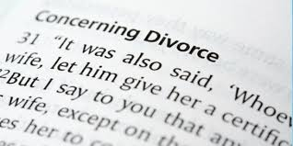
All Are Subject To Christ’s Law on MDR
      The Lord’s usage of the term “whosoever” in the application of teaching regarding marriage and divorce is significant (Matt. 5:32; 19:9; cf. 7:24; 11:6; 12:32, 50; 21:44).

Slide 22
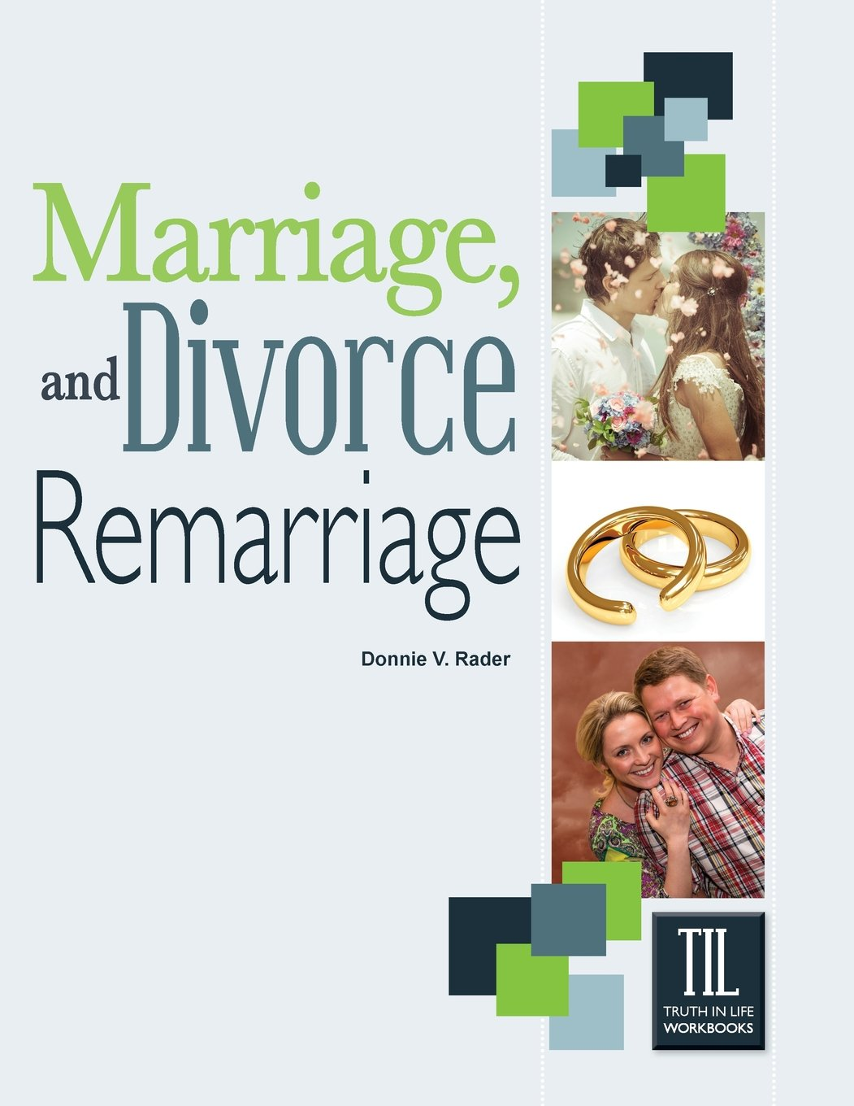
All Are Subject To Christ’s Law on MDR
      “…Some of those who argue that Jesus’ teaching doesn’t apply to the alien are the same ones who argue that baptism washes away their sin of adultery. How could there be adultery if they are not subject to the law of Christ on divorce and remarriage?”
      (Rader, 181).

Slide 23

All Are Subject To Christ’s Law on MDR
      “This conclusion is curious. Could we apply the same rationale to Jesus’ conversation with Nicodemus? He told him, ‘unless one is born of water and the Spirit, he cannot enter the kingdom of God’ (John 3:5). He was a Jew, in covenant relationship with God – does that mean baptism does not apply to Gentiles? Is the alien sinner not addressed?”
      (Pope, 616)

Slide 24
All Are Subject To Christ’s Law on MDR
      Does Jesus really have more permissive guidelines regarding marriage for the unbeliever than He does the Christian?
      Where does universal moral law teach the terms of pardon such as faith, repentance, confession, and baptism into Christ?
      Where does the UML condemn the use of instruments in worship?

Slide 25
The Nature of a Covenant
      “The alien is not under the covenant law of Christ until he brings himself under it by obedience to its terms”
      (Hailey, 52).

Slide 26
The Nature of a Covenant
      “The alien is not under the covenant of Christ, having never submitted to its conditions or demands”
      (Hailey, 60).

Slide 27
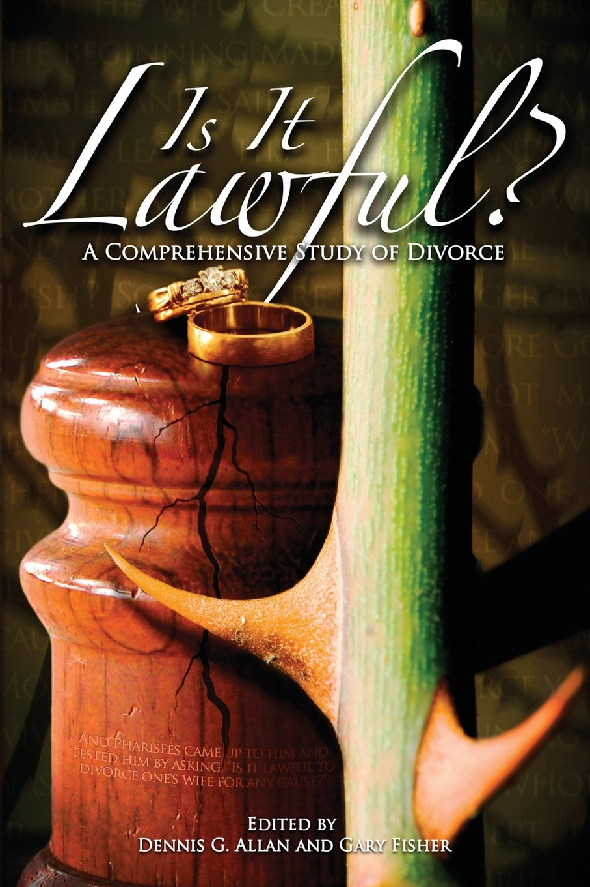
The Nature of a Covenant
      “In God’s case, covenant indicates not a mutual agreement but a sovereign unilateral dispensation of grace by God, a command, an obligation imposed by the Creator on His creatures”
      (Earnhart, 227).

Slide 28
The Nature of a Covenant
      New Bible Dictionary: “The first occurrence of the term in Scripture is Gn. vi.18, where the reference is to the prediluvian Noahic covenant. In this brief reference we have already an intimation of what covenant is. The thought is as far removed as can be from that of compact, or agreement between God and Noah. God announces to Noah that He will establish His covenant with him. It is a sovereign dispensing of grace on God’s part, and the security arises from action of God. It is God’s covenant, and He establishes it. Flowing from this dispensation to Noah there are corresponding obligations” (Murray, 264).

Slide 29
The Nature of a Covenant
      Theological Dictionary of the Old Testament: The original meaning of the Heb. Berith …is not “agreement or settlement between two parties,” as is commonly argued. Berith implies first and foremost the notion of “imposition,” “liability,” or “obligation,” as might be learned from the “bond” etymology discussed above. Thus we find that the berith is commanded….(“he has commanded this covenant,” Psa. 111:9; Jgs. 2:20), which certainly cannot be said about a mutual agreement…”

Slide 30
The Nature of a Covenant
      Biblical Examples of the Term “Covenant” Referencing “Command,” “Law,” or “Promise.”
      God’s promise to not destroy the earth by a flood again is described as a covenant (Gen. 9:8-17).
      Gen. 17:2-8 uses the term “covenant” to refer to God’s promise to Abraham to multiply his seed and make a great nation.
      The Ten Commandments are called a “covenant” (Exodus 19:5; 34:27-28; Deut. 4:13; Heb. 9:4).

Slide 31
The Nature of a Covenant
      Biblical Examples of the Term “Covenant” Referencing “Command,” “Law,” or “Promise.”
      In Exodus 24:12 YHWH describes His covenant as “the law and the commandment which I have written for their instruction.”
      The Lord uses the term “law” and covenant” interchangeably (Jer. 31:33; Heb. 10:16).
      Joshua 24:25 shows that a divine ordinance can be described as a covenant.
      A covenant is a command (Josh. 23:16).

Slide 32
The Nature of a Covenant
      Amenability to the New Covenant is not based on our agreeing to submit to its demands, but our reception of the benefits of the New Covenant is dependent on our willingness to surrender to its obligations.
      All of humanity is under the law of Christ!
      Paul makes it clear that he was living under the law of God in that he was living under the law of Christ.
      So it is today – all men and women are under the law of Christ!

Slide 33
What About The “R” Word – Repentance?
      Defining Repentance
        Required for both the non-Christian and the child of God (Acts 2:38; 17:30-31; 8:22-23).
        Motivated by godly sorrow, inclusive of a change of mind, and productive of reformation of life (Matt. 3:2, 8; 2 Cor. 7:8-11; I Thess. 1:8-10).
        We must cease from sin (Rom. 6:11-13; 2 Cor. 1:20-21; I Pet. 4:1, 2; cf. Matt. 14:3, 4; Mark 6:18).

Slide 34
What About The “R” Word – Repentance?
Can One “Live in Adultery”?
      “To demand that a remarried couple break their marriage covenant on the basis of repentance rests on the assumption that their marriage is ‘an adulterous marriage’ or ‘they are continuing to live in adultery’ … The sin was in breaking the covenant by the wife (or husband) in order to marry another and not in a ‘continuous sexual adulterous condition.’ Therefore, repentance demands that they do not break such a covenant again”
      (Hailey, 71-72)

Slide 35
What About The “R” Word – Repentance?
Can One “Live in Adultery”?
      The concept that the sin is merely the breaking of the covenant, therefore, one who has unscripturally divorced and remarried can repent of that action, but continue in the resulting marriage is nowhere taught in the word of God.
      The term “adultery” is not used in that way in Scripture (Matt. 5:28; 32).

Slide 36
What About The “R” Word – Repentance?
Can One “Live in Adultery”?
      Whether “adultery” is used literally as is the case in Matt. 5:32; 19:9; Mark 10:11-12; and Luke 16:18 or in a figurative sense regarding Israel committing adultery with idols the concept always includes a third party.
      Ray Summers comments, “The present tense indicates progressive action at the present time…” thus indicating that one can live in an adulterous relationship (Summers, 11).

Slide 37
What About The “R” Word – Repentance?
Can One “Live in Adultery”?
      “…She shall be called an adulteress” (Romans 7:2-3):
      The term χρηματίσει, chrematisei, translates the phrase “she shall be called.”
      It is a term referring to a warning, admonition, or revelation from God (Matt. 2:12, 22; Luke 2:26; Acts 10:22; 11:26; Heb. 8:5; 11:7; 12:25).
      Therefore, this woman is called an “adulteress” by the law of God so long as she is married to another man while her rightful husband lives (I Cor. 7:39).

Slide 38
What About The “R” Word – Repentance?
Can One “Live in Adultery”?
        Paul clearly teaches that one may “live in adultery” (Col. 3:5).
        He warns that God will bring wrathful judgment on such sins as adultery (Col. 3:6; Heb. 13:4).
        He even says, “…and in them you also once walked when you were living in them.”
        How can one argue that it is impossible to live in adultery when Paul affirms the very opposite?

Slide 39
What About The “R” Word – Repentance?
What About David?
        “The contention that Genesis 2:18-24 was recognized as law which demanded that a person who takes the wife of another must give her up as demanded by repentance is disputed in the case of David…Surely, no one would deny that David repented, yet he was permitted to keep the woman as his wife. Repentance did not demand that she be put away or that the two live apart for the remainder of their lives”
        (Hailey, 72, 73).

Slide 40
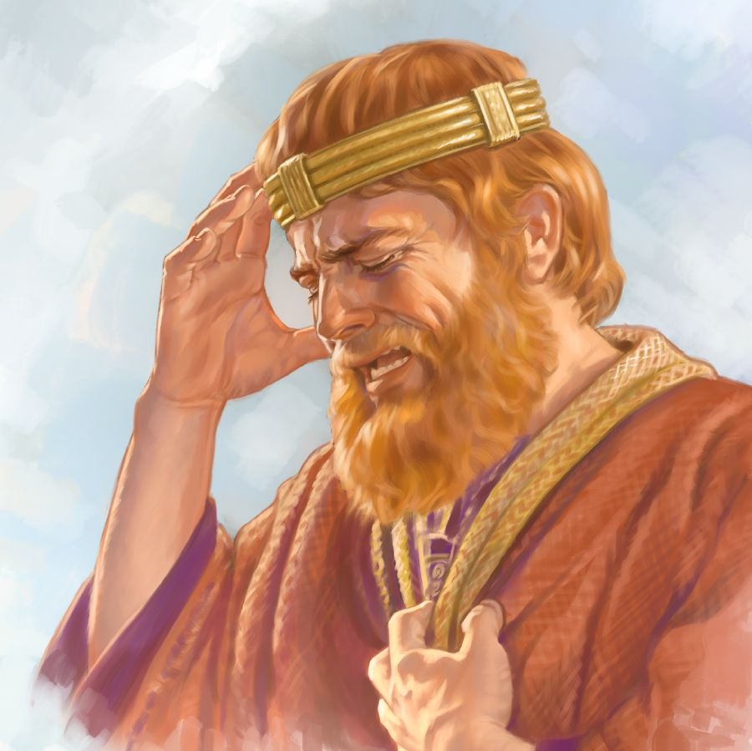
What About The “R” Word – Repentance?
What About David?
        David was not an alien sinner, but a child of God.
        How does David’s example as a child of God establish the right for divorced and remarried alien sinners to remain together?
        David was guilty of several sins, but he married Bathsheeba after Uriah was dead (2 Sam. 11:27).

Slide 41
What About The “R” Word – Repentance?
“David” & the Attempt To Broaden Grace
          “Will not the same God of loving kindness and tender mercies forgive and blot out sins under a system of grace as He did under a system of law?”
          (Hailey, 73).
          There was grace available under the Old Covenant and there is a law aspect in the New Covenant of grace (Gen. 6:8; Psa. 51; I Cor. 9:21; Gal. 6:2; James 1:25).
          Grace does not permit a sinful way of life, but leads us to be a new creation (Titus 2:11-15; Jude 4).

Slide 42
What About The “R” Word – Repentance?
David & An Attempt To Broaden Grace
        David lived during a time when God made concessions due to the hardness of hearts (Matt. 19:7-9).
        The question is not what David did, but what does Jesus allow?
        David also engaged in polygamy – the argument that whatever was good enough for David under the Old Covenant is good enough for me under the law of Christ is absurd.

Slide 43
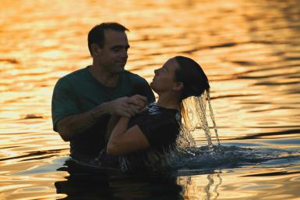
What About The “R” Word – Repentance?
Are Husbands/Wives
Washed Away At Baptism?
    It is true that through the grace of God and the blood of Christ sins are washed away when we are baptized (Acts 2:38; 22:16).
    However, baptism does not permit one to continue to live in sin, but requires a heart of repentance (Rom. 6:3, 4).

Slide 44
How Serious Is This Teaching?
There Is No Room For Compromise
    “Generally accepted view” (9)
    “Traditional teaching” (9)
    “Dangerous error” (9)
    “Solely of man” (74)
    “More like the doctrine of penance than the doctrine of grace” (74)
    “Not by the word of God” (74)

Slide 45
How Serious Is This Teaching?
There Is No Room For Compromise
    This doctrine leads some to continue in adulterous marriages.
    It distorts a proper understanding of the law and covenant under which we live.
    It presents an erring view of grace and the need for true repentance.

Slide 46
What Should We Do!
    Study: When there are differences we must study lovingly, honestly and openly with a view toward the truth of the Scriptures (Acts 15:1-22; 17:10-11).
    Live: Give our all to submit to God’s truth (Matt. 7:24-27; James 1:22-25).
    Respect and support the truth (2 Thess. 2:10-12; 2 Tim. 2:15).
    Love one another enough to share the truth even when it is difficult (I Pet. 1:22).

